Slide 1
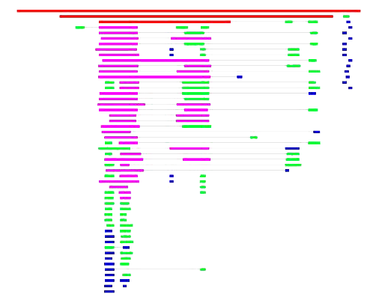


Short Read Sequence Alignment Algorithms
From BWT to Bowtie2
Lebanese American University
Department of Computer Science and Mathematics
Computational Methods in Biology
Ghadi El Hasbani - ghadi.elhasbani@lau.edu
Mohamed Mehdi Merbah - mohamedmehdi.merbah@lau.edu
Eileen-Marie Hanna, PhD
February 8, 2022

Slide 2
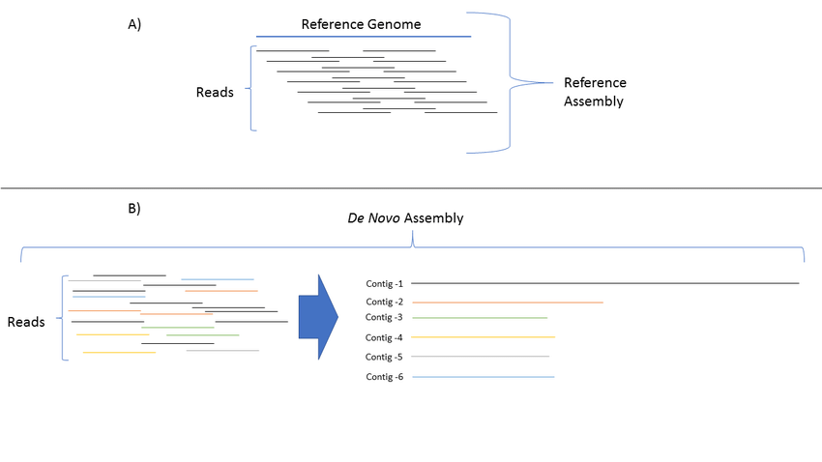
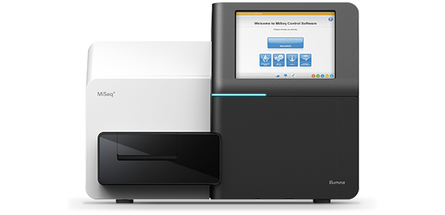
The Biological Context
The scope of the computational methods related to sequence alignment, arises in the context of reads.
The sequencing platforms give us pieces of DNA, or fragments, that we call reads. The task then is to re-assemble these pieces into a complete genome.

Slide 3
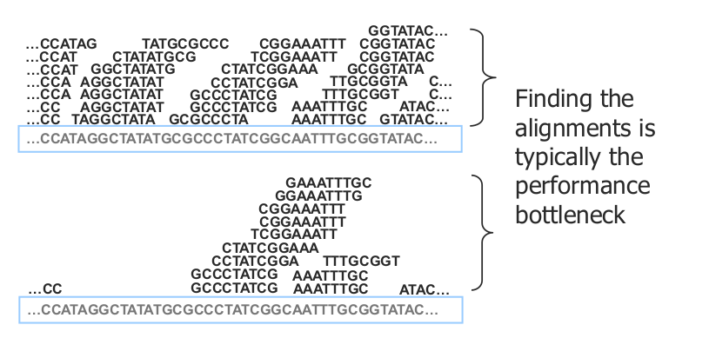
Short Read Alignment
Illustrations Courtesy of Ben Langmead

Slide 4
Short Read Alignment
What is the alignment problem?
Given a reference genome and set of reads, find a good local alignment for each one of them if it exists.
But how good is good? How do we measure it?
- Has fewer mismatches.
- Prioritizes aligning high quality over low quality reads.

Slide 5
Short Read Alignment
Many methods have been developed to try and solve the problem within the constraints of memory and time, and the bounds of our current computing power.
An efficient method for optimizing read mapping to a reference genome was one that we had already seen last time:
The Burrows-Wheeler Transform.

Slide 6
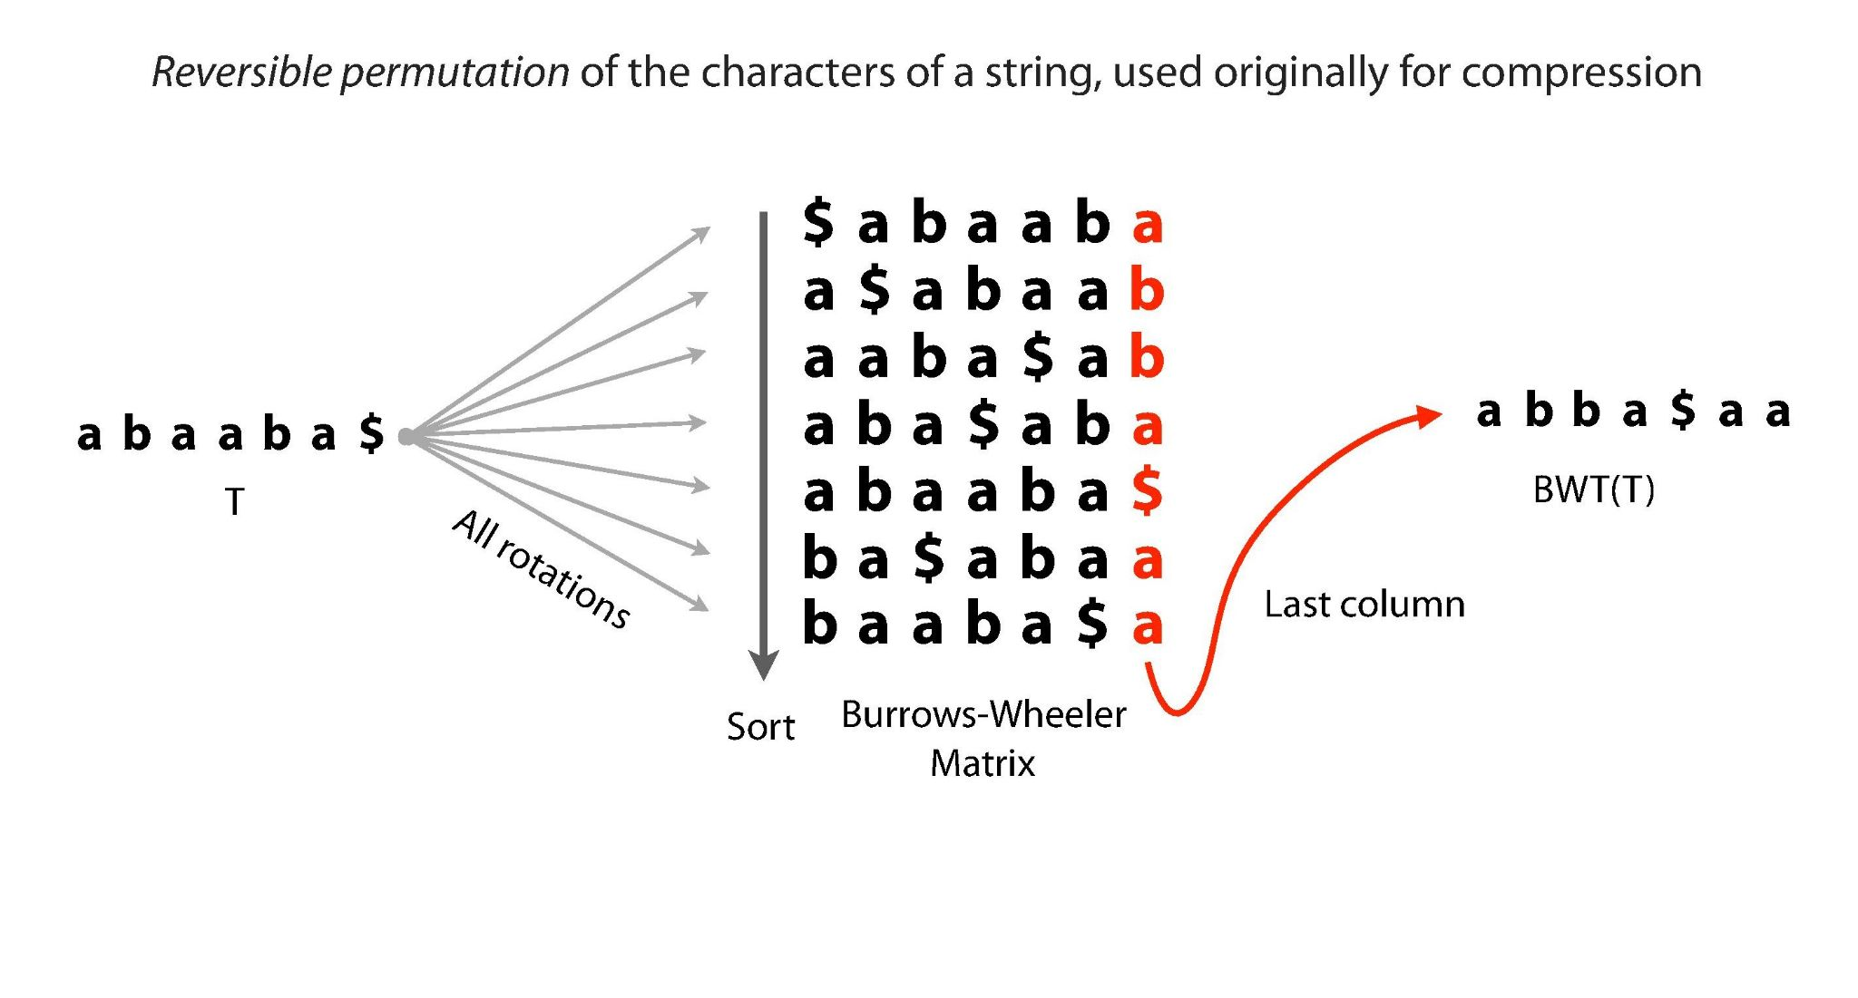
Burrows-Wheeler Transform
Illustrations Courtesy of Ben Langmead

Slide 7
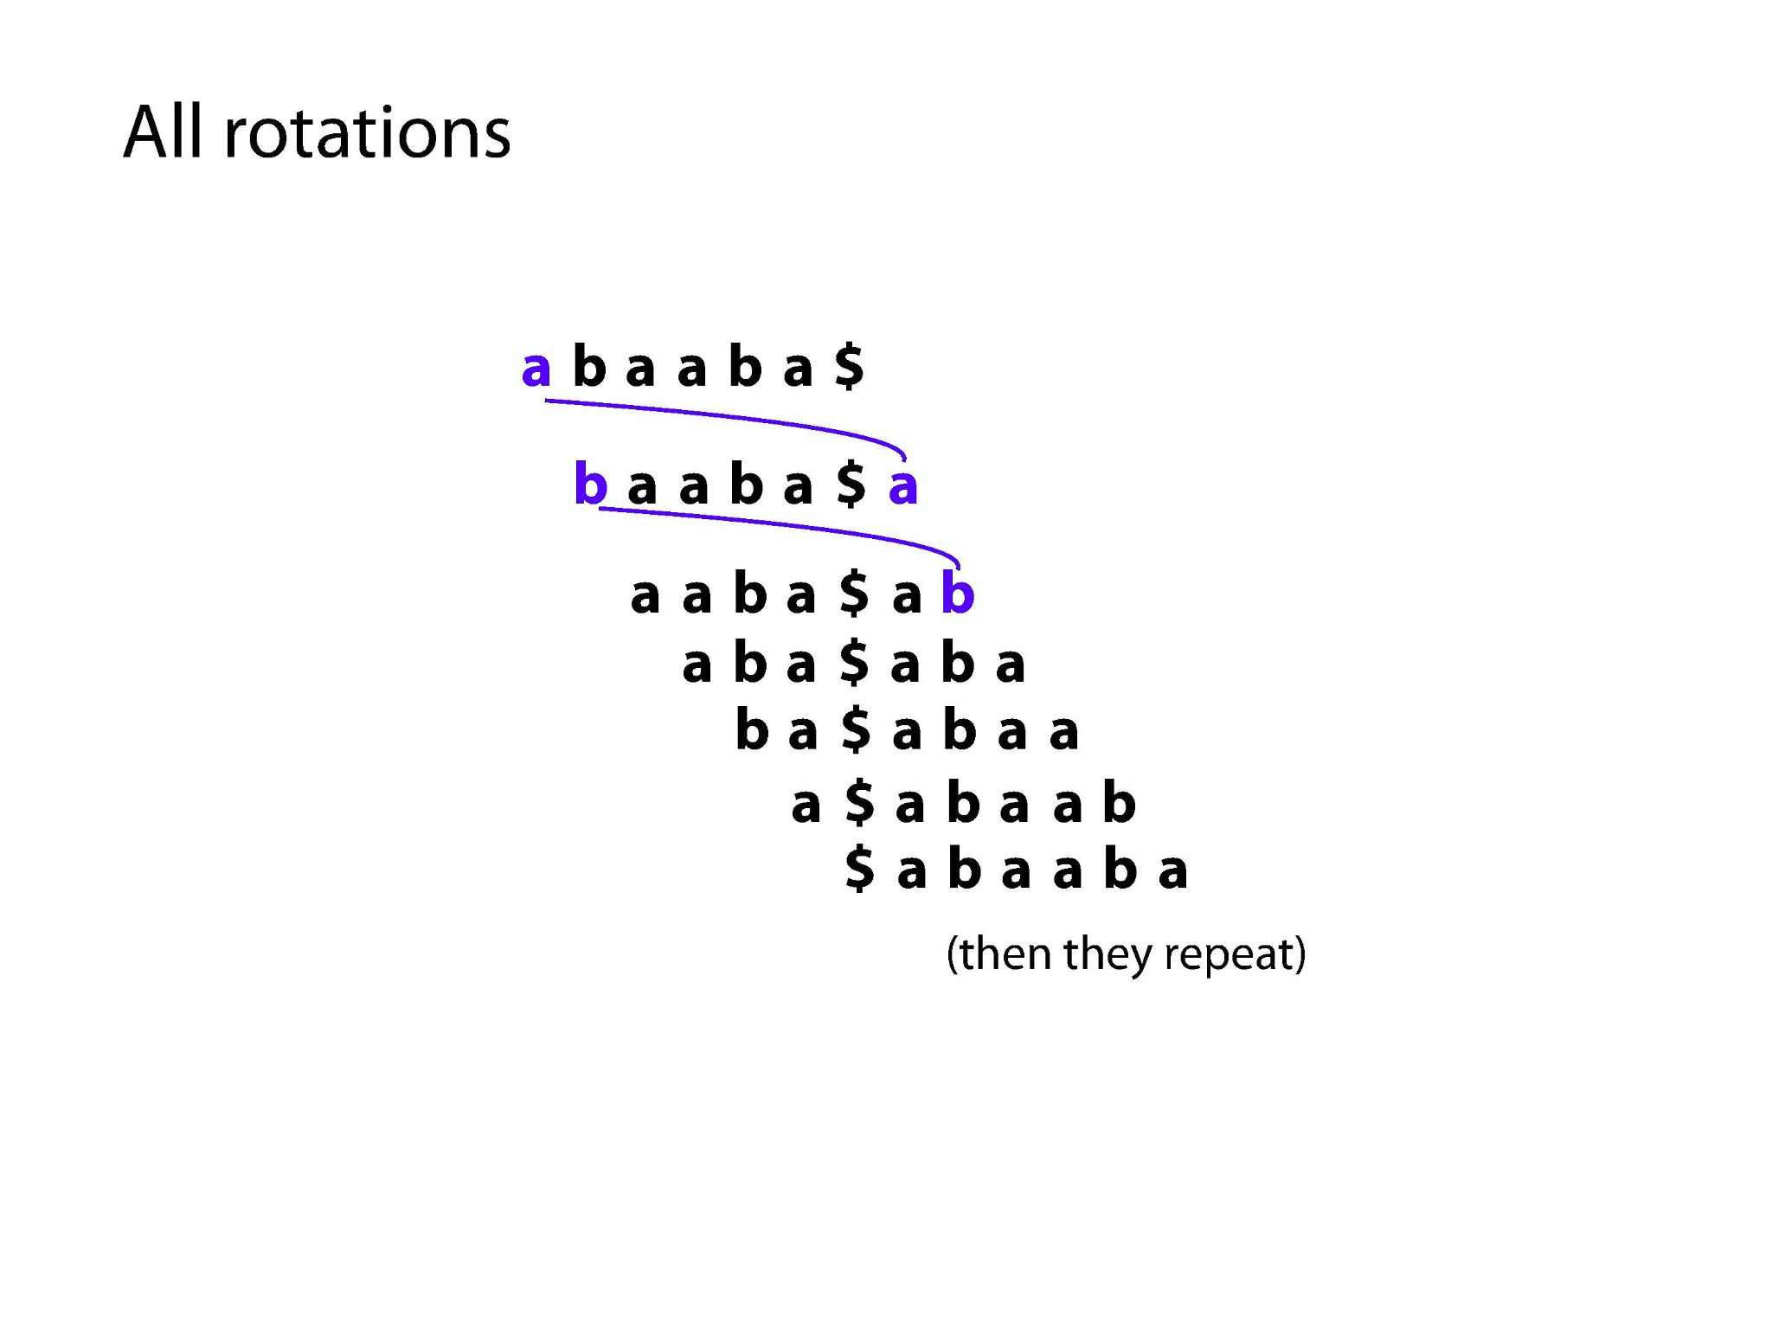
Illustrations Courtesy of Ben Langmead

Slide 8
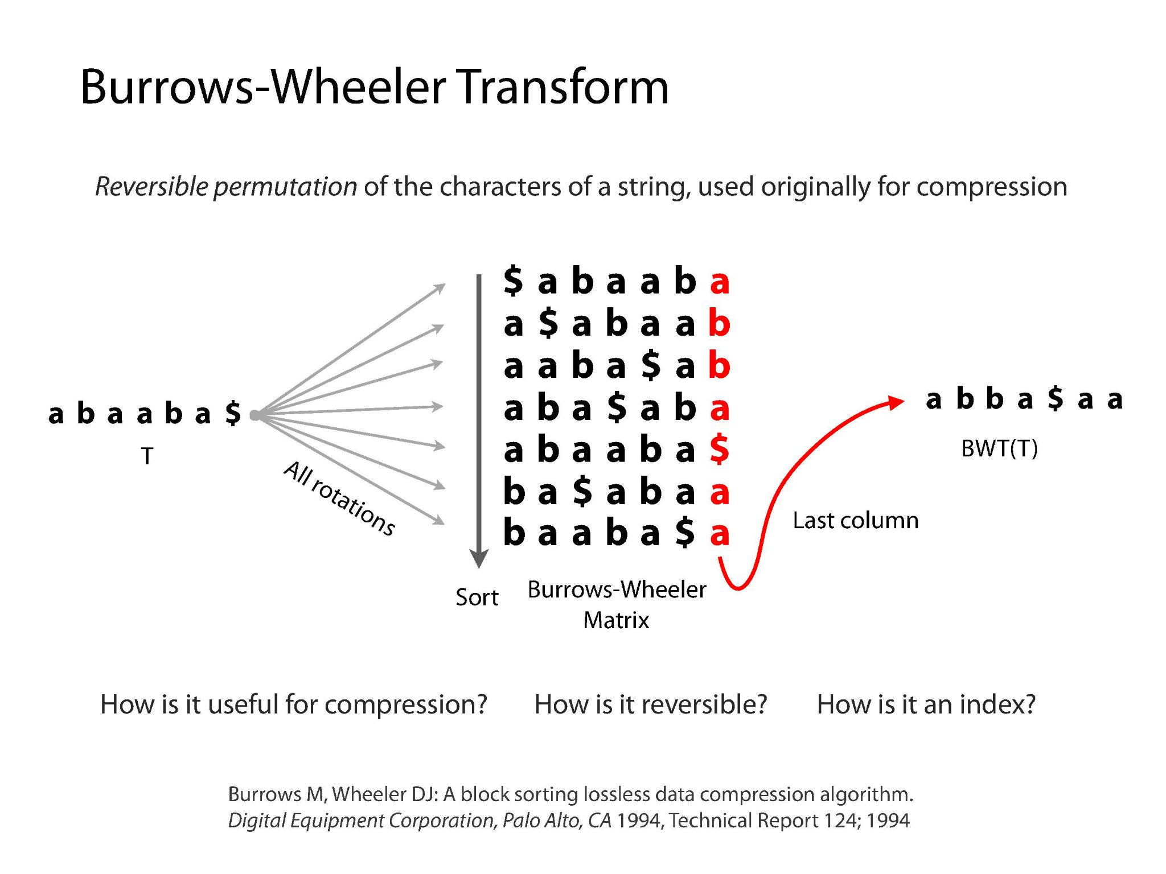
Illustrations Courtesy of Ben Langmead

Slide 9
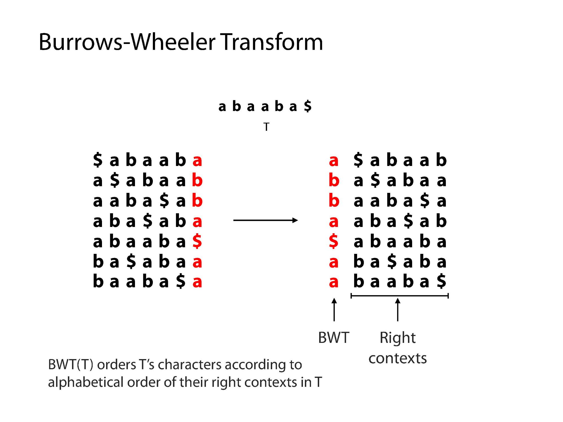
Illustrations Courtesy of Ben Langmead

Slide 10
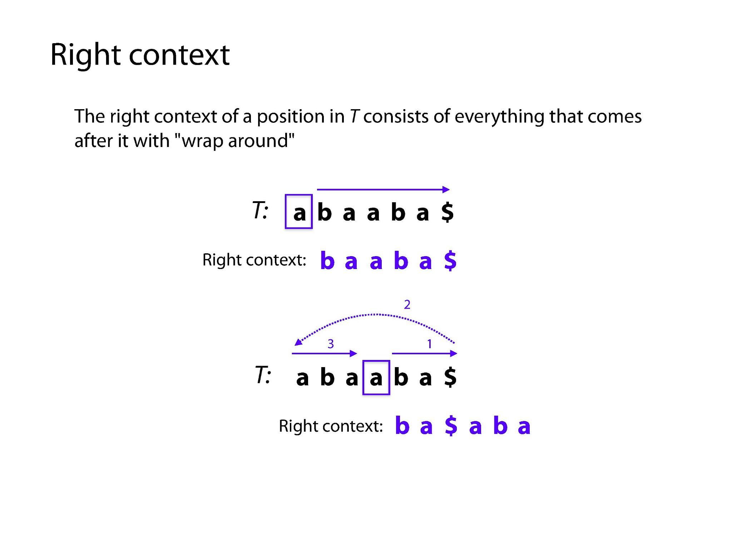
Illustrations Courtesy of Ben Langmead

Slide 11
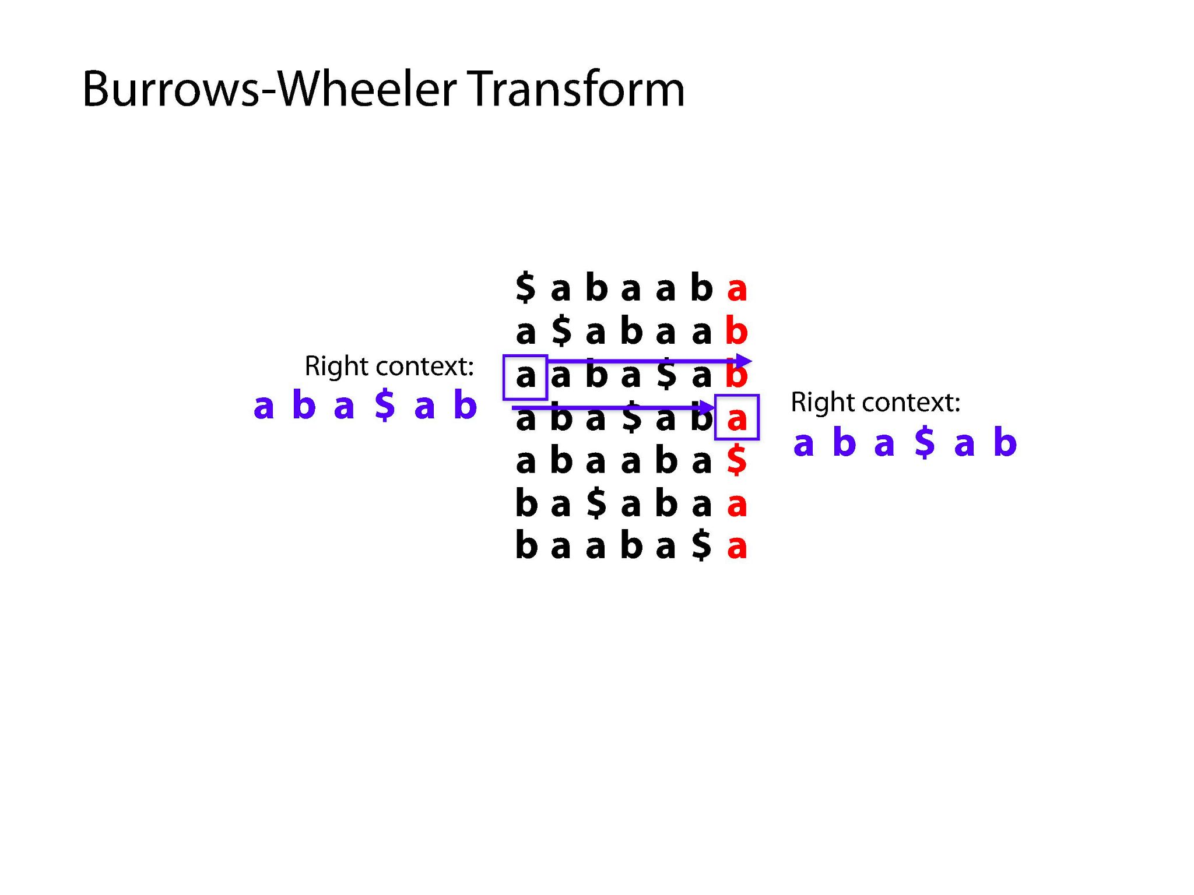
Illustrations Courtesy of Ben Langmead

Slide 12
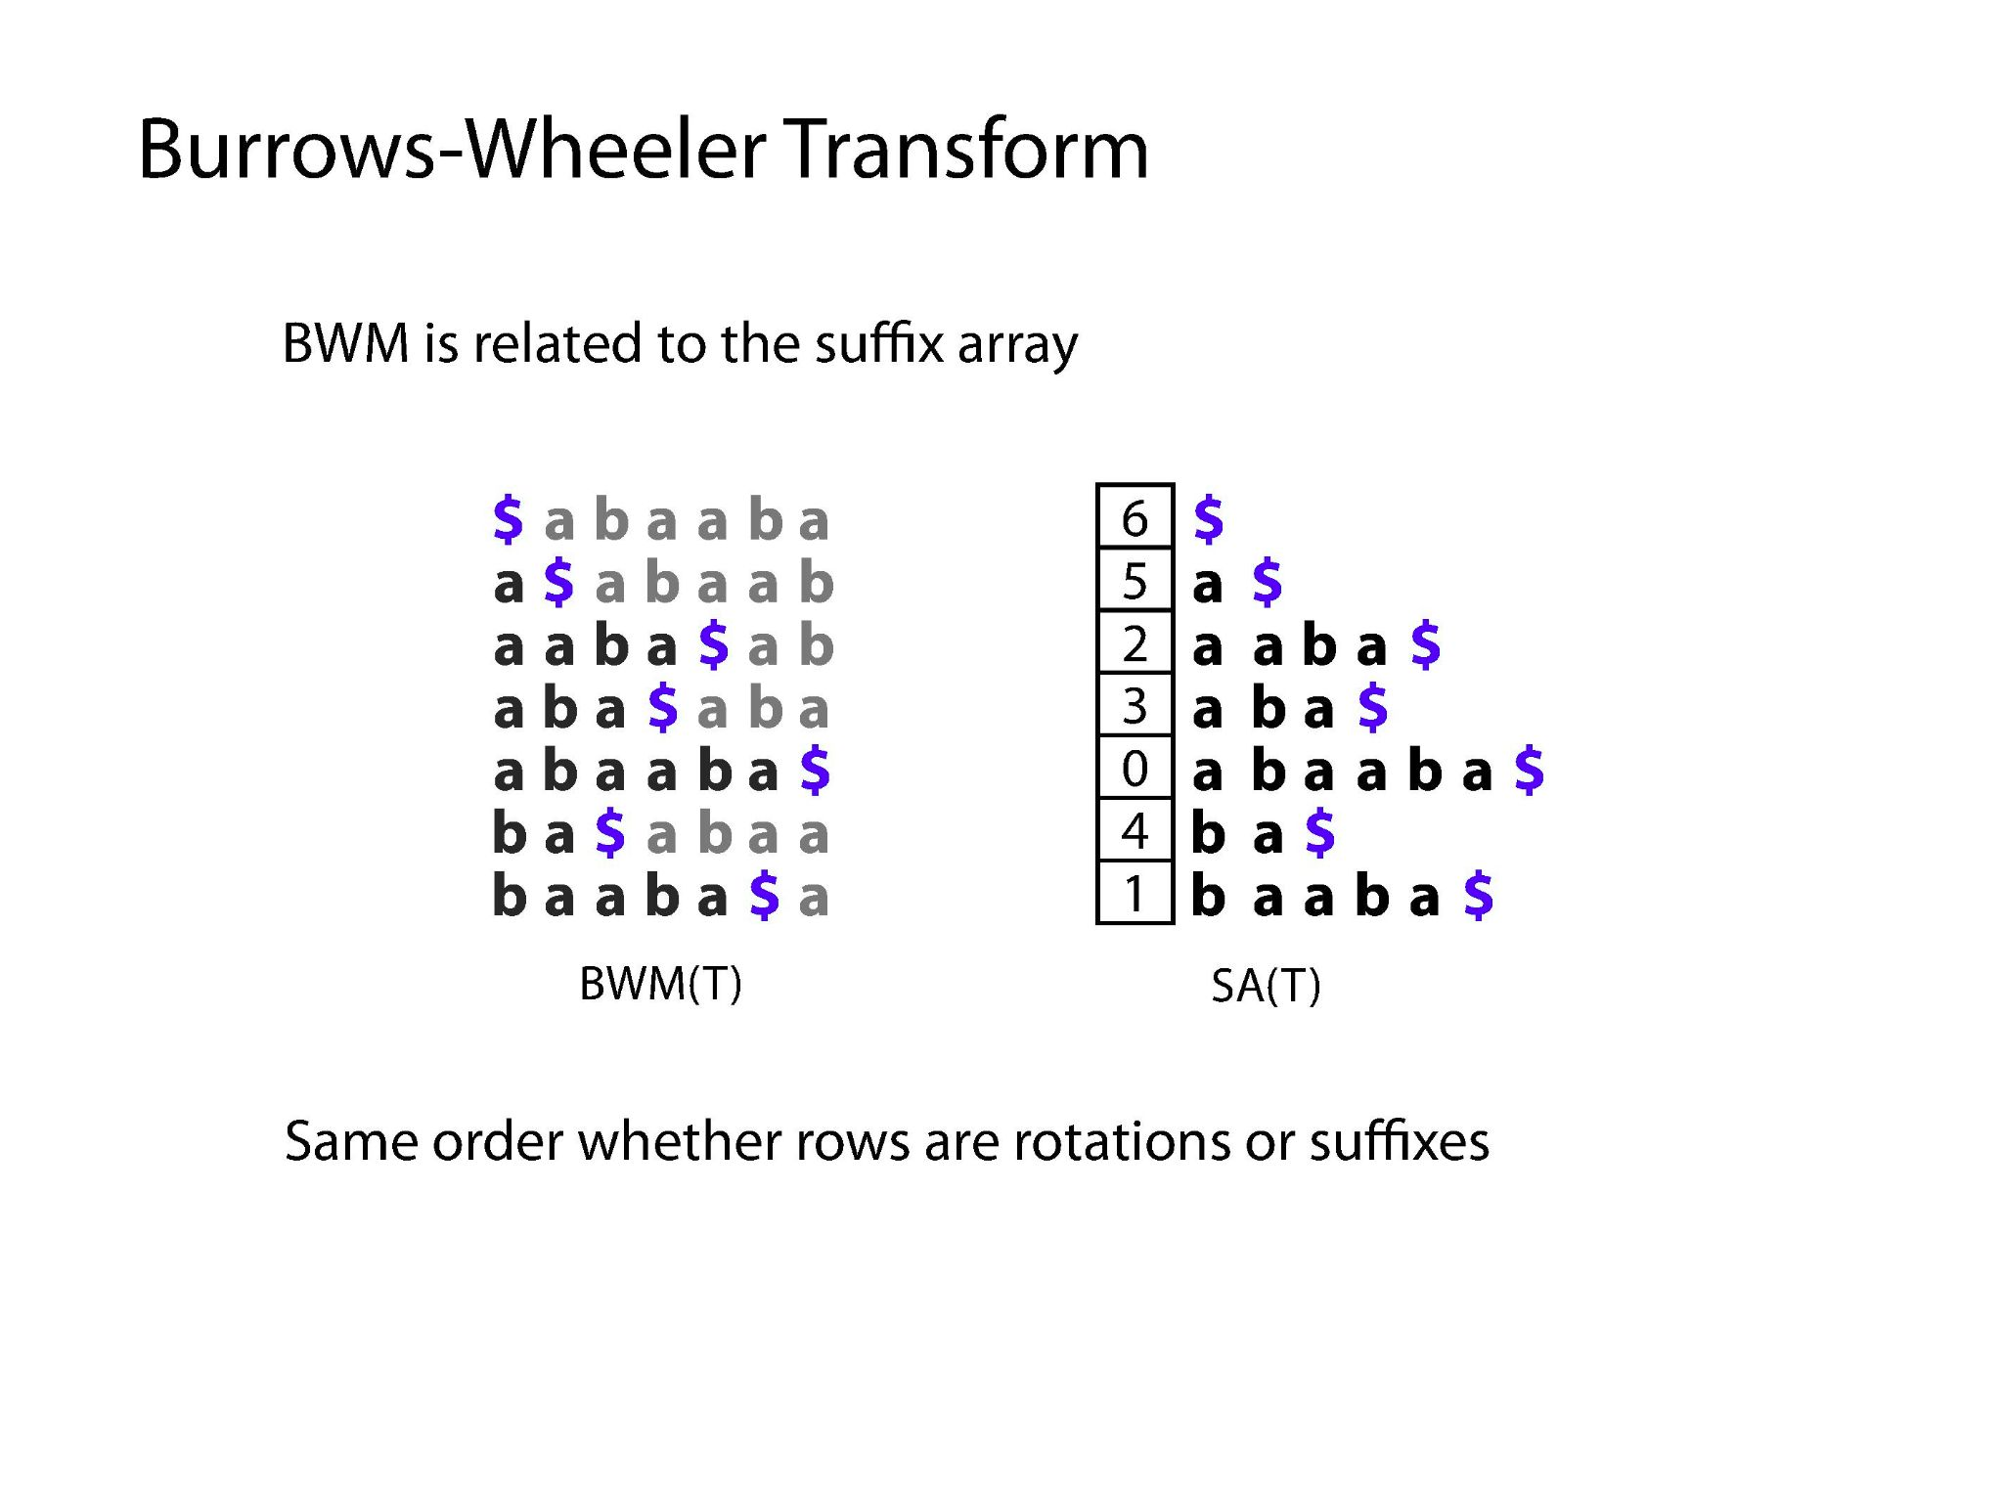
Illustrations Courtesy of Ben Langmead

Slide 13
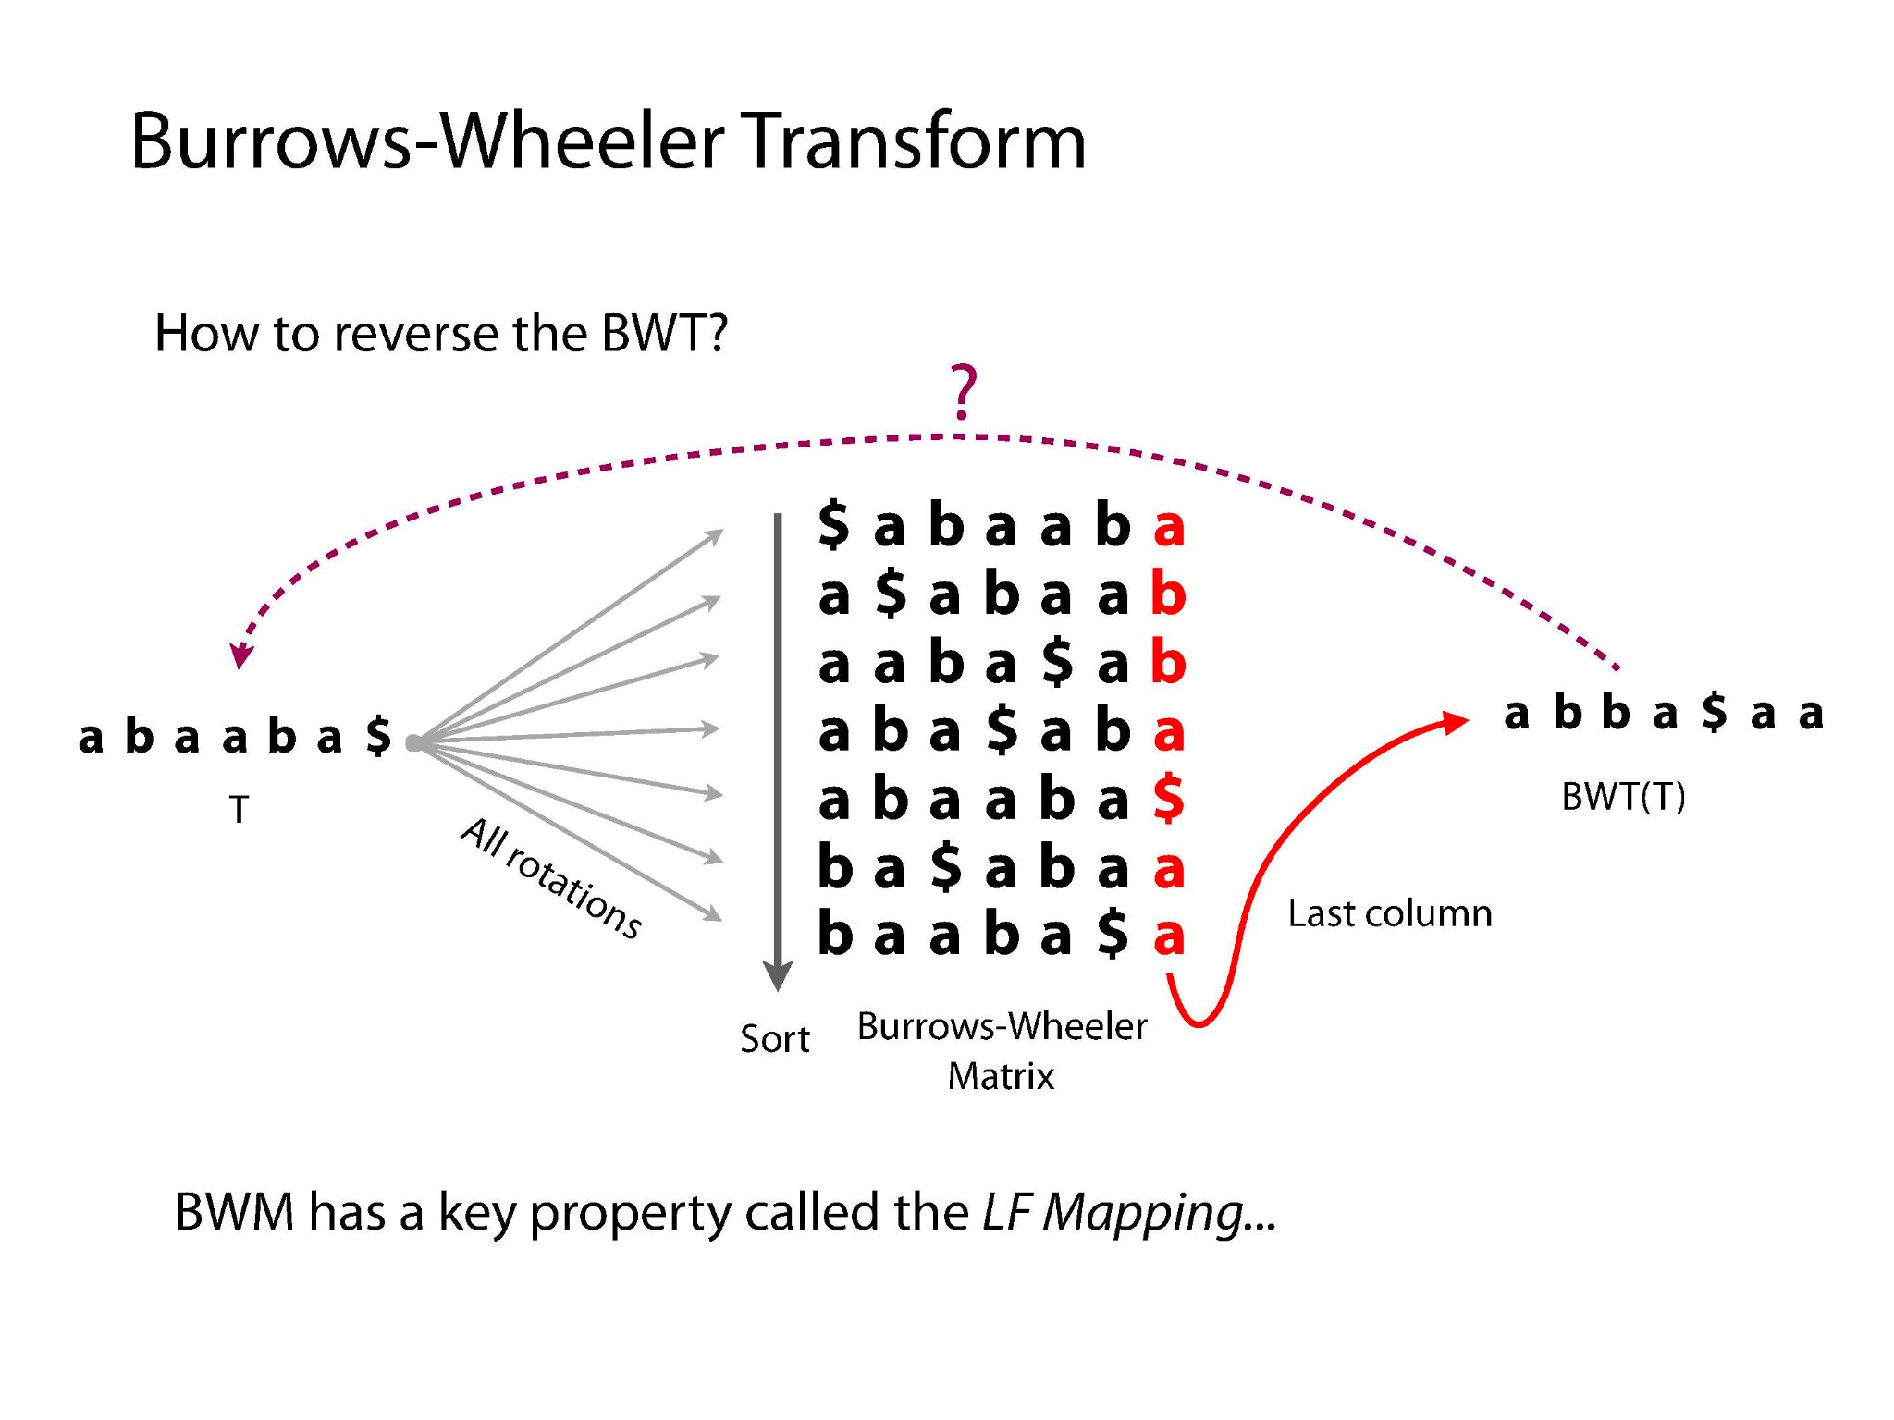
Illustrations Courtesy of Ben Langmead

Slide 14
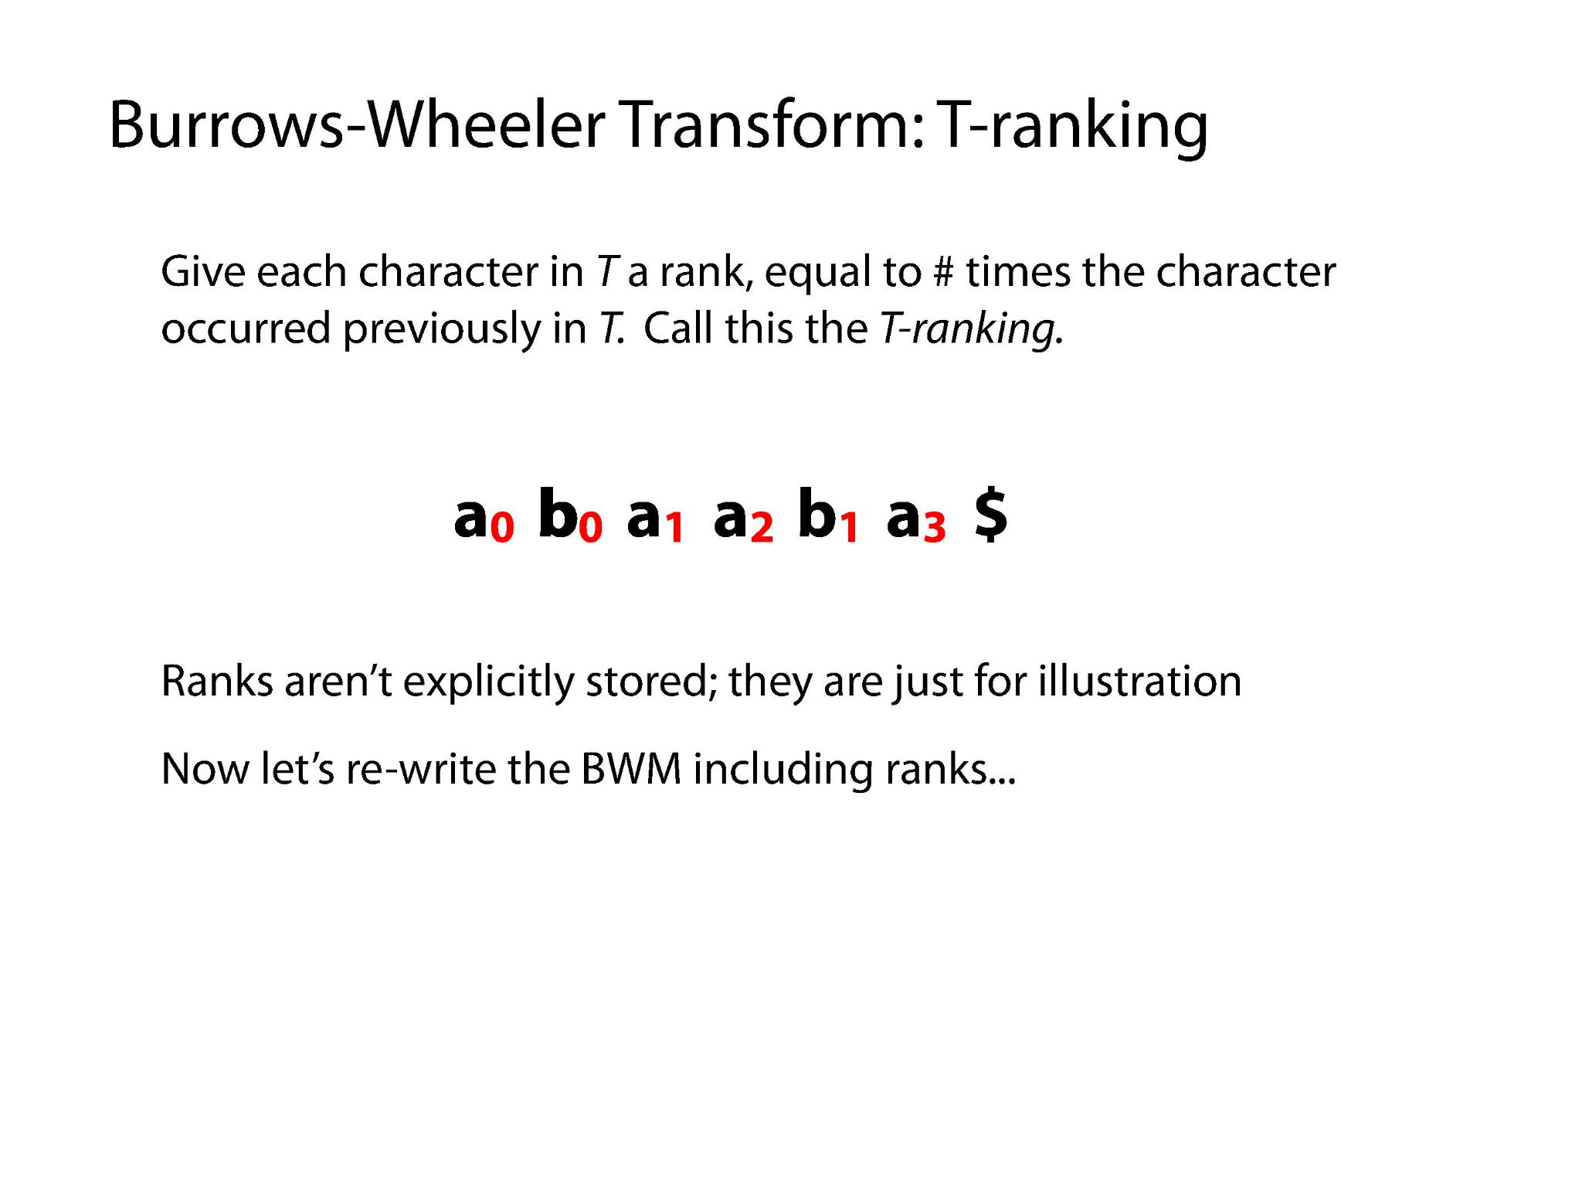
Illustrations Courtesy of Ben Langmead

Slide 15
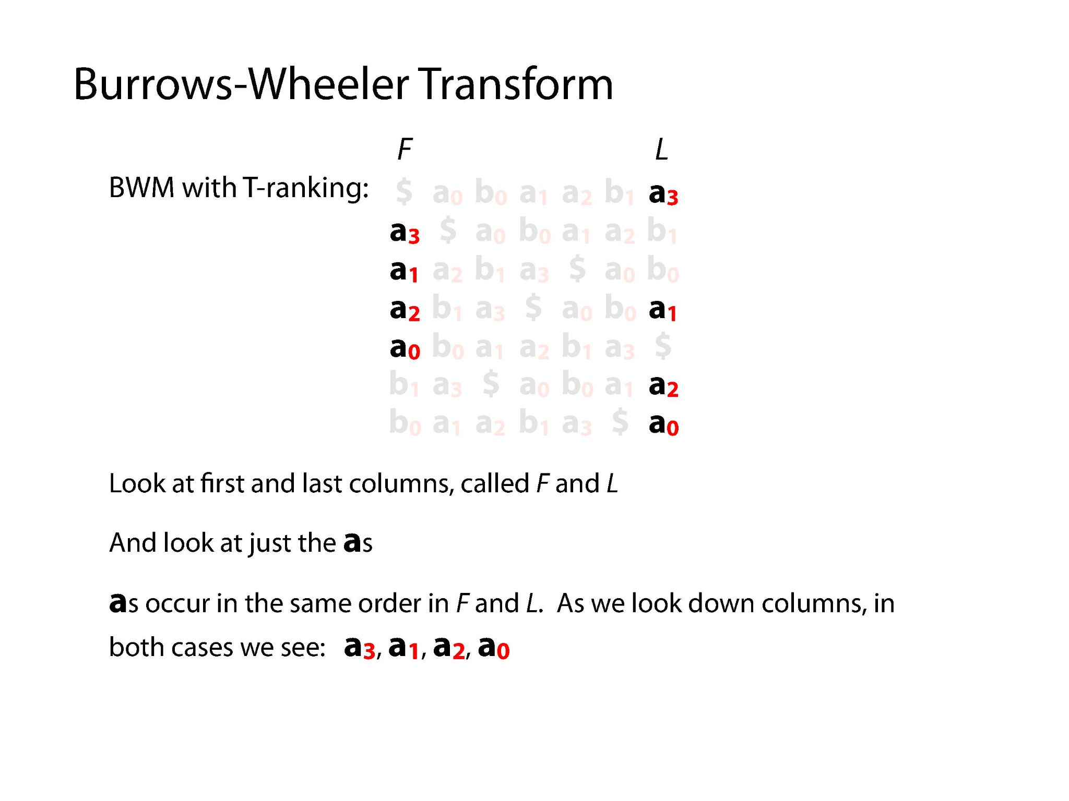
Illustrations Courtesy of Ben Langmead

Slide 16
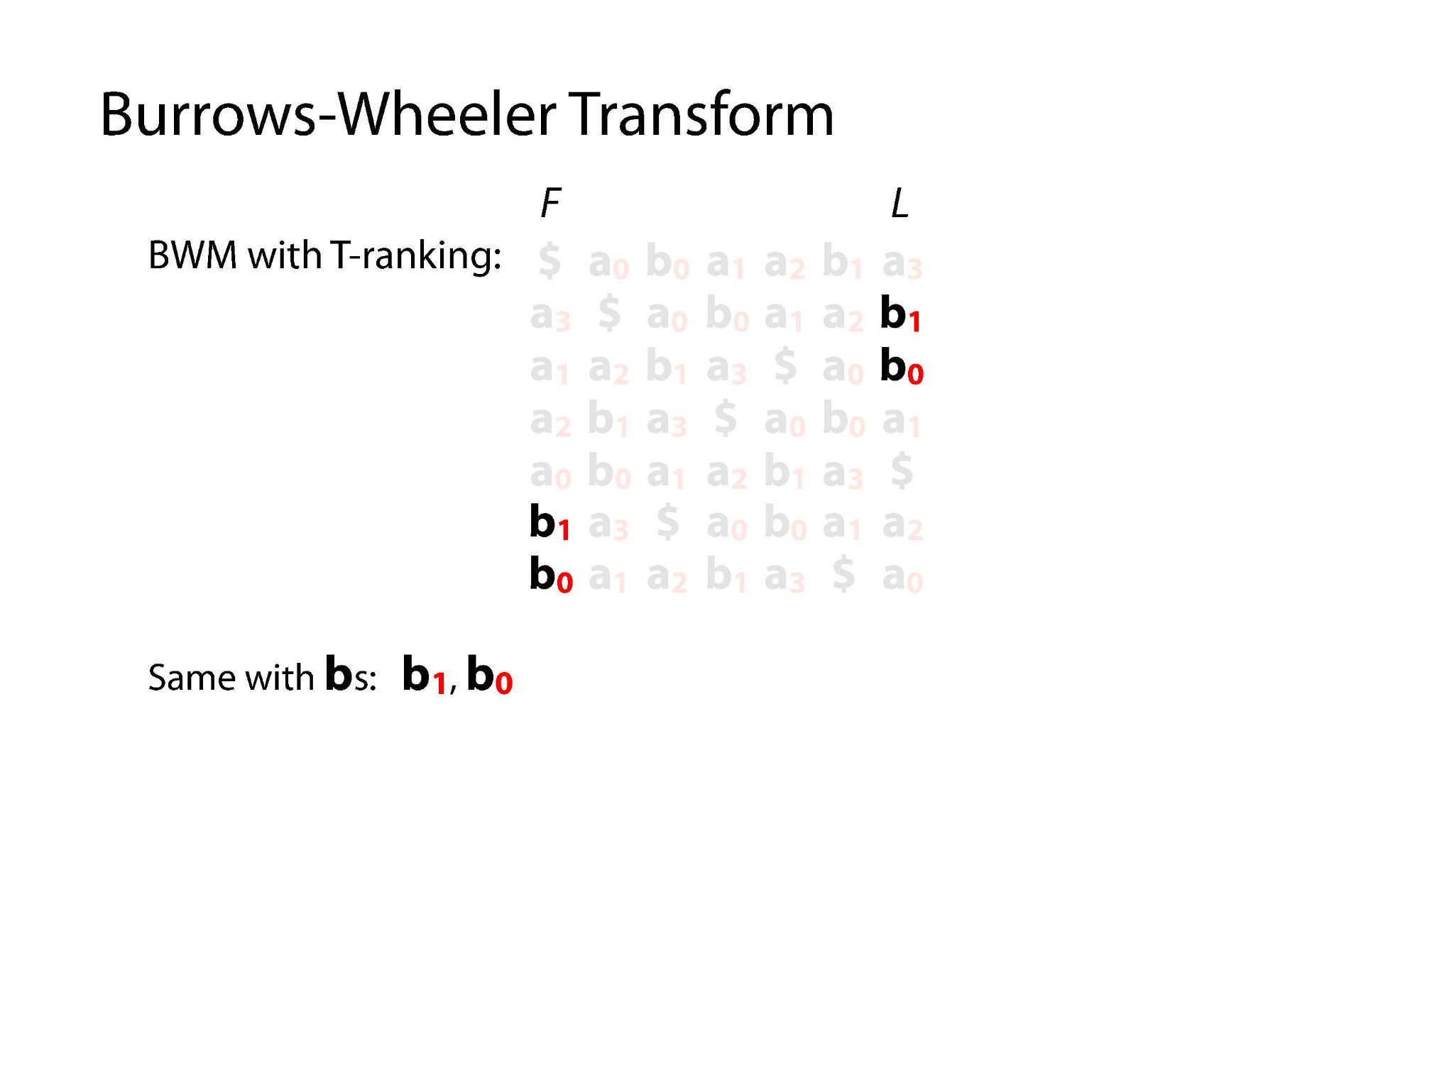
Illustrations Courtesy of Ben Langmead

Slide 17
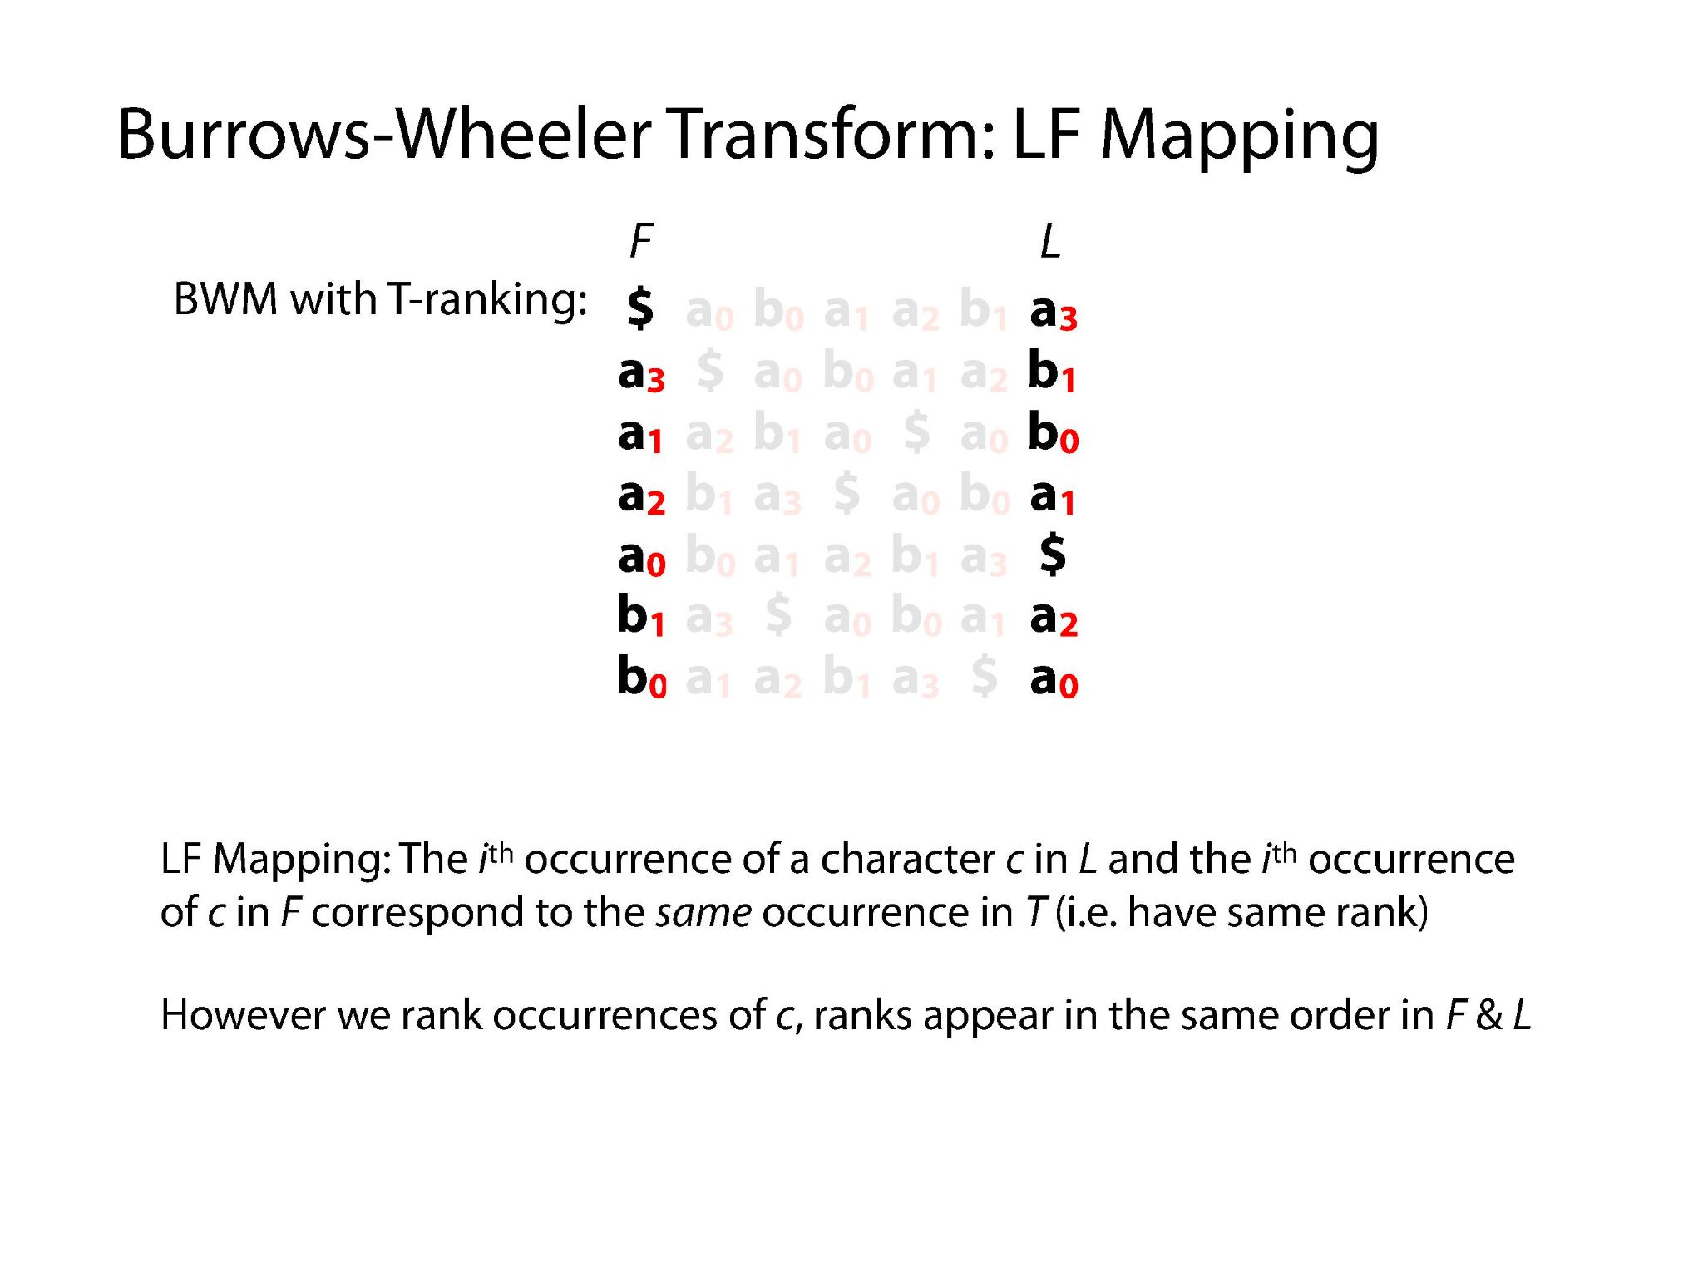
Illustrations Courtesy of Ben Langmead

Slide 18
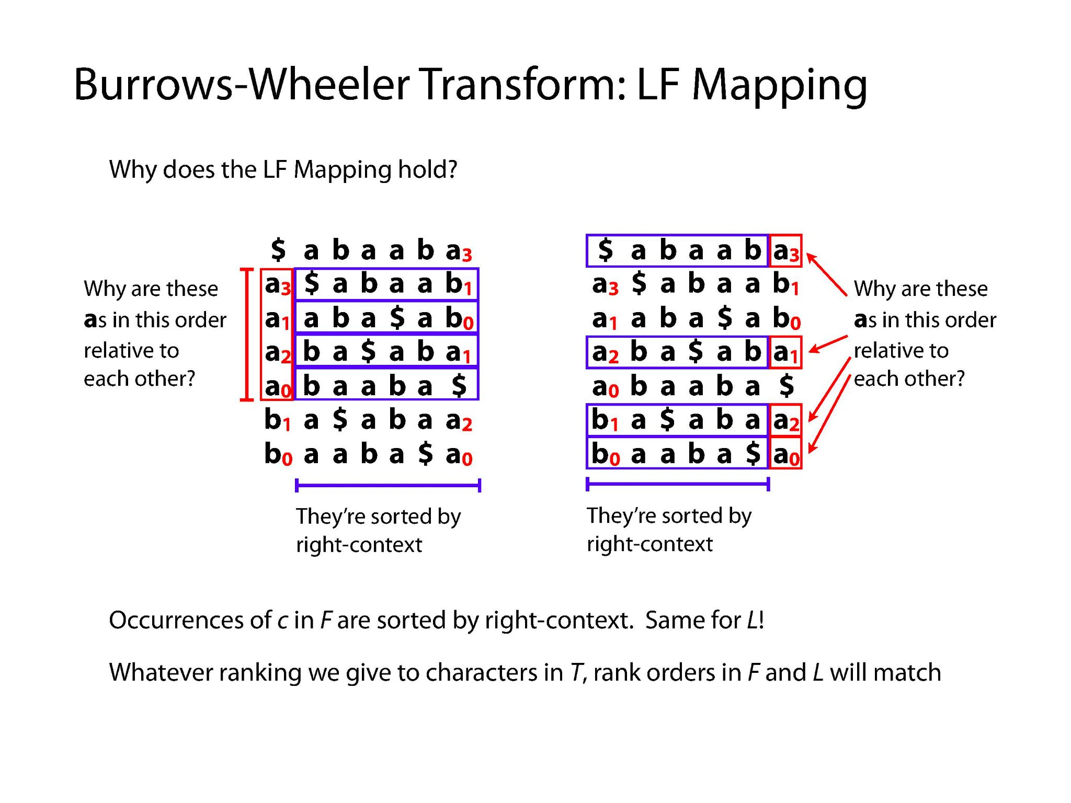
Illustrations Courtesy of Ben Langmead

Slide 19
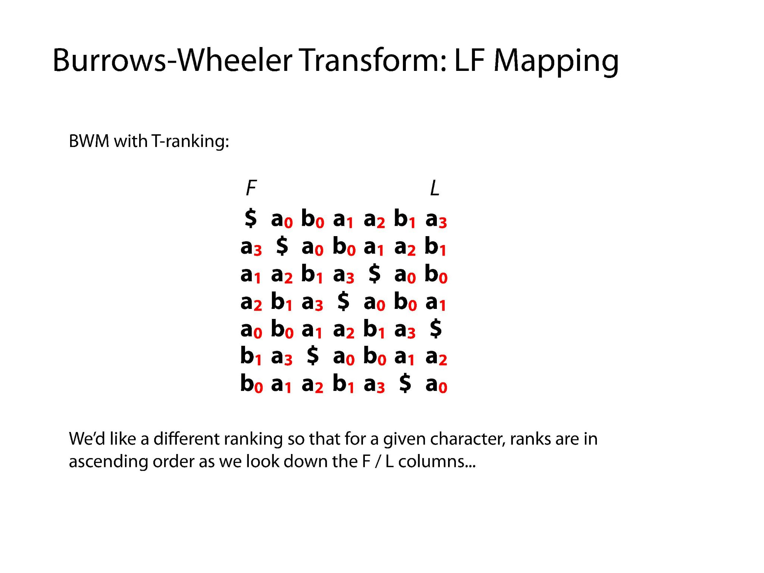
Illustrations Courtesy of Ben Langmead

Slide 20
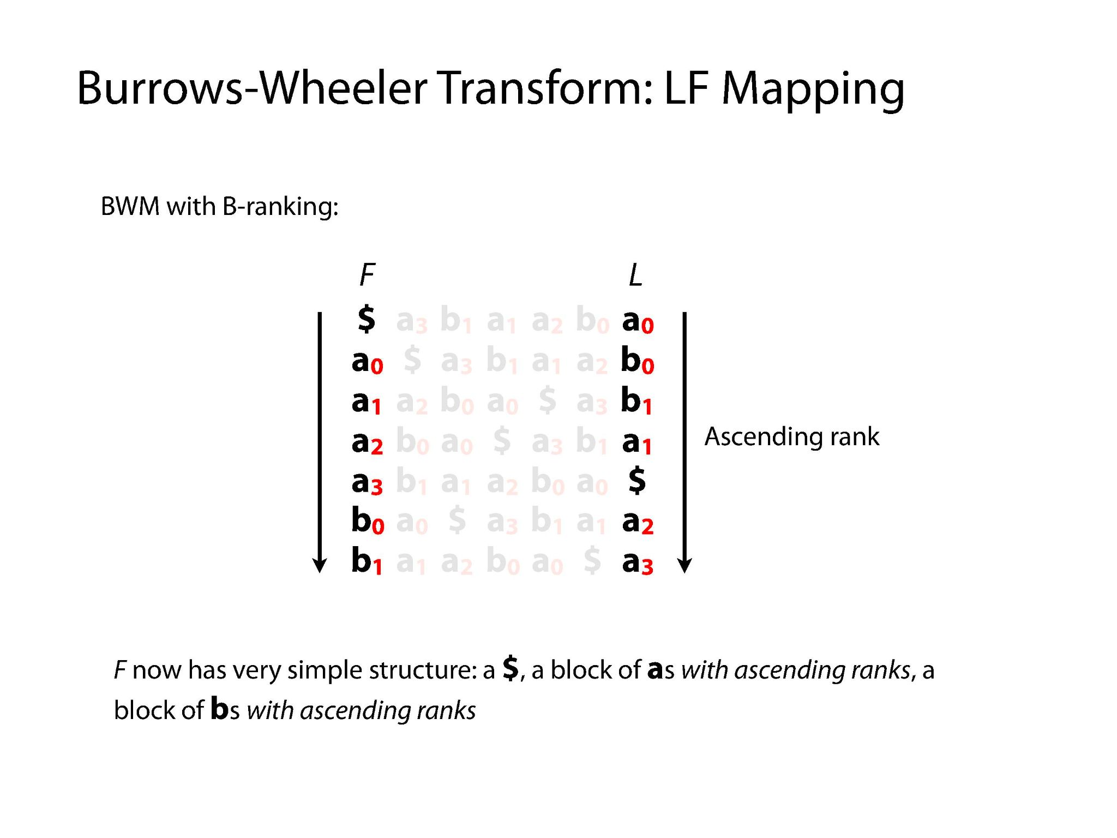
Illustrations Courtesy of Ben Langmead

Slide 21
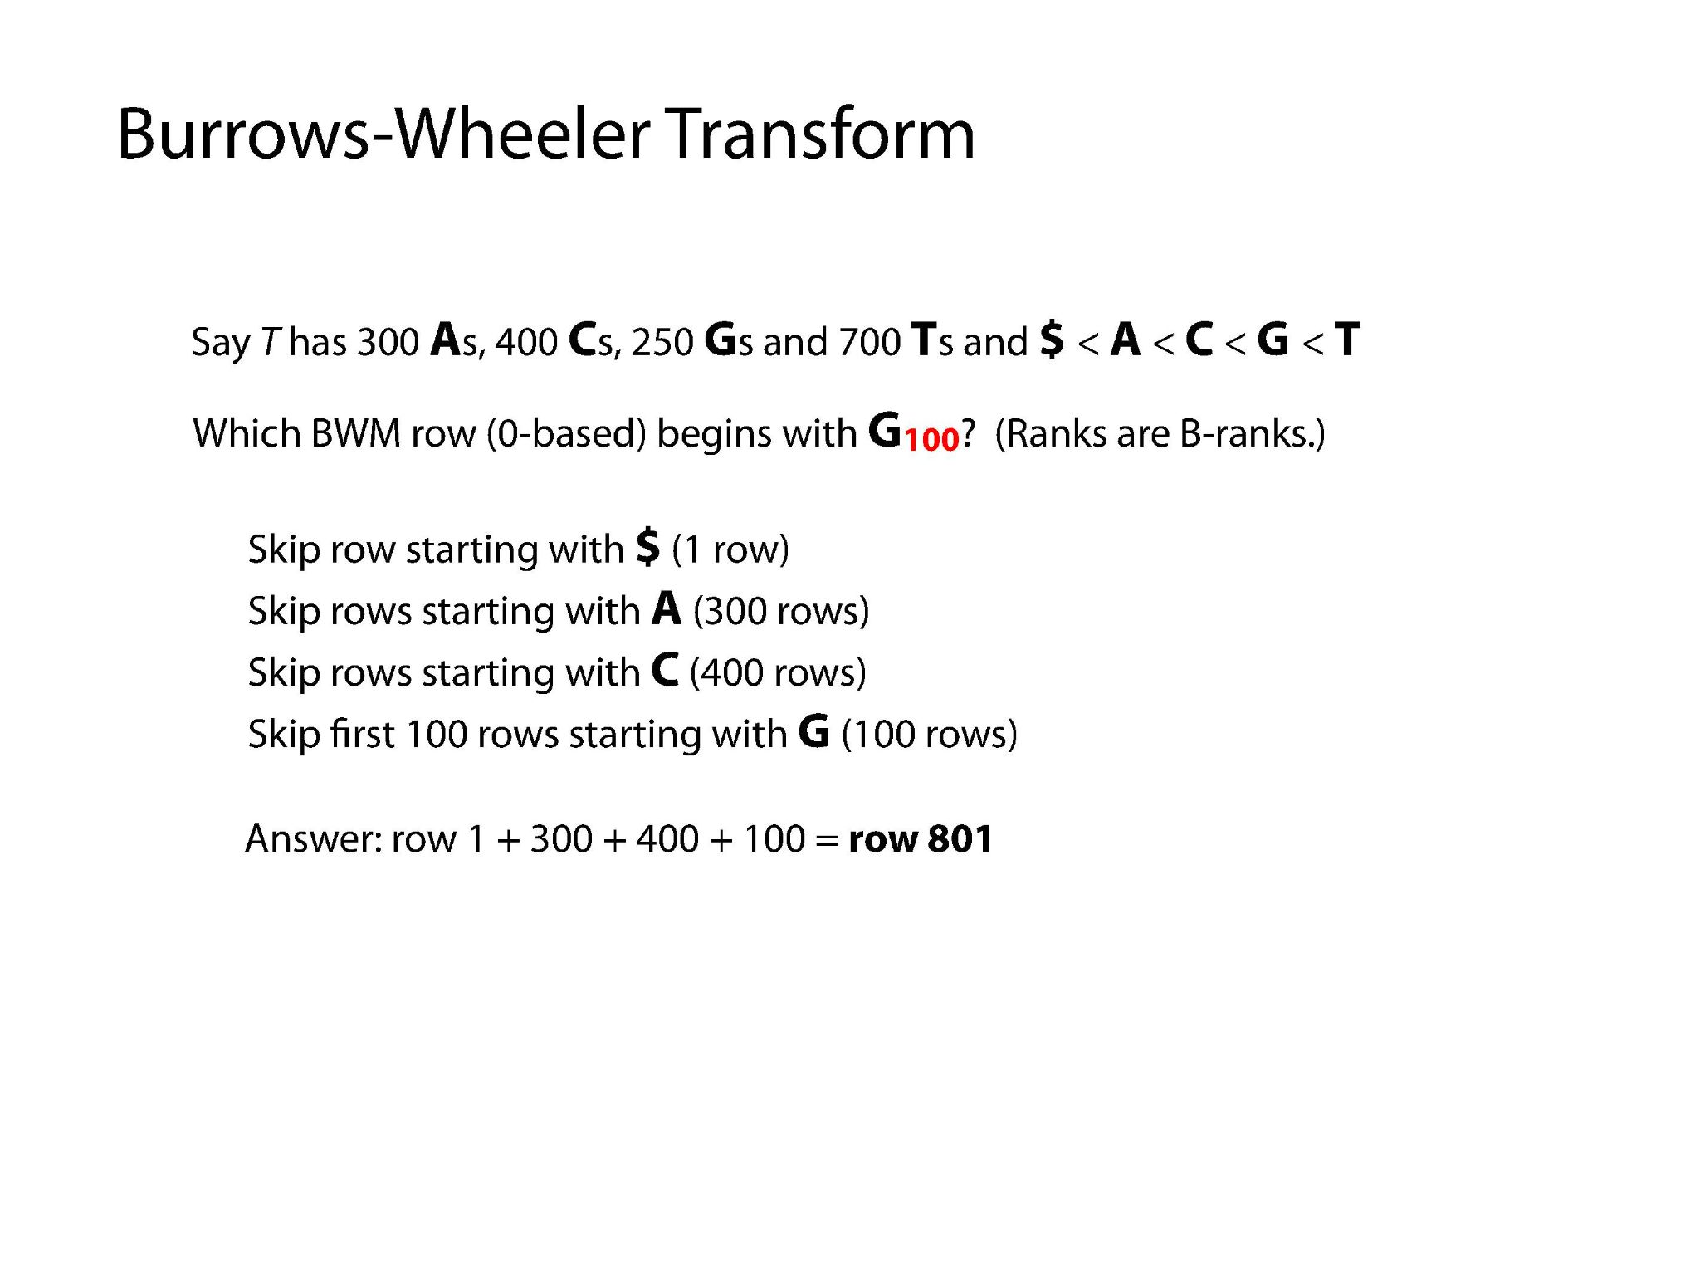
Illustrations Courtesy of Ben Langmead

Slide 22
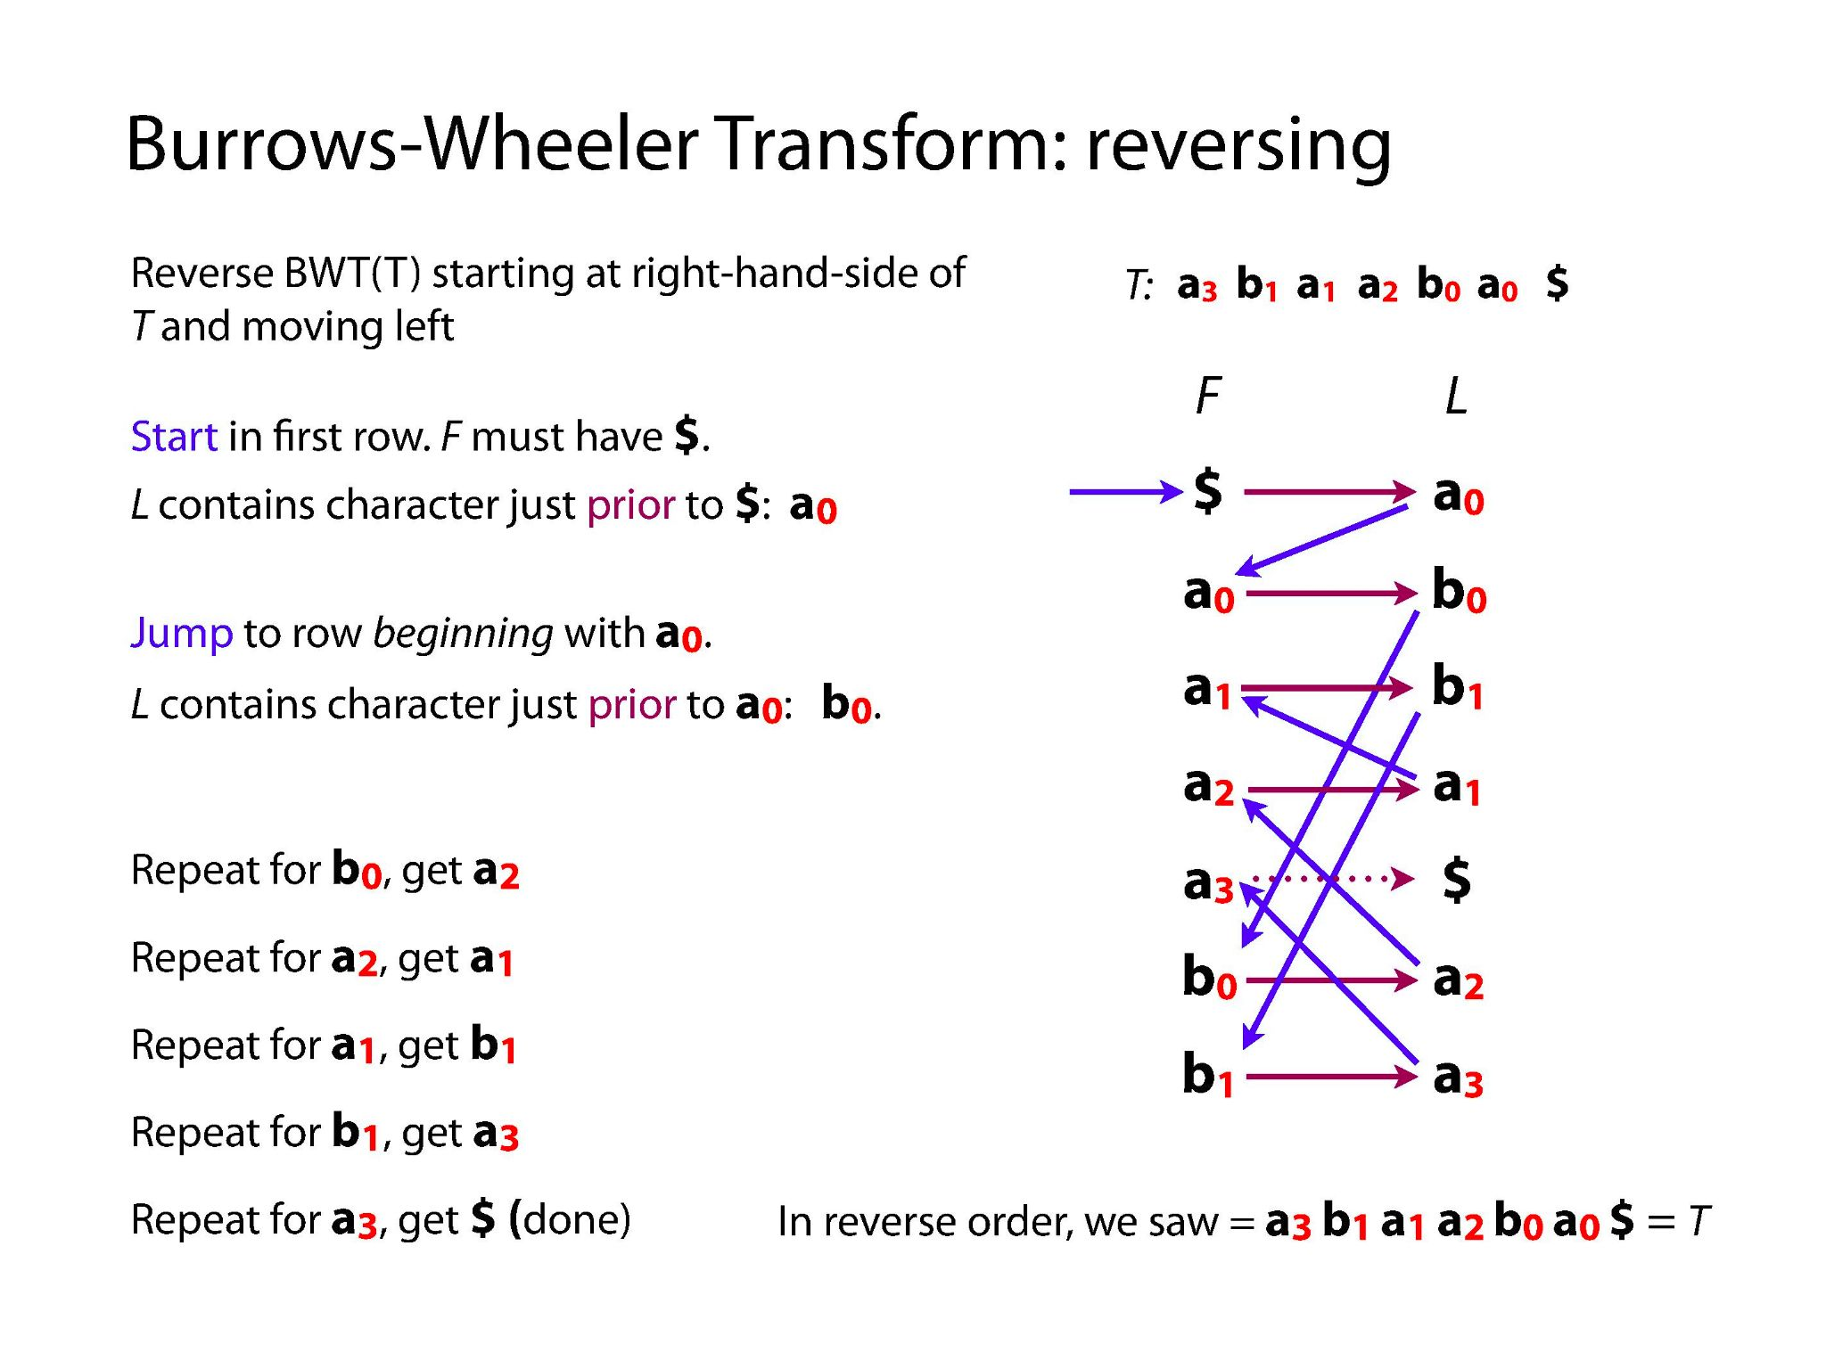
Illustrations Courtesy of Ben Langmead

Slide 23
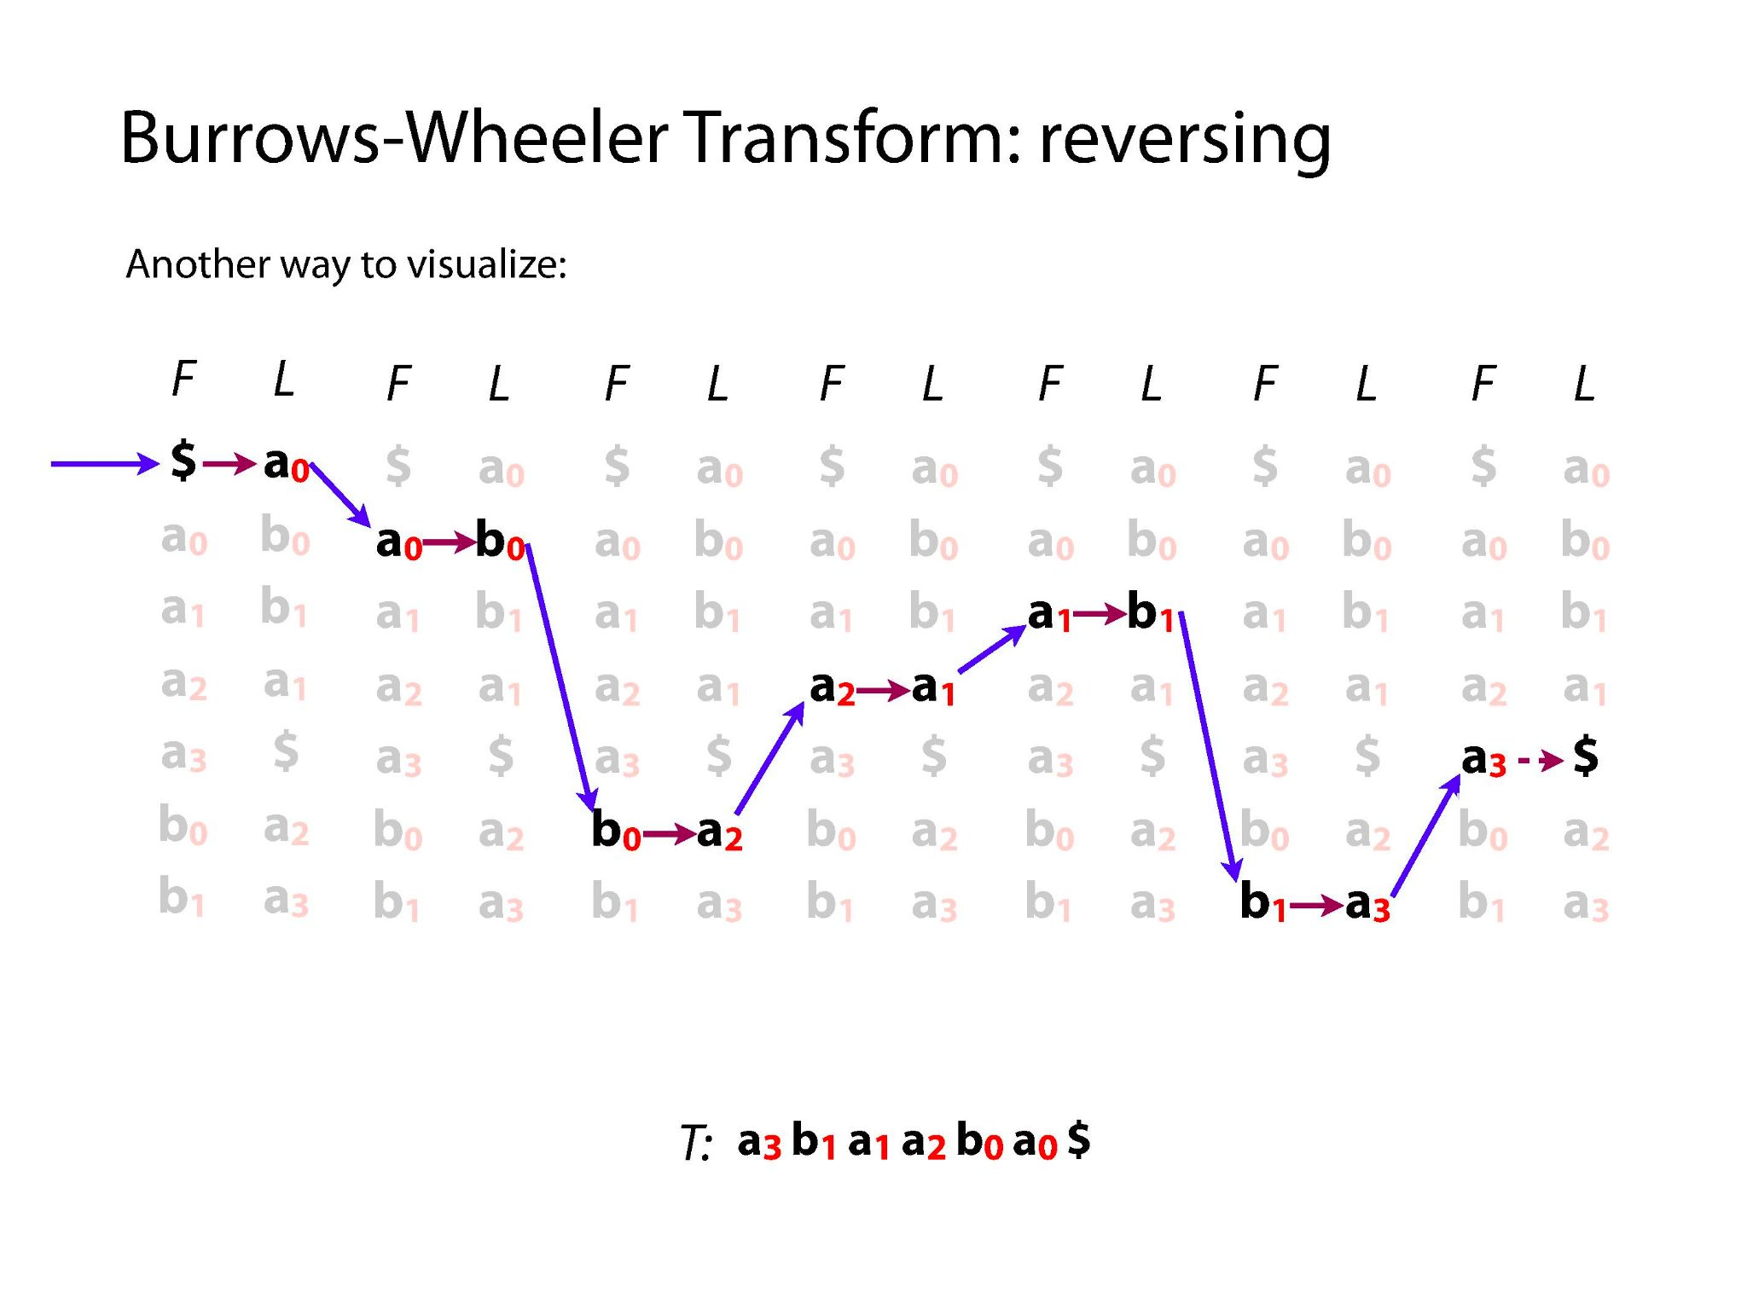
Illustrations Courtesy of Ben Langmead

Slide 24
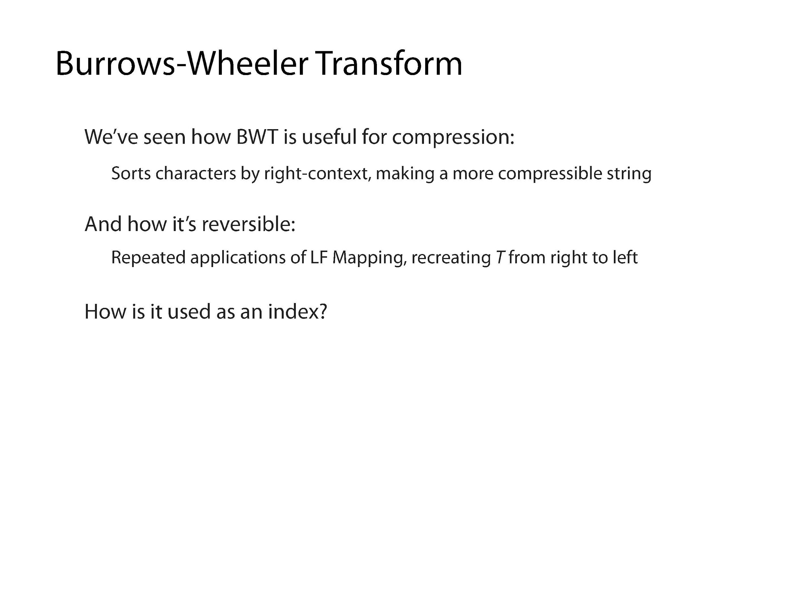
Illustrations Courtesy of Ben Langmead

Slide 25
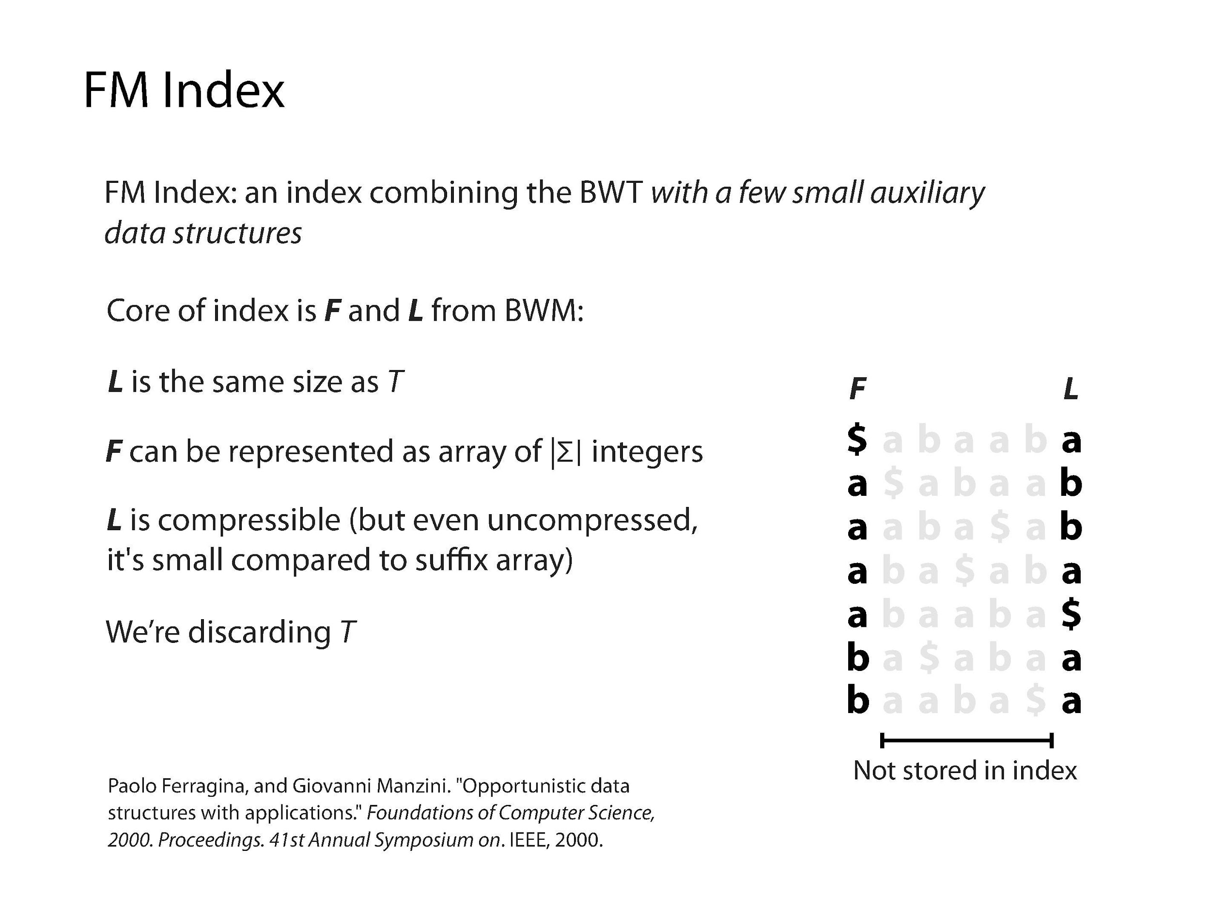
Illustrations Courtesy of Ben Langmead

Slide 26
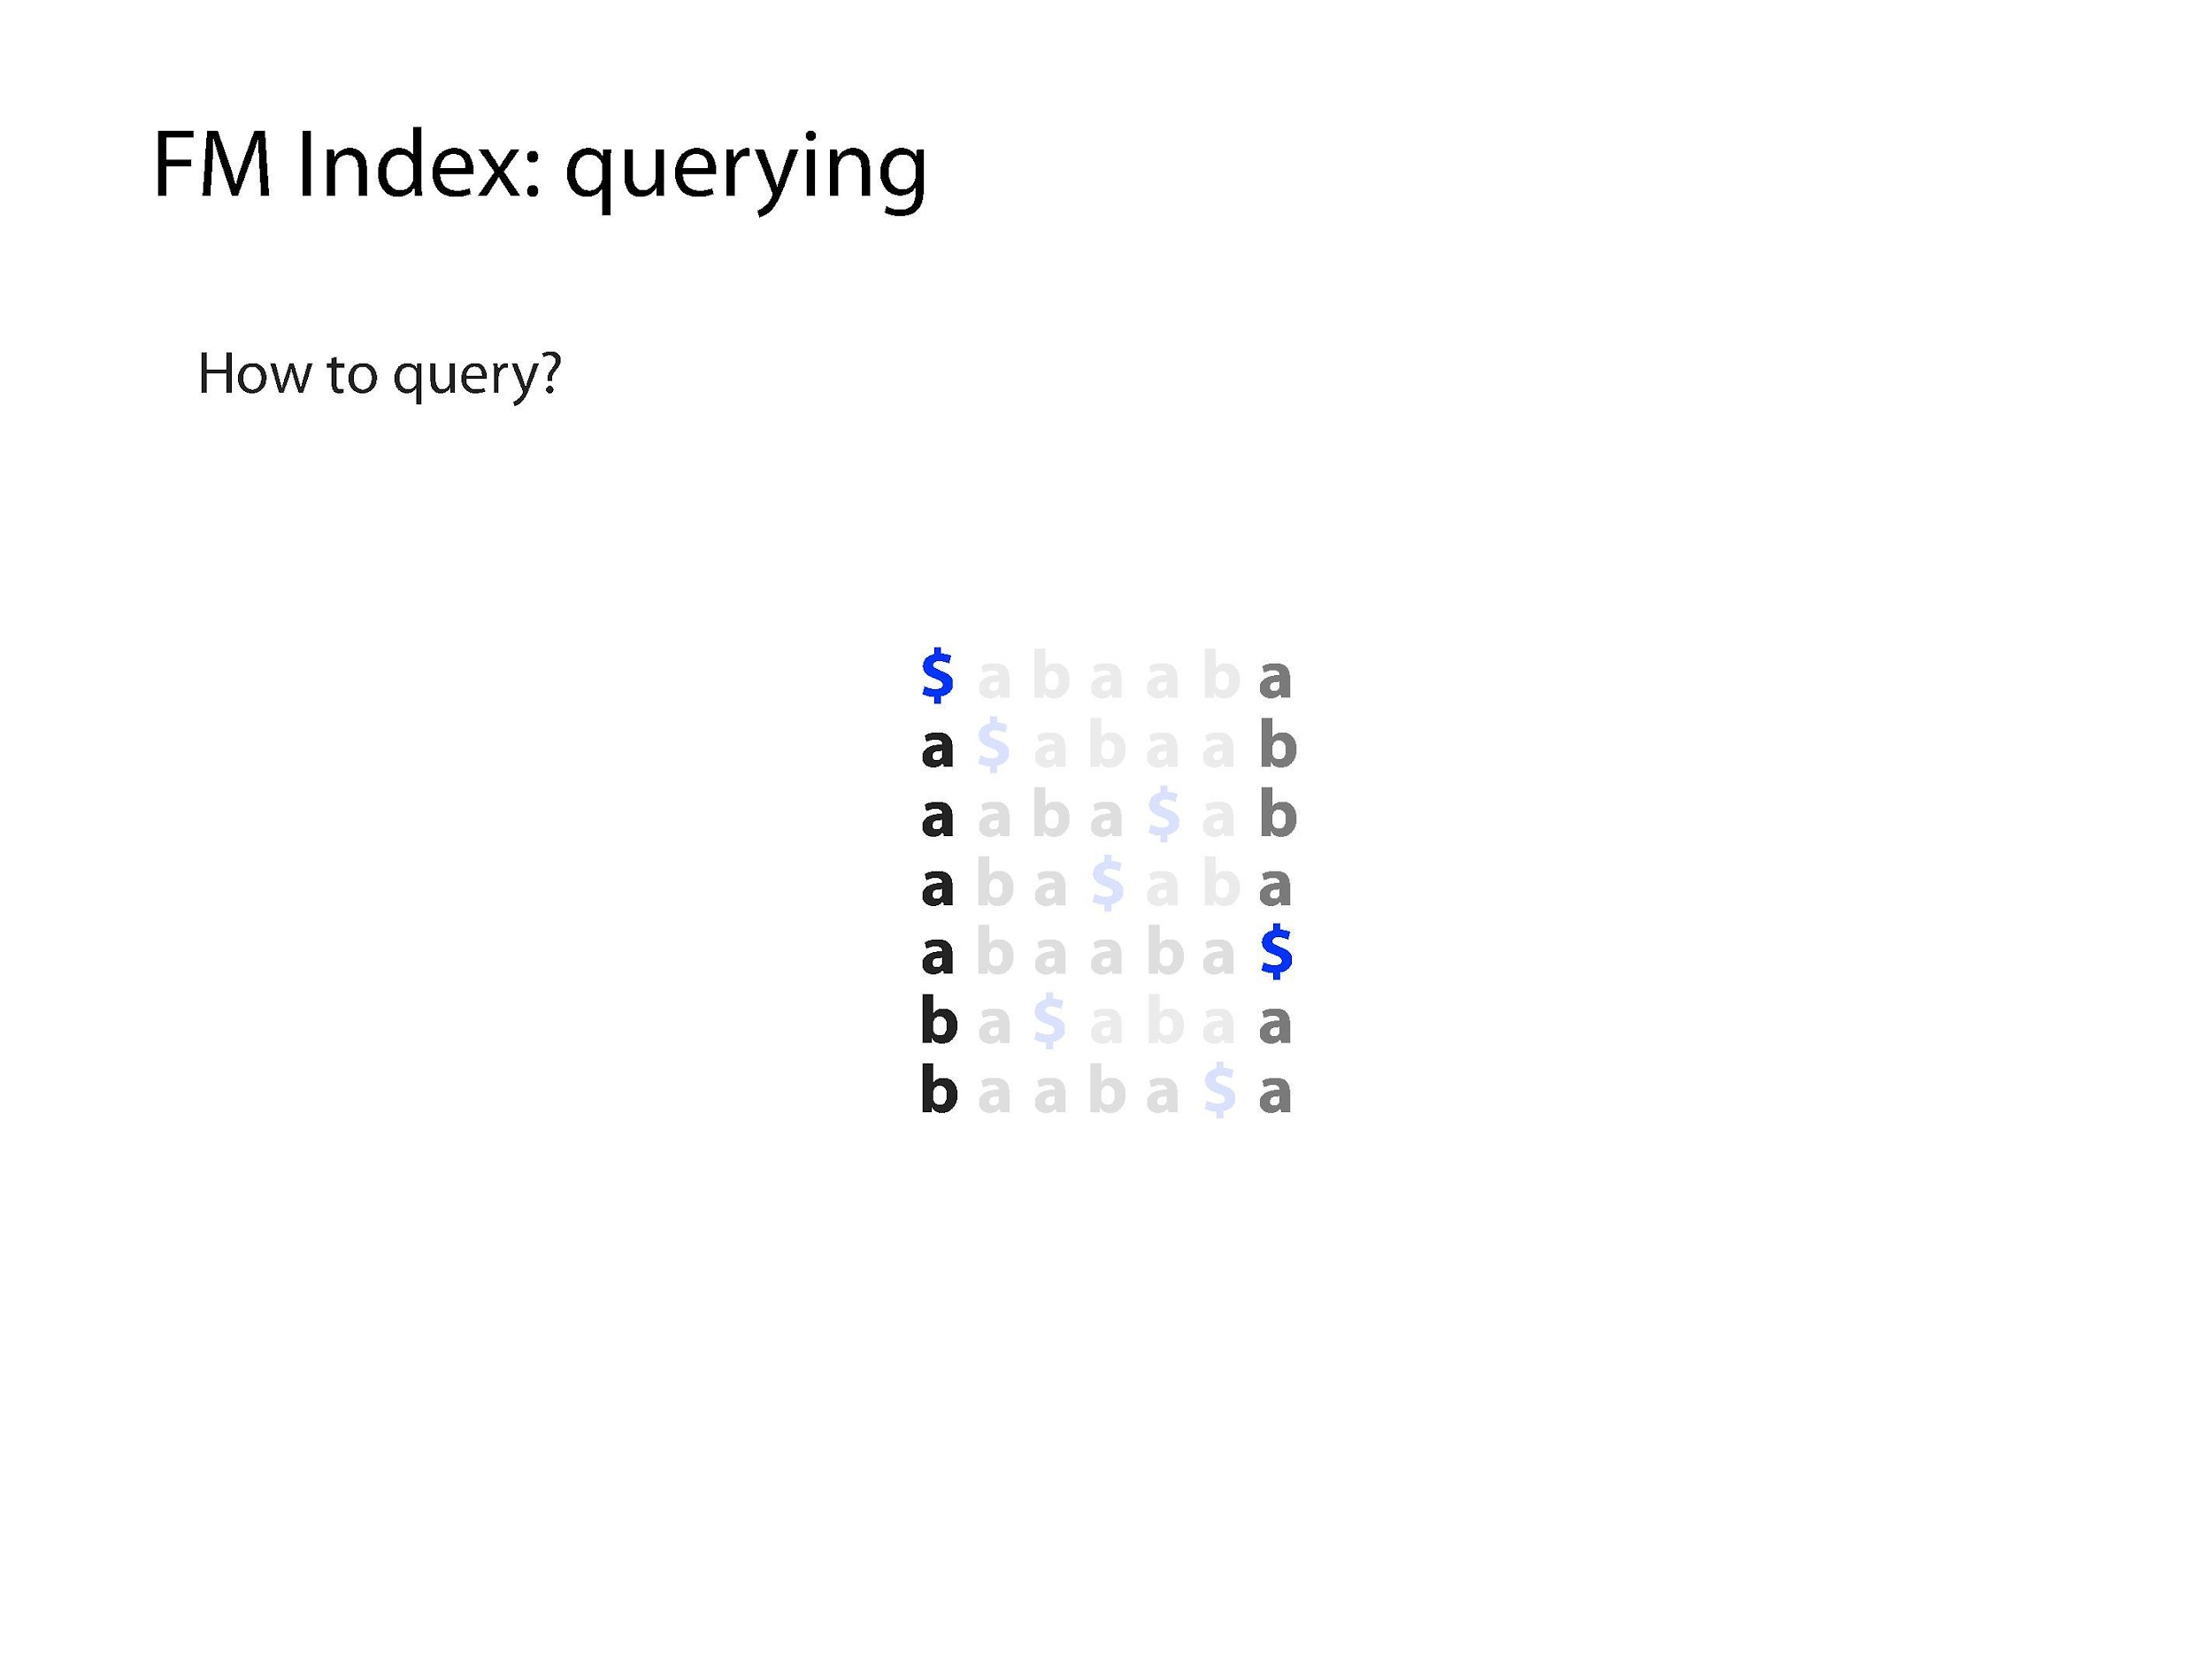
Illustrations Courtesy of Ben Langmead

Slide 27
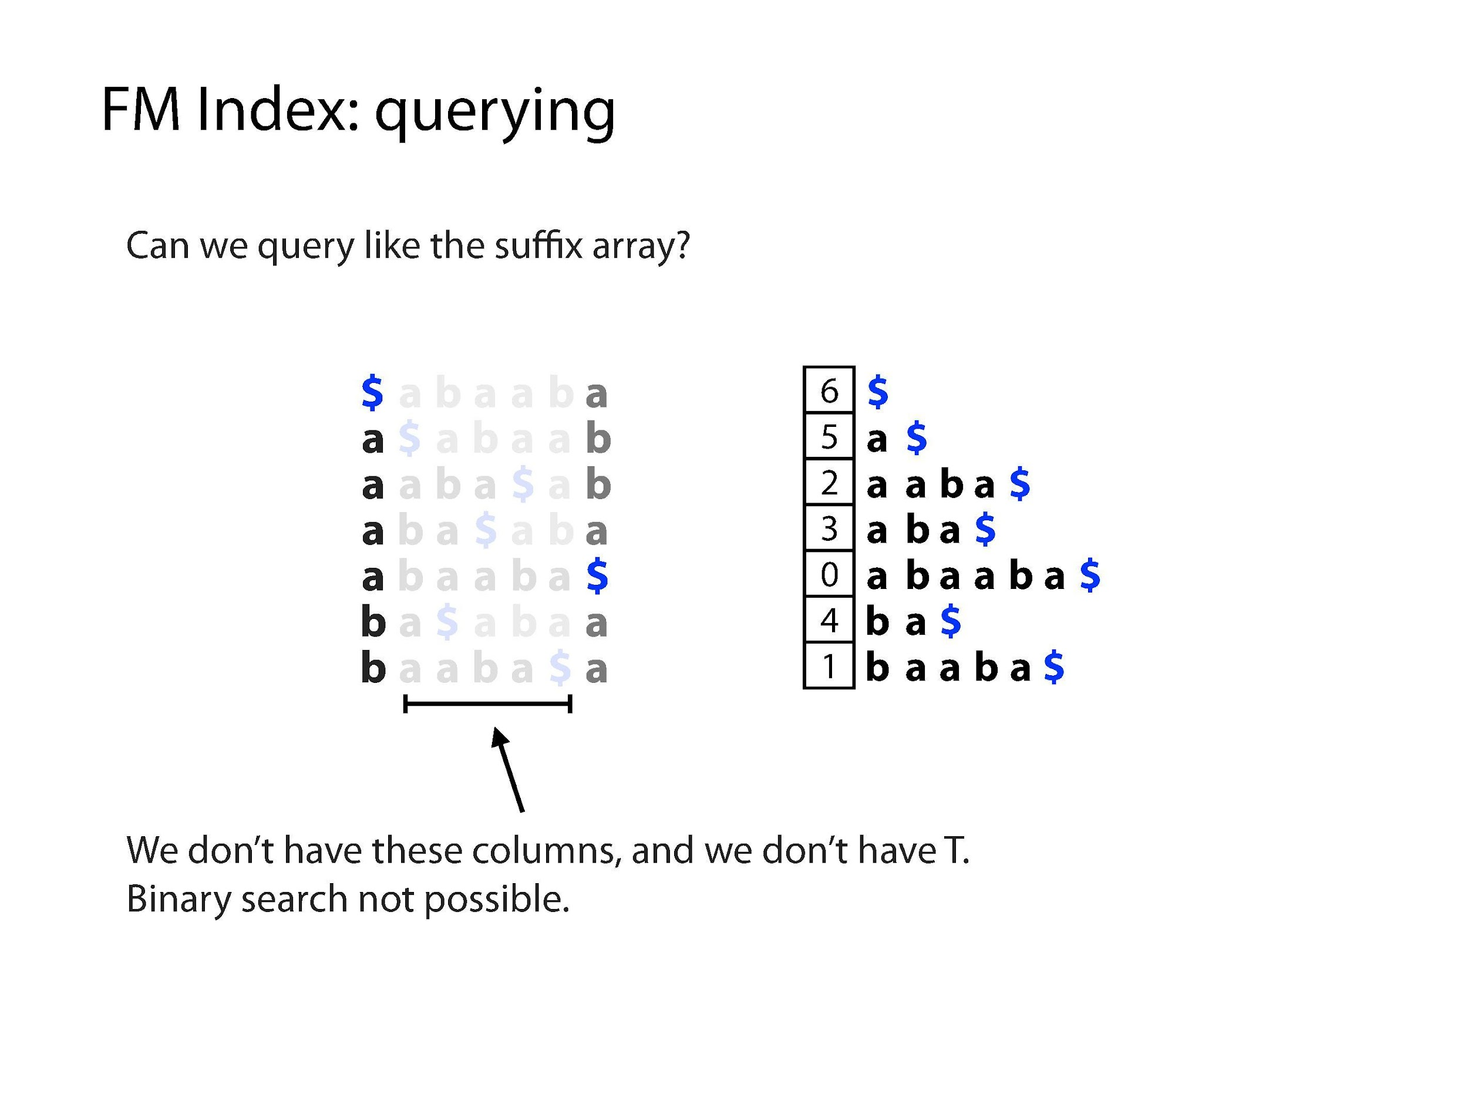
Illustrations Courtesy of Ben Langmead

Slide 28
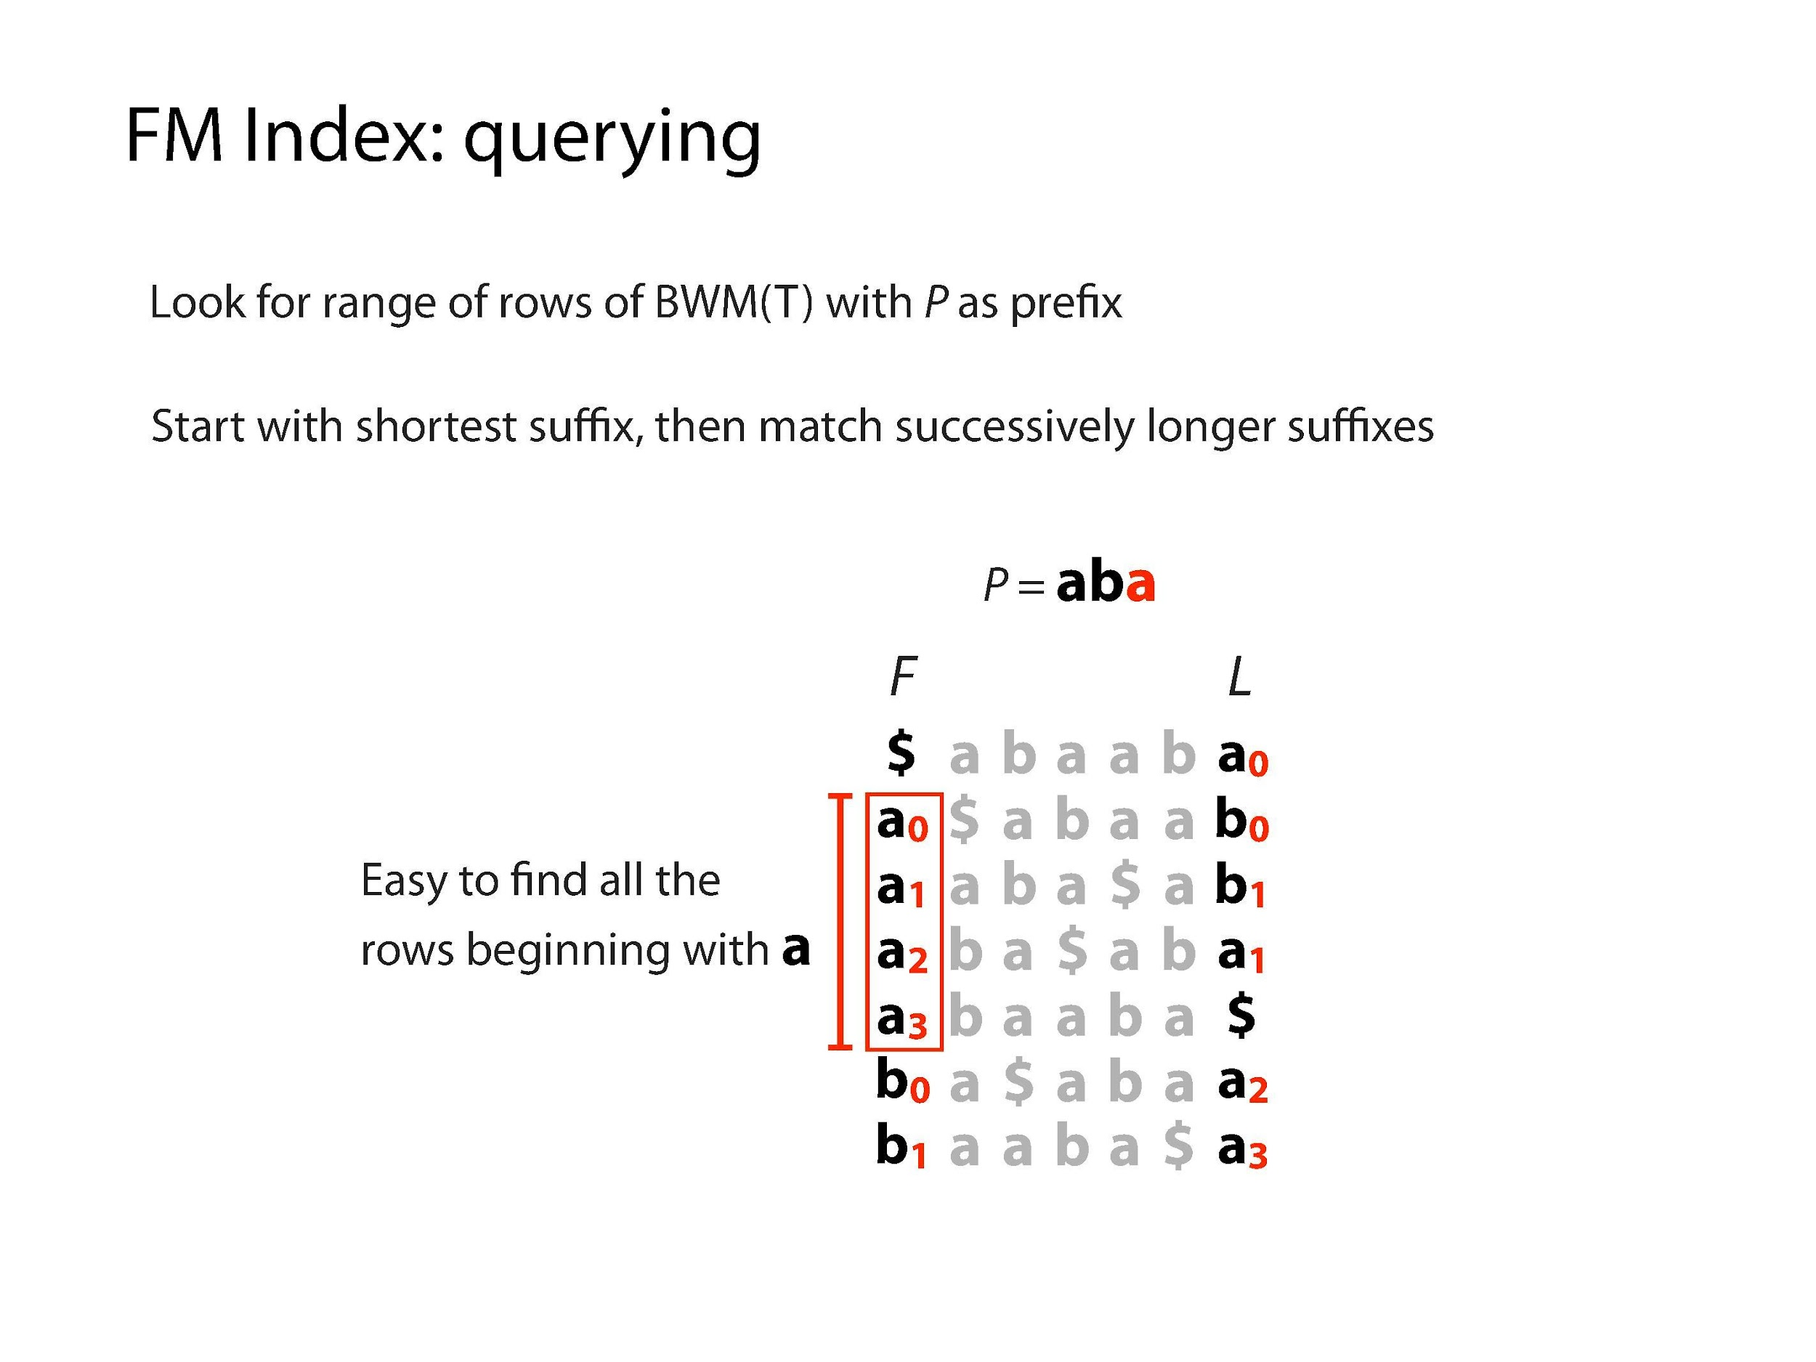
Illustrations Courtesy of Ben Langmead

Slide 29
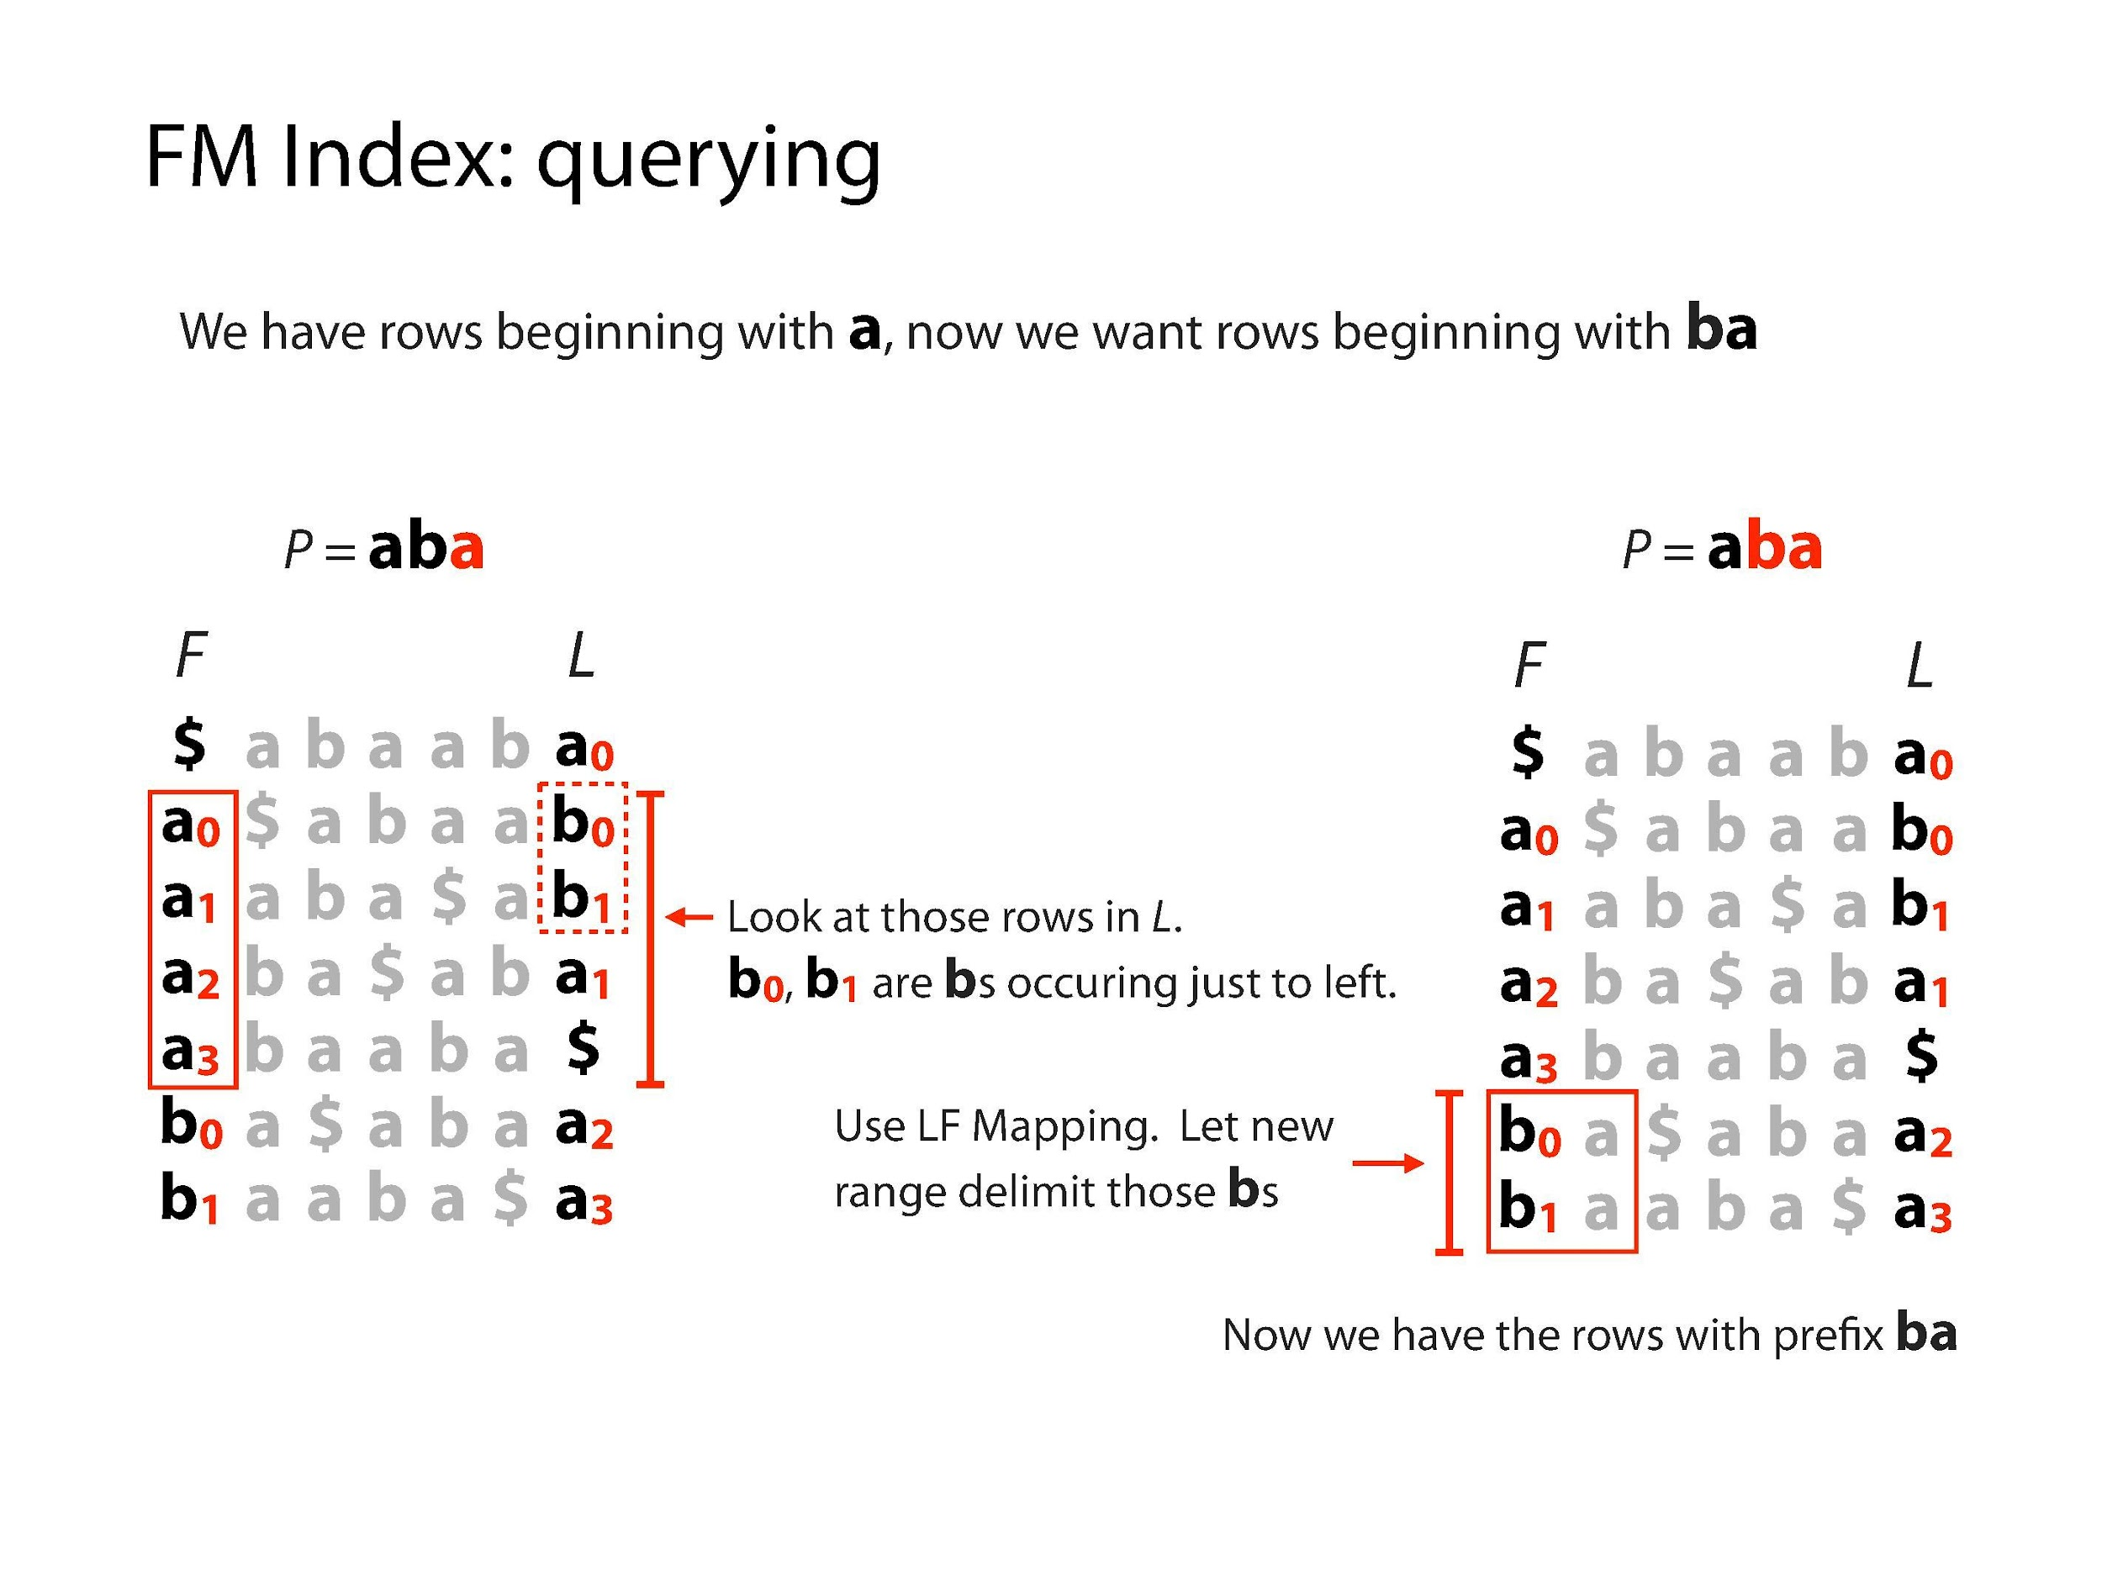
Illustrations Courtesy of Ben Langmead

Slide 30
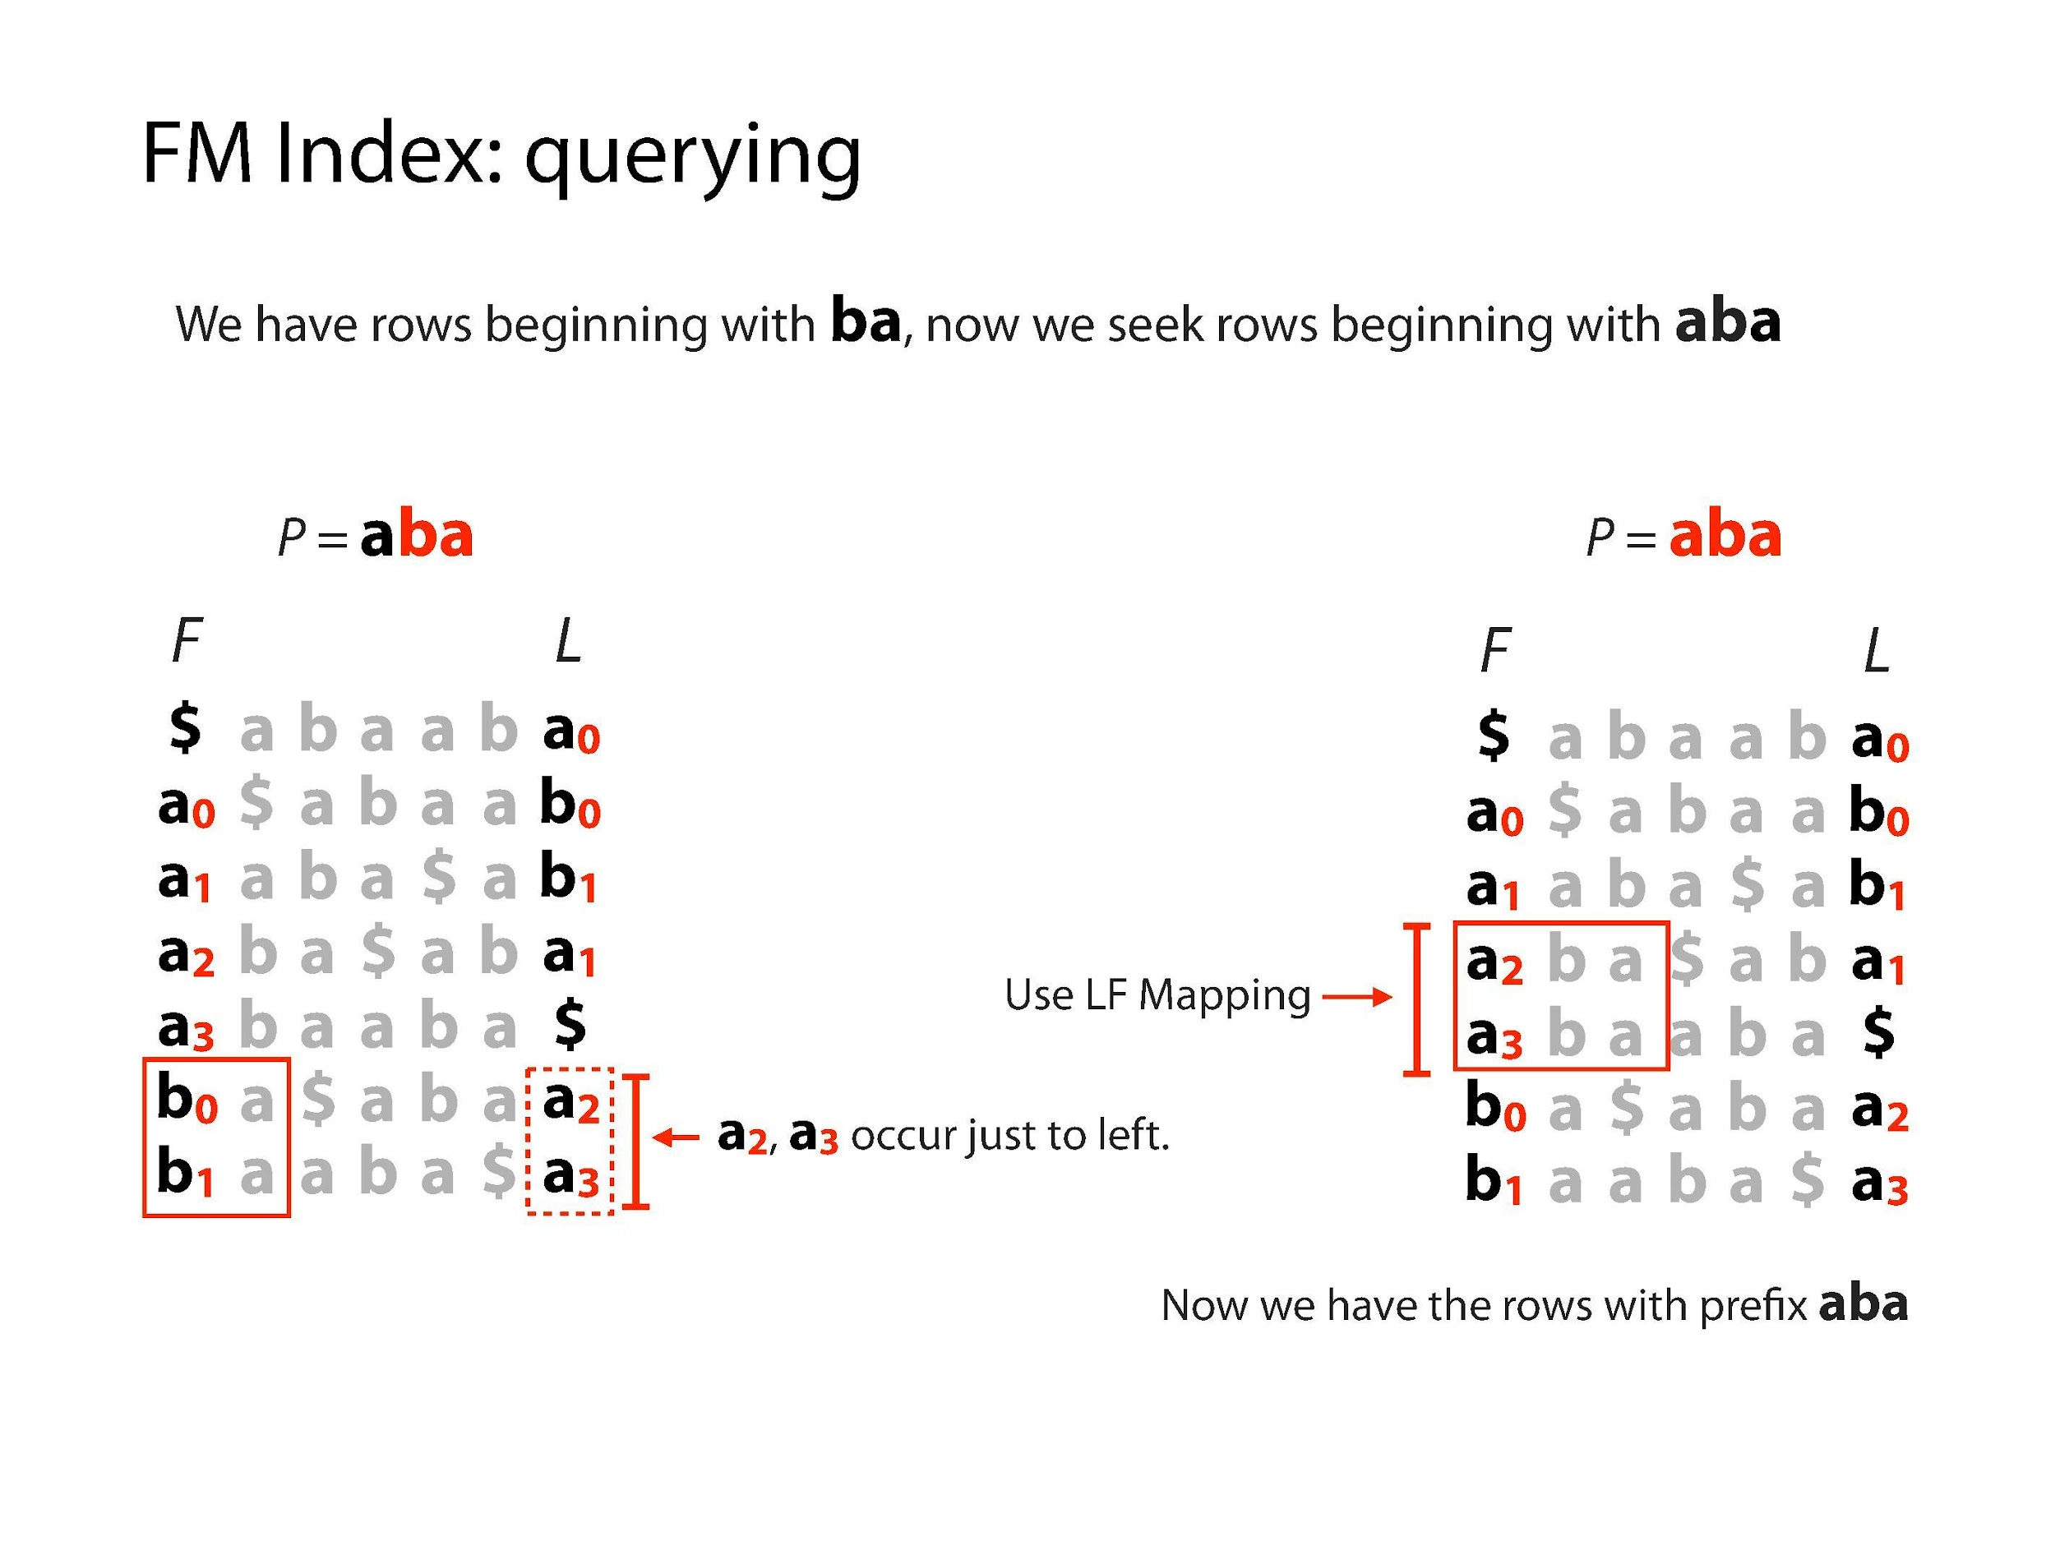
Illustrations Courtesy of Ben Langmead

Slide 31
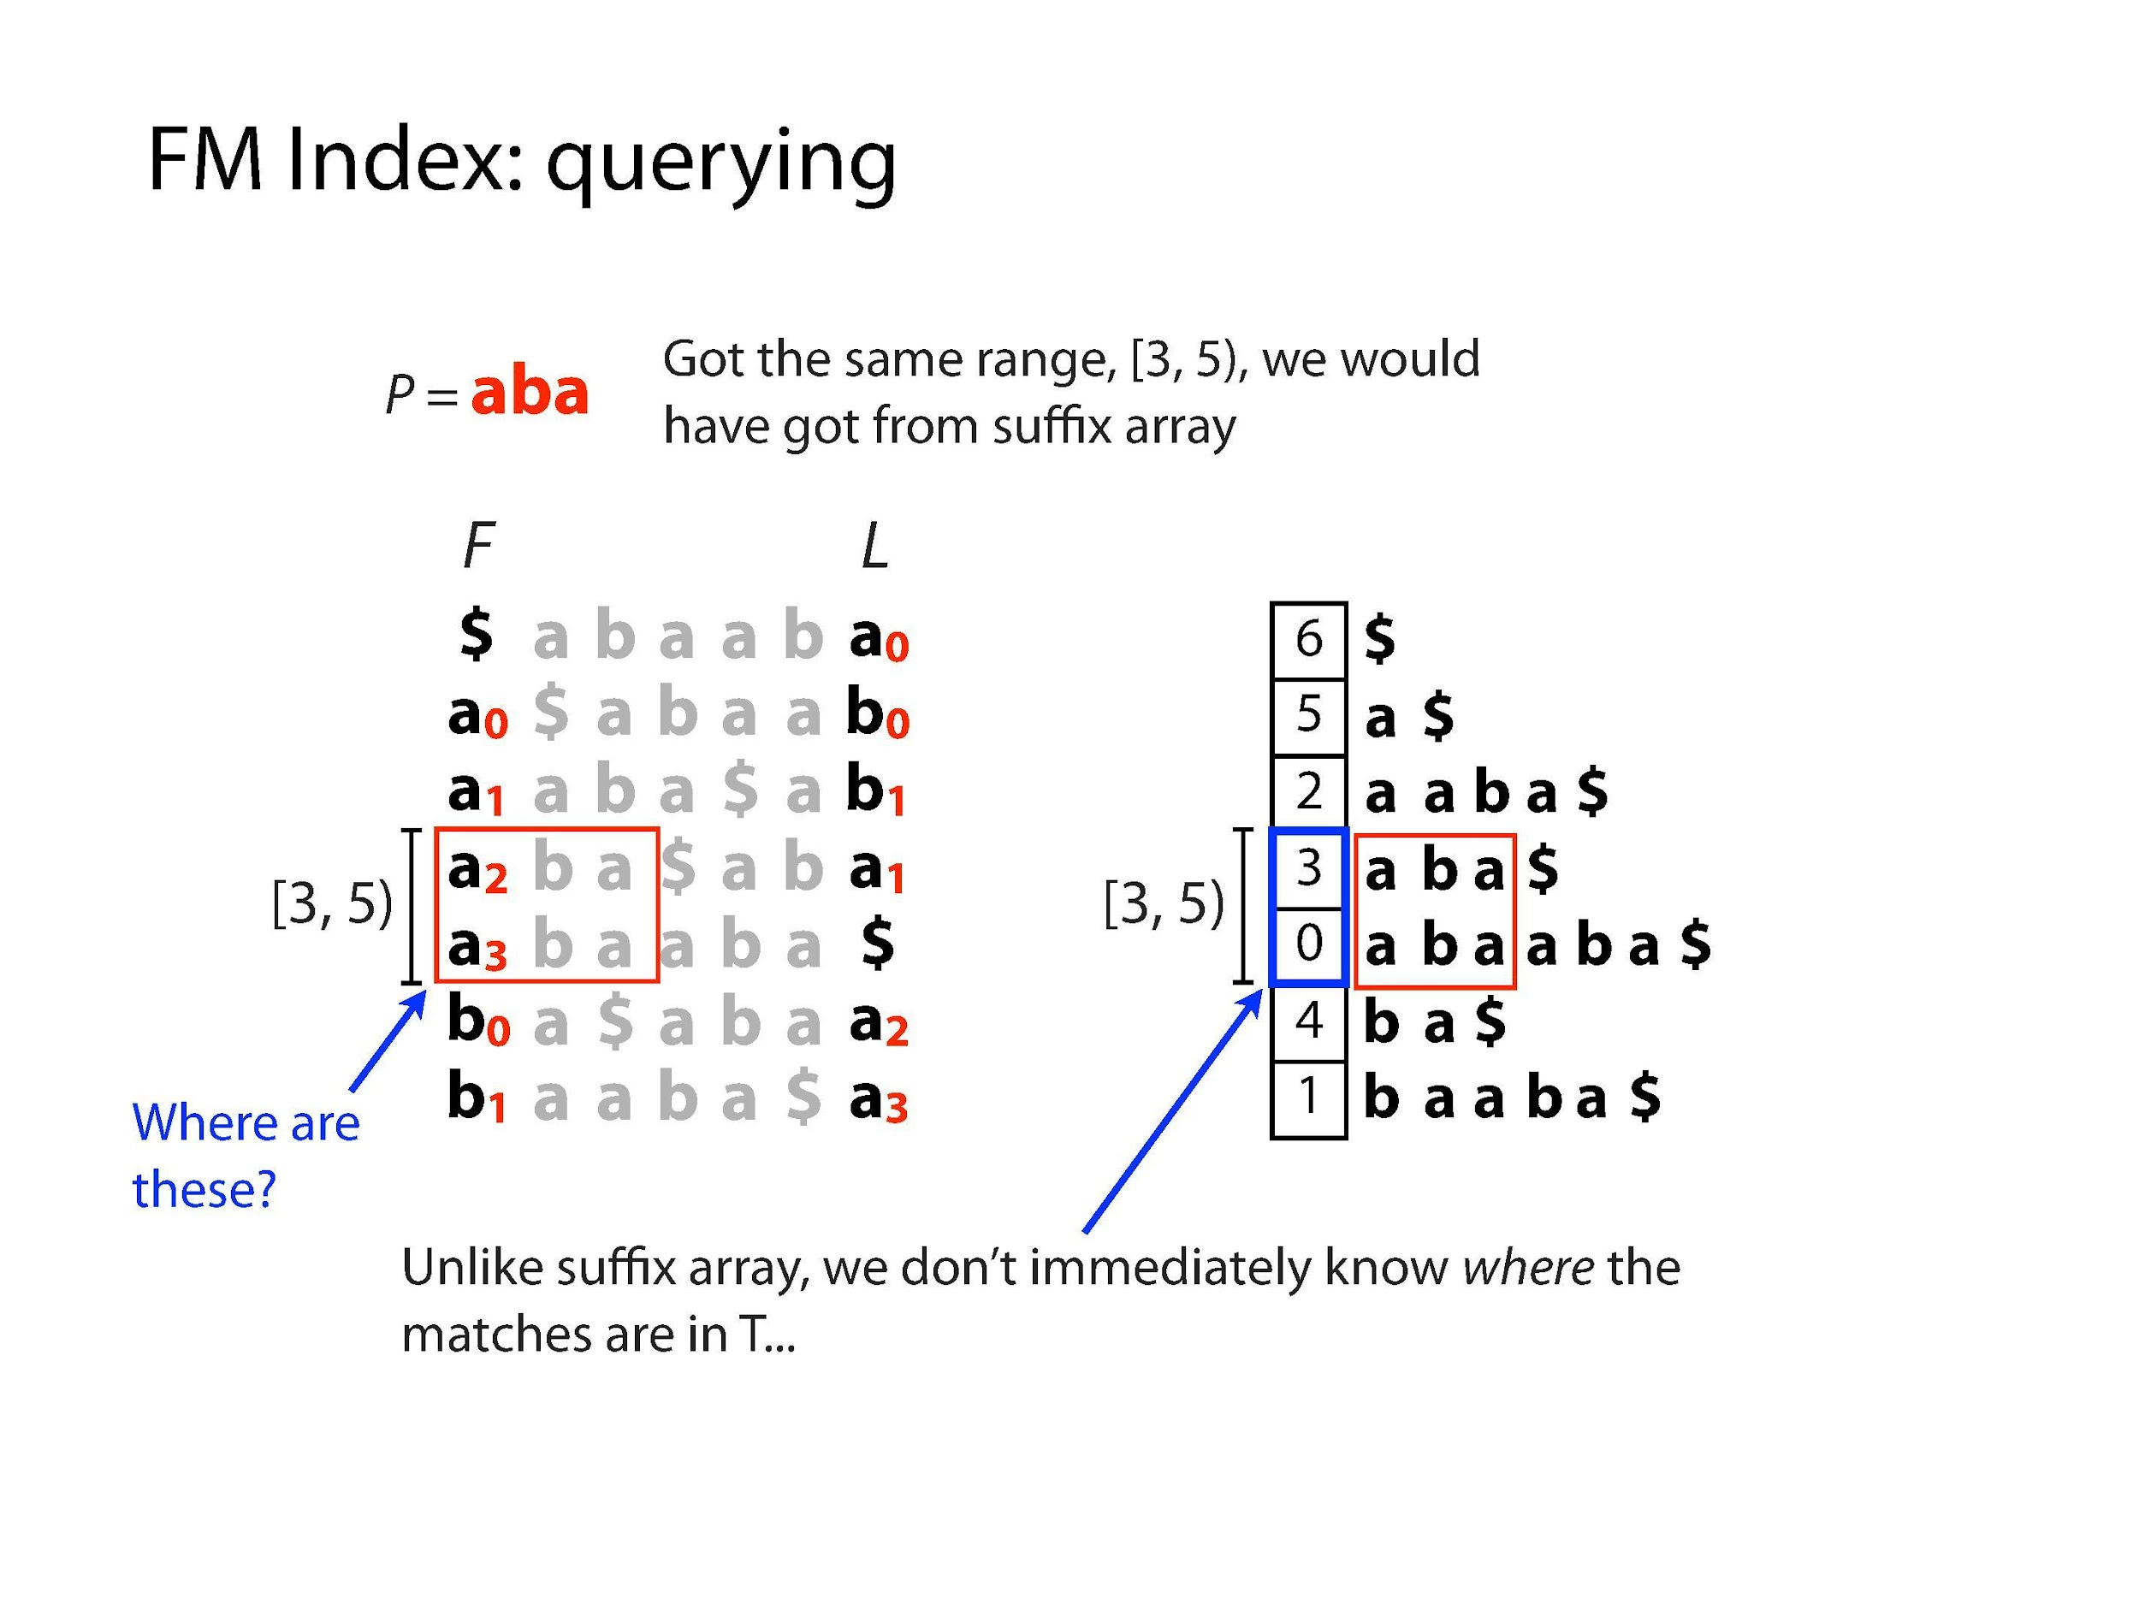
Illustrations Courtesy of Ben Langmead

Slide 32
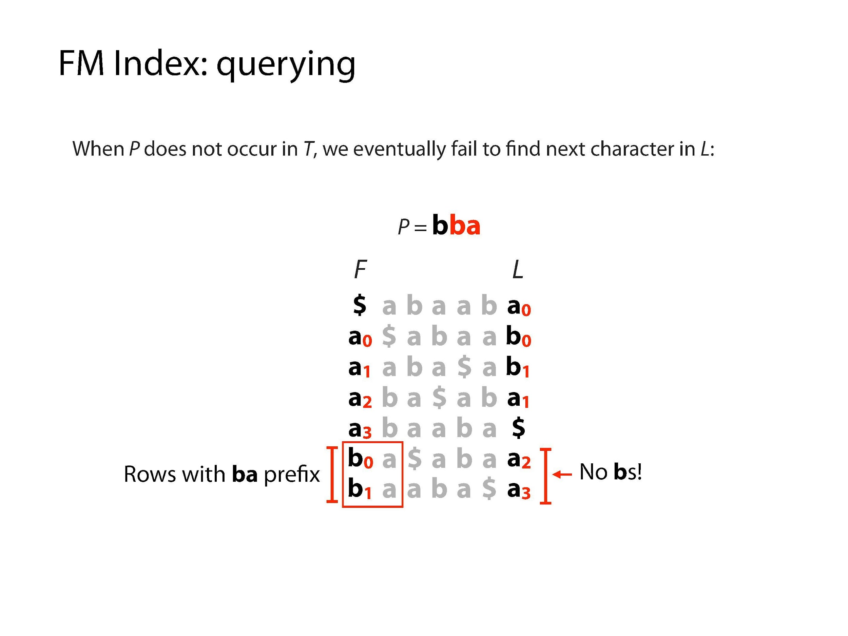
Illustrations Courtesy of Ben Langmead

Slide 33
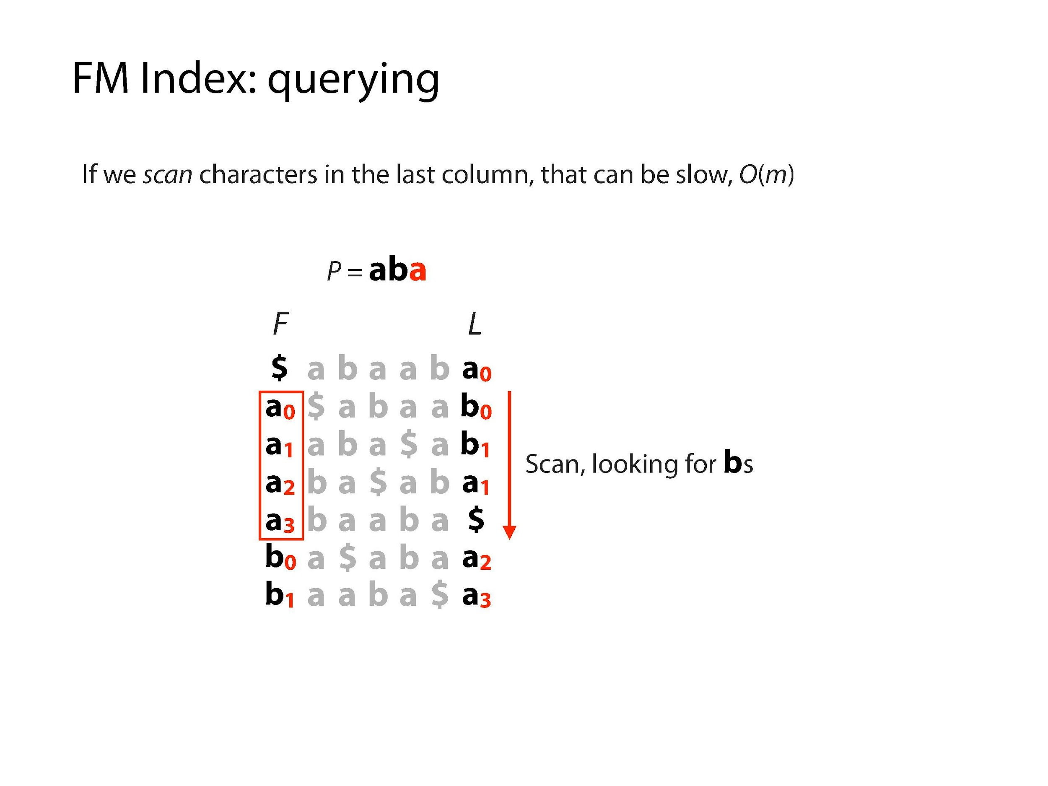
Illustrations Courtesy of Ben Langmead

Slide 34
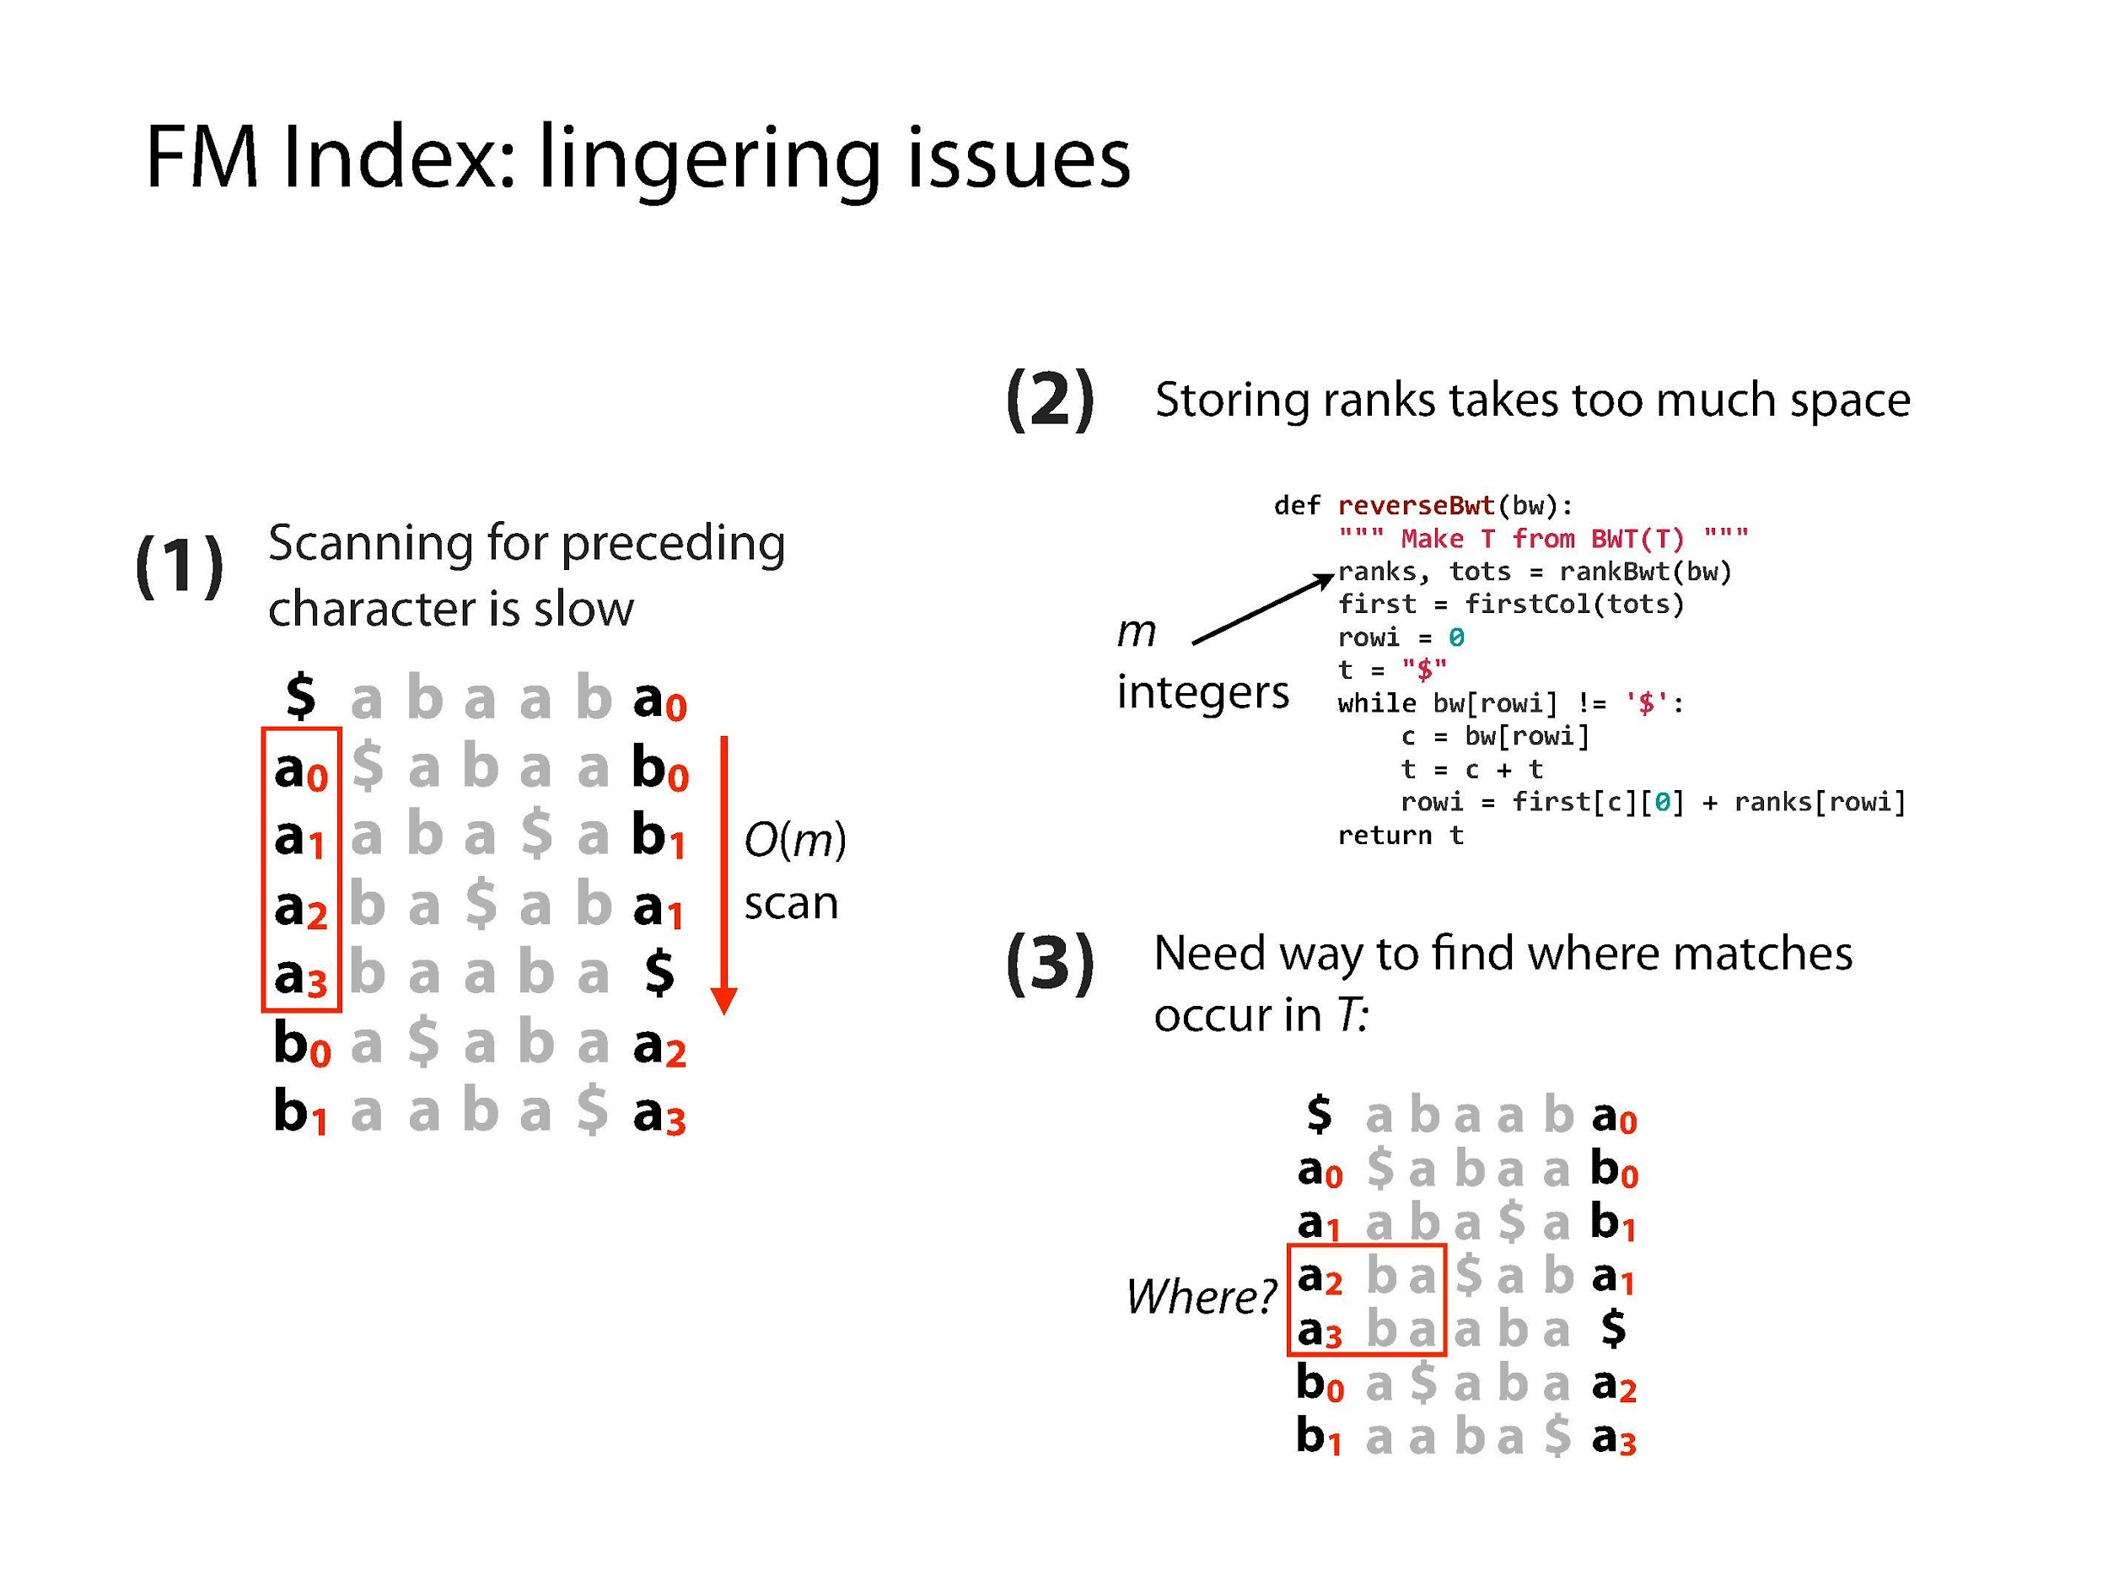
Illustrations Courtesy of Ben Langmead

Slide 35
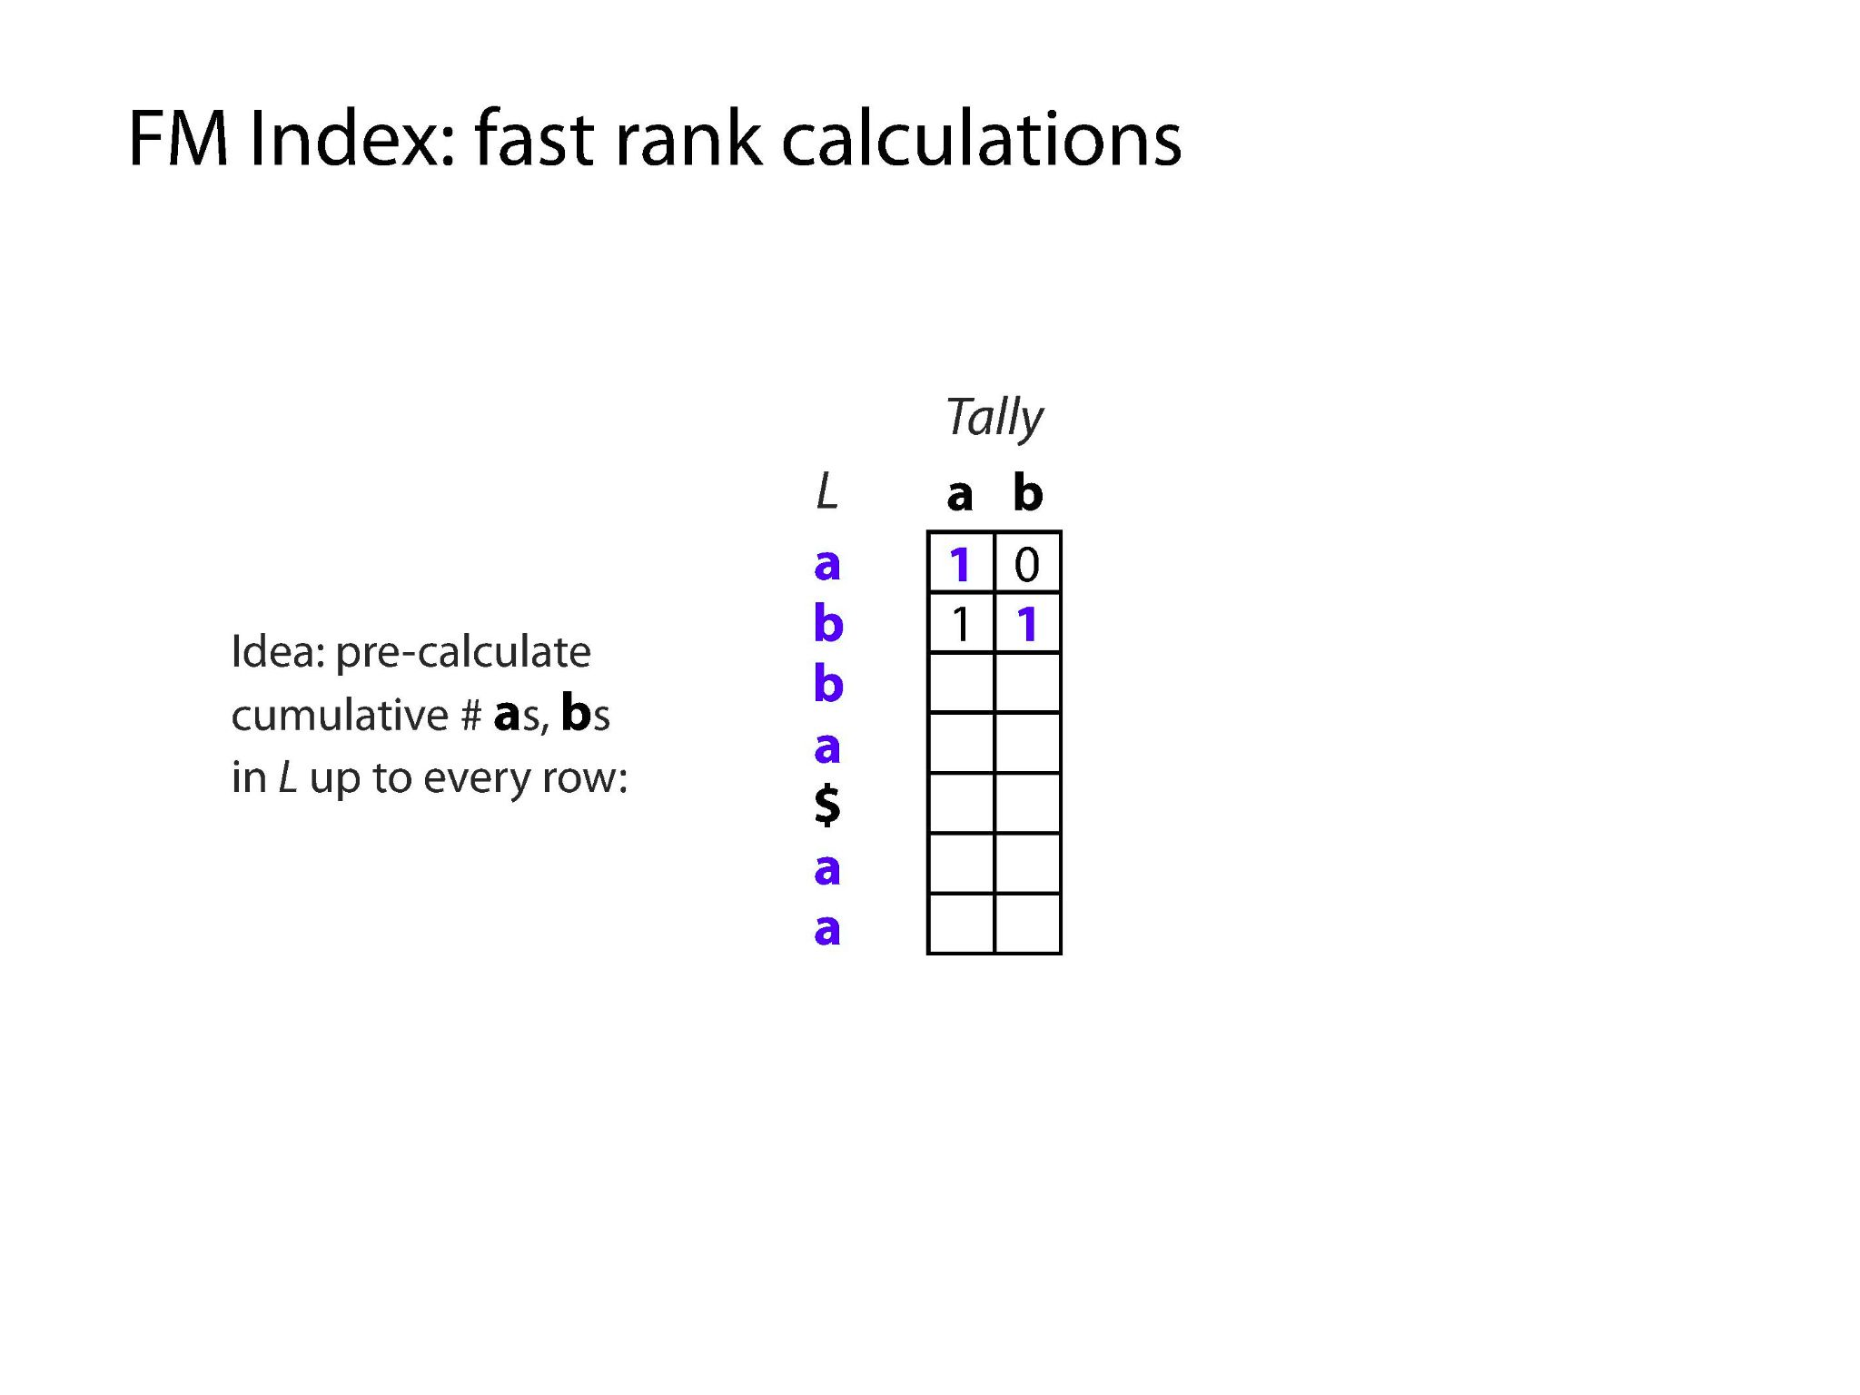
Illustrations Courtesy of Ben Langmead

Slide 36
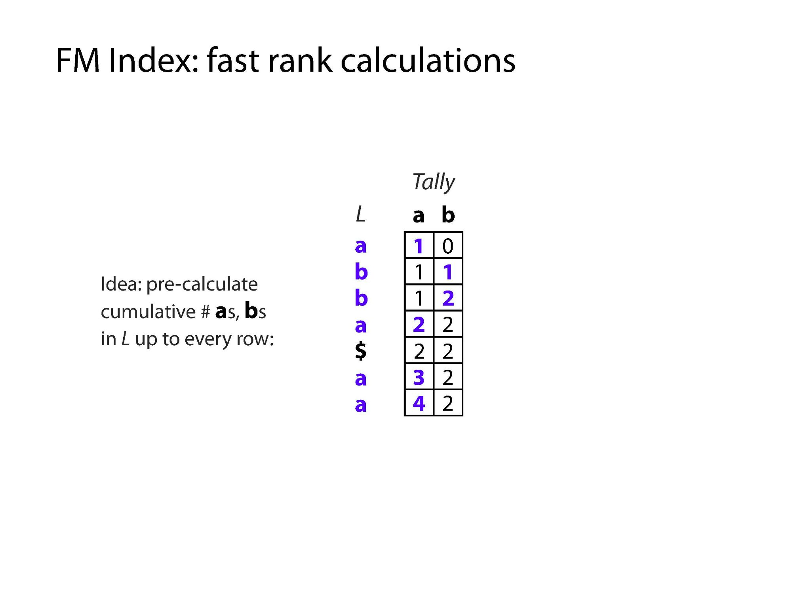
Illustrations Courtesy of Ben Langmead

Slide 37
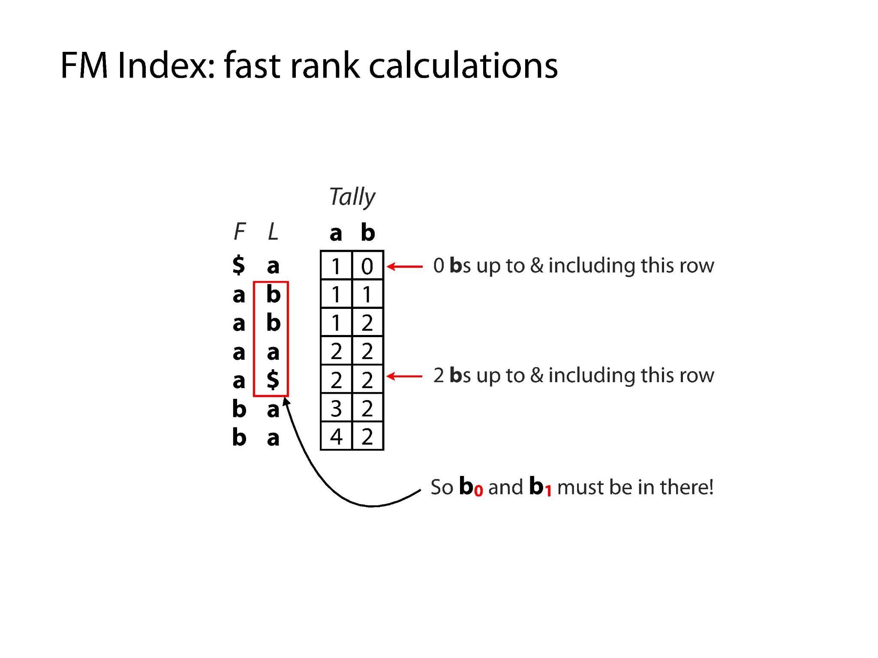
Illustrations Courtesy of Ben Langmead

Slide 38
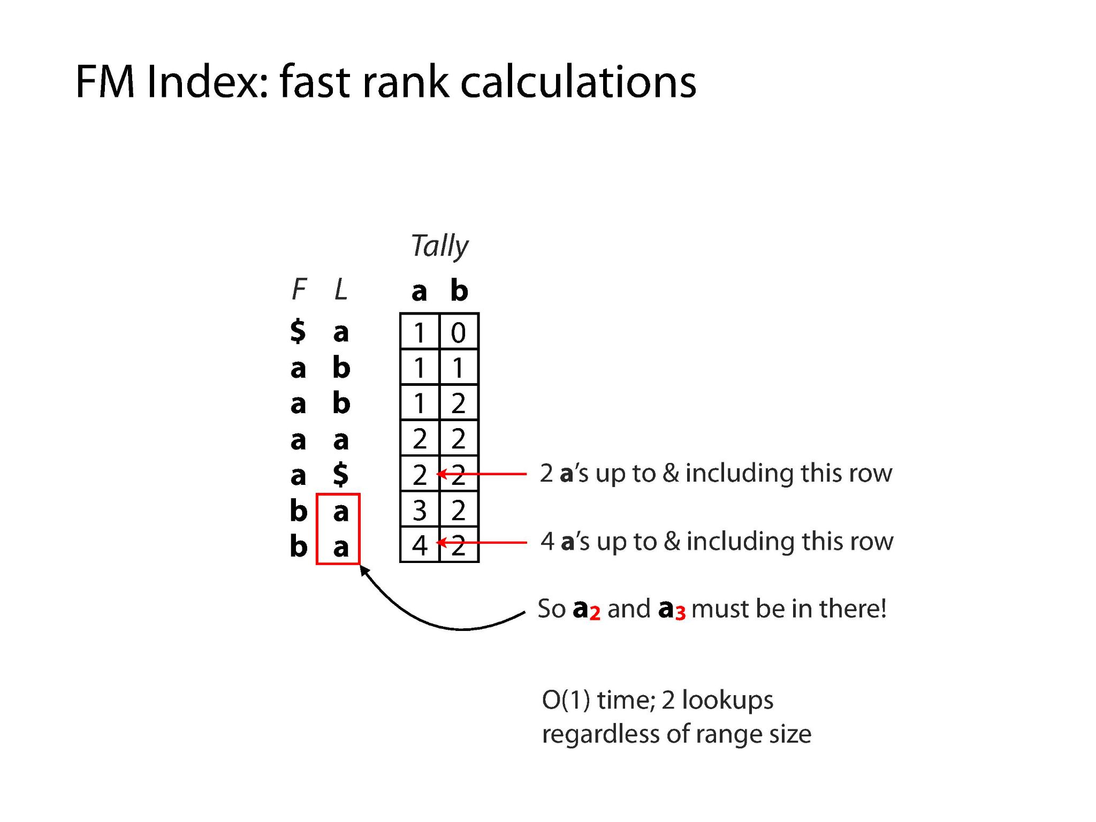
Illustrations Courtesy of Ben Langmead

Slide 39
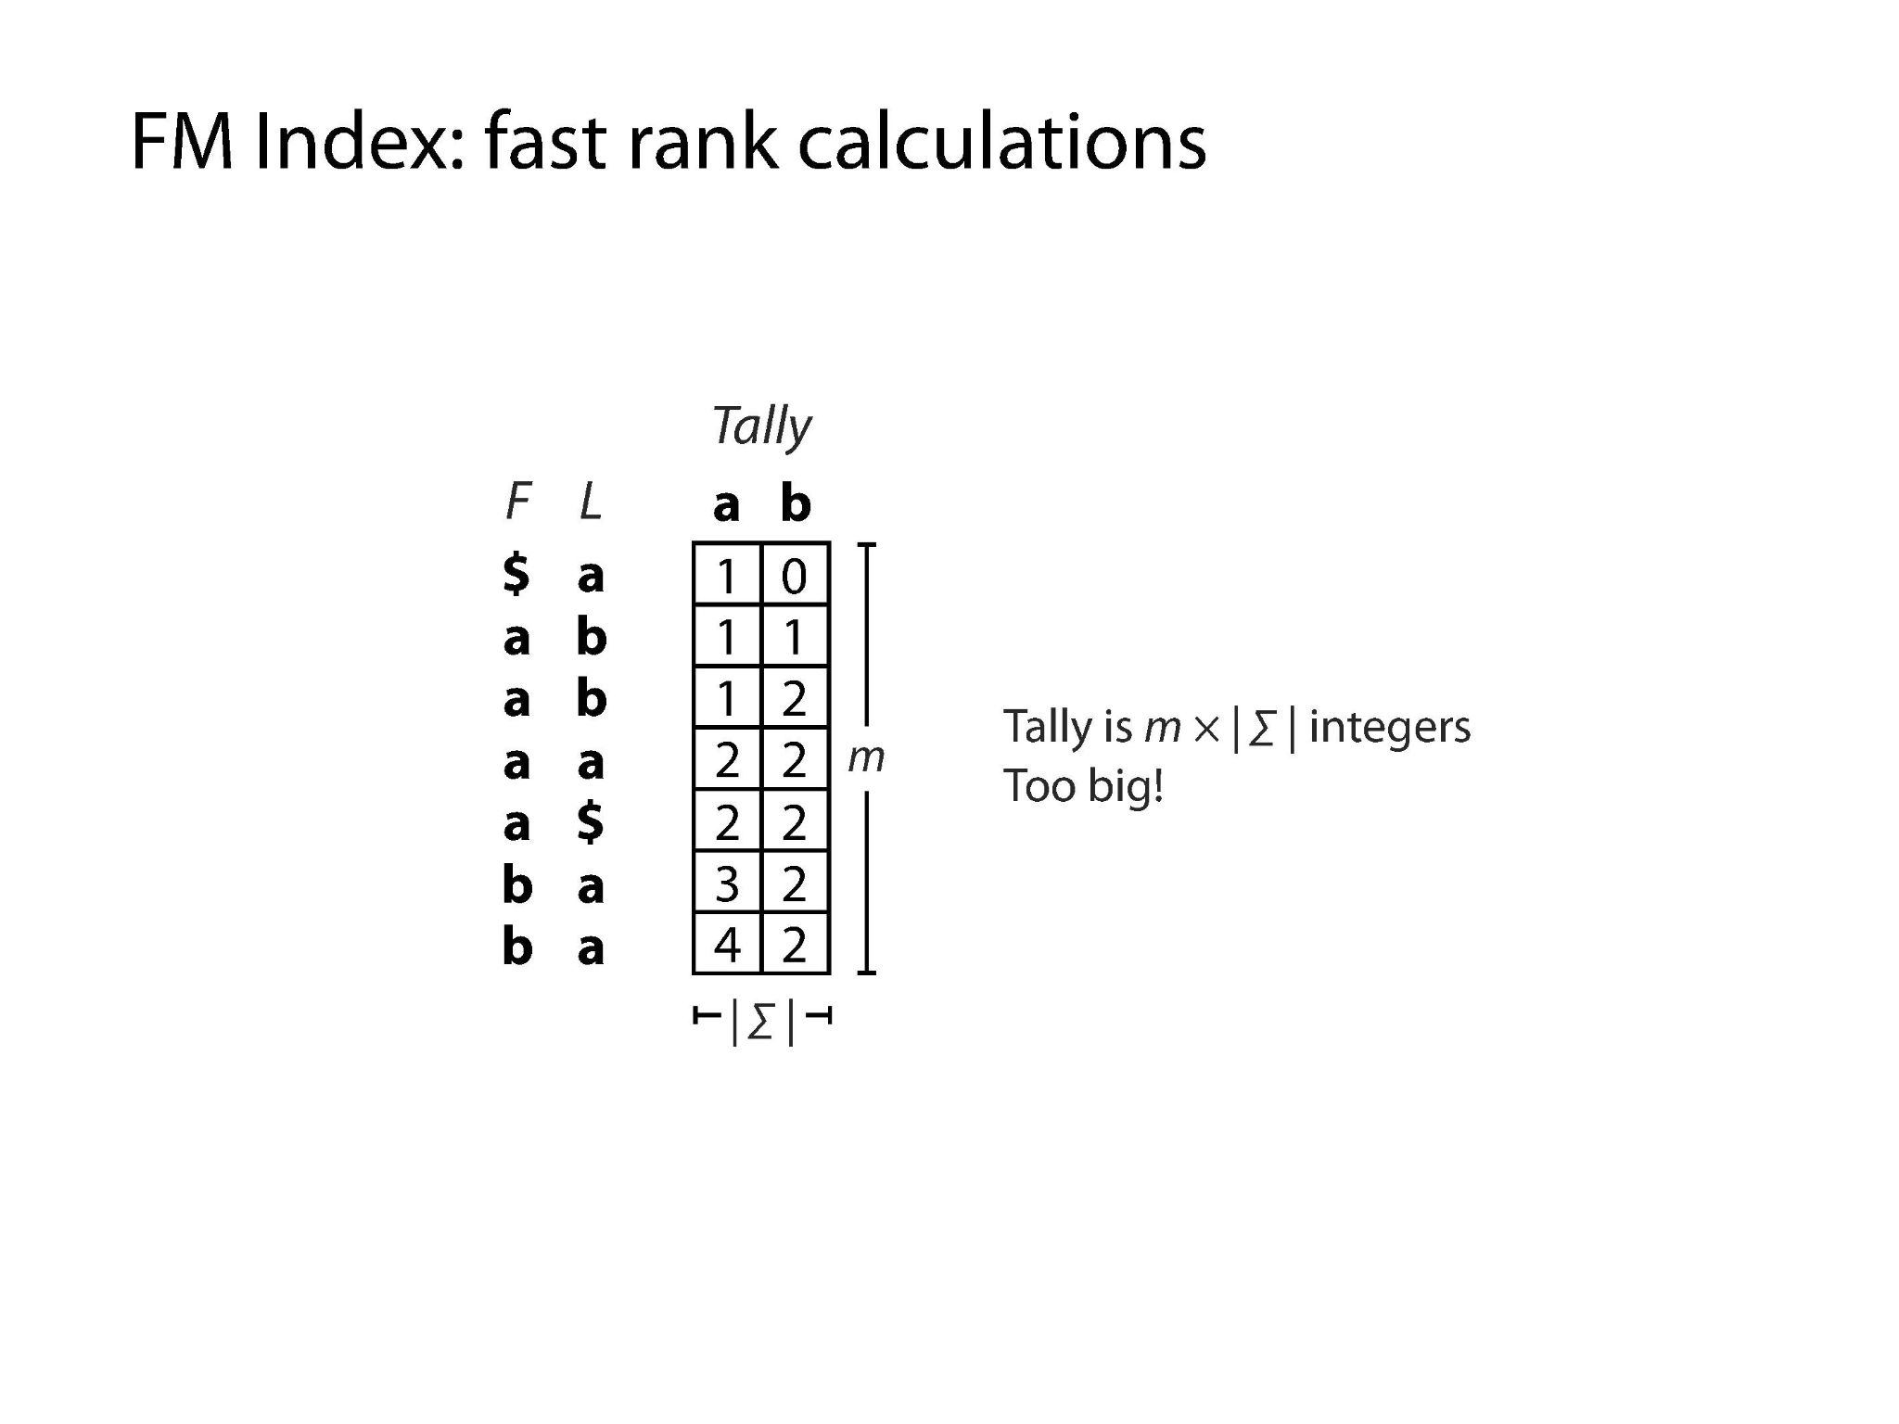
Illustrations Courtesy of Ben Langmead

Slide 40
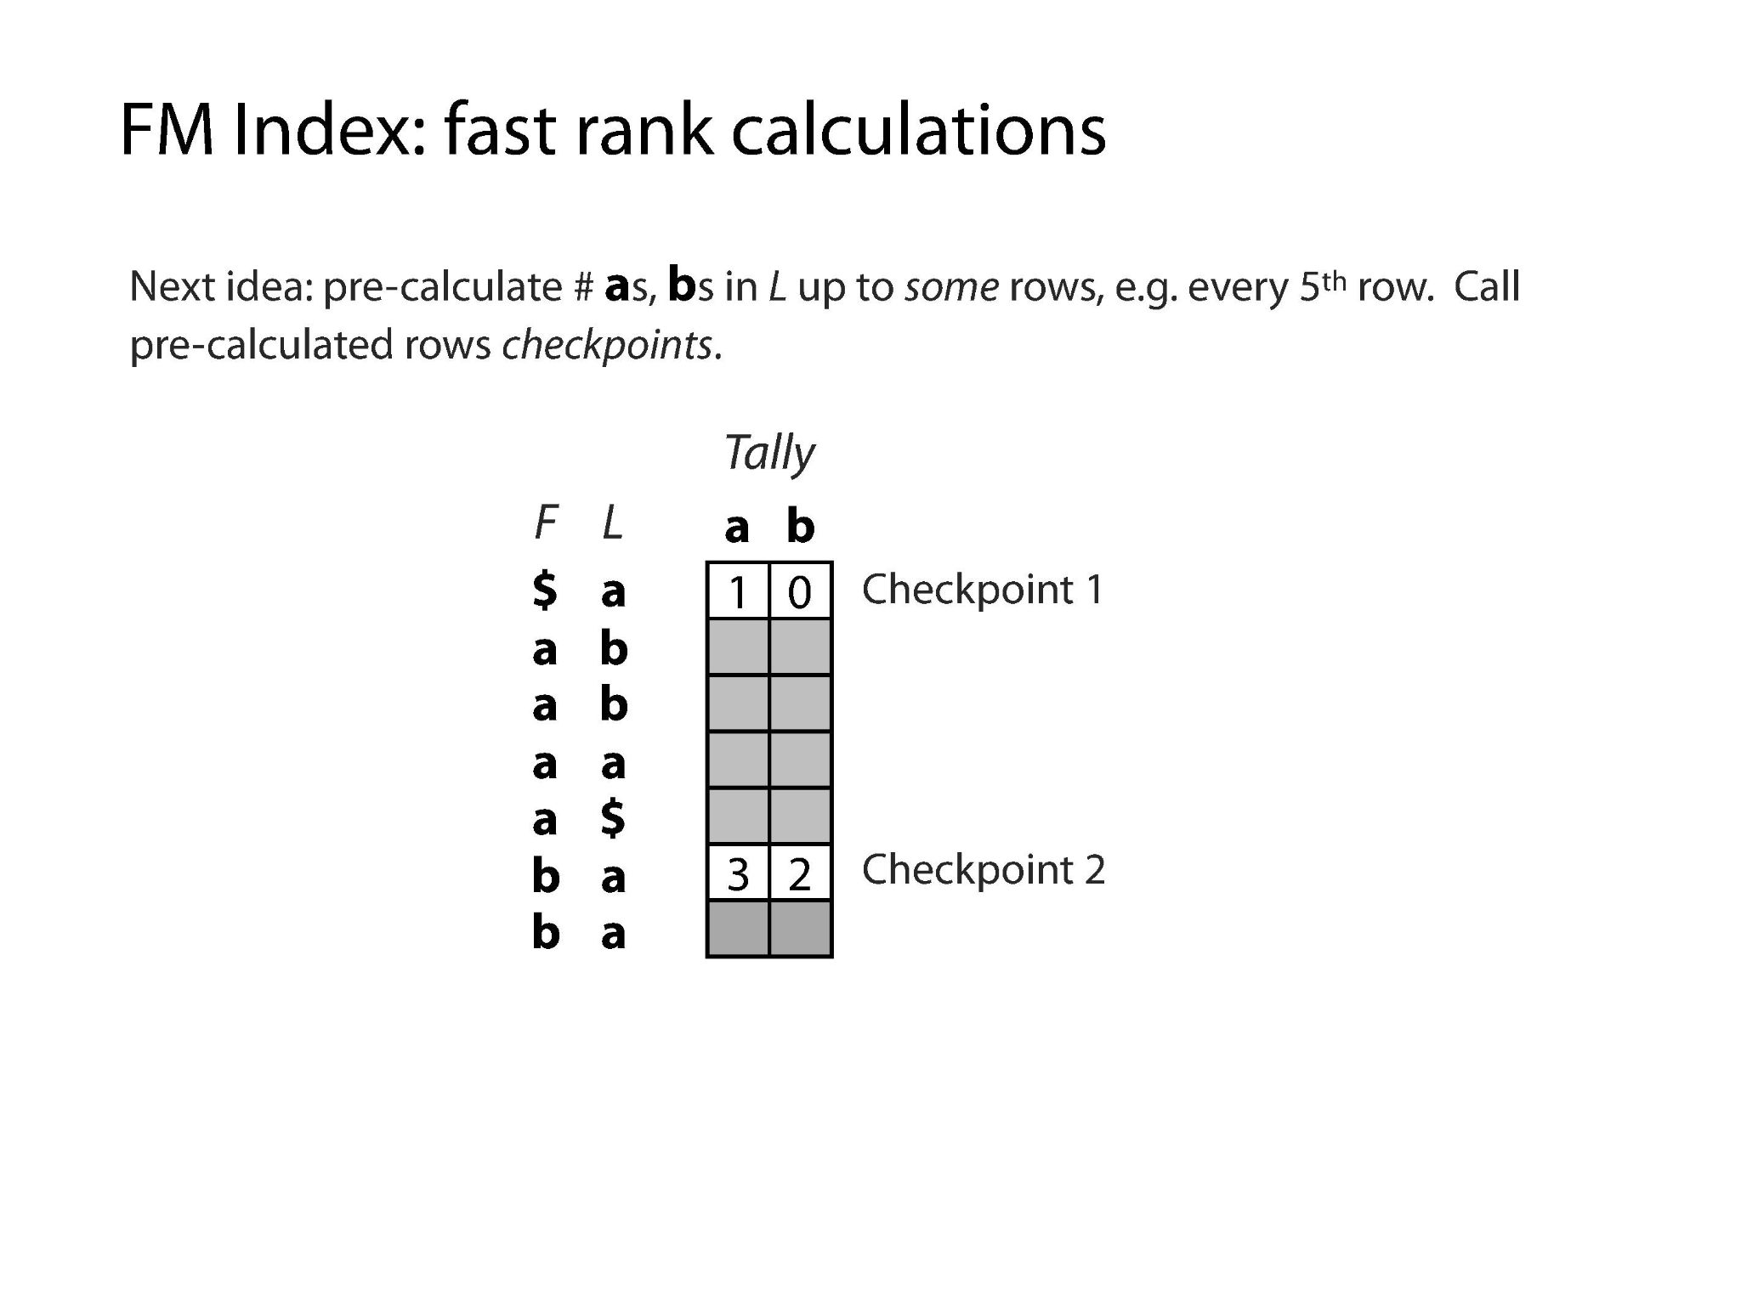
Illustrations Courtesy of Ben Langmead

Slide 41
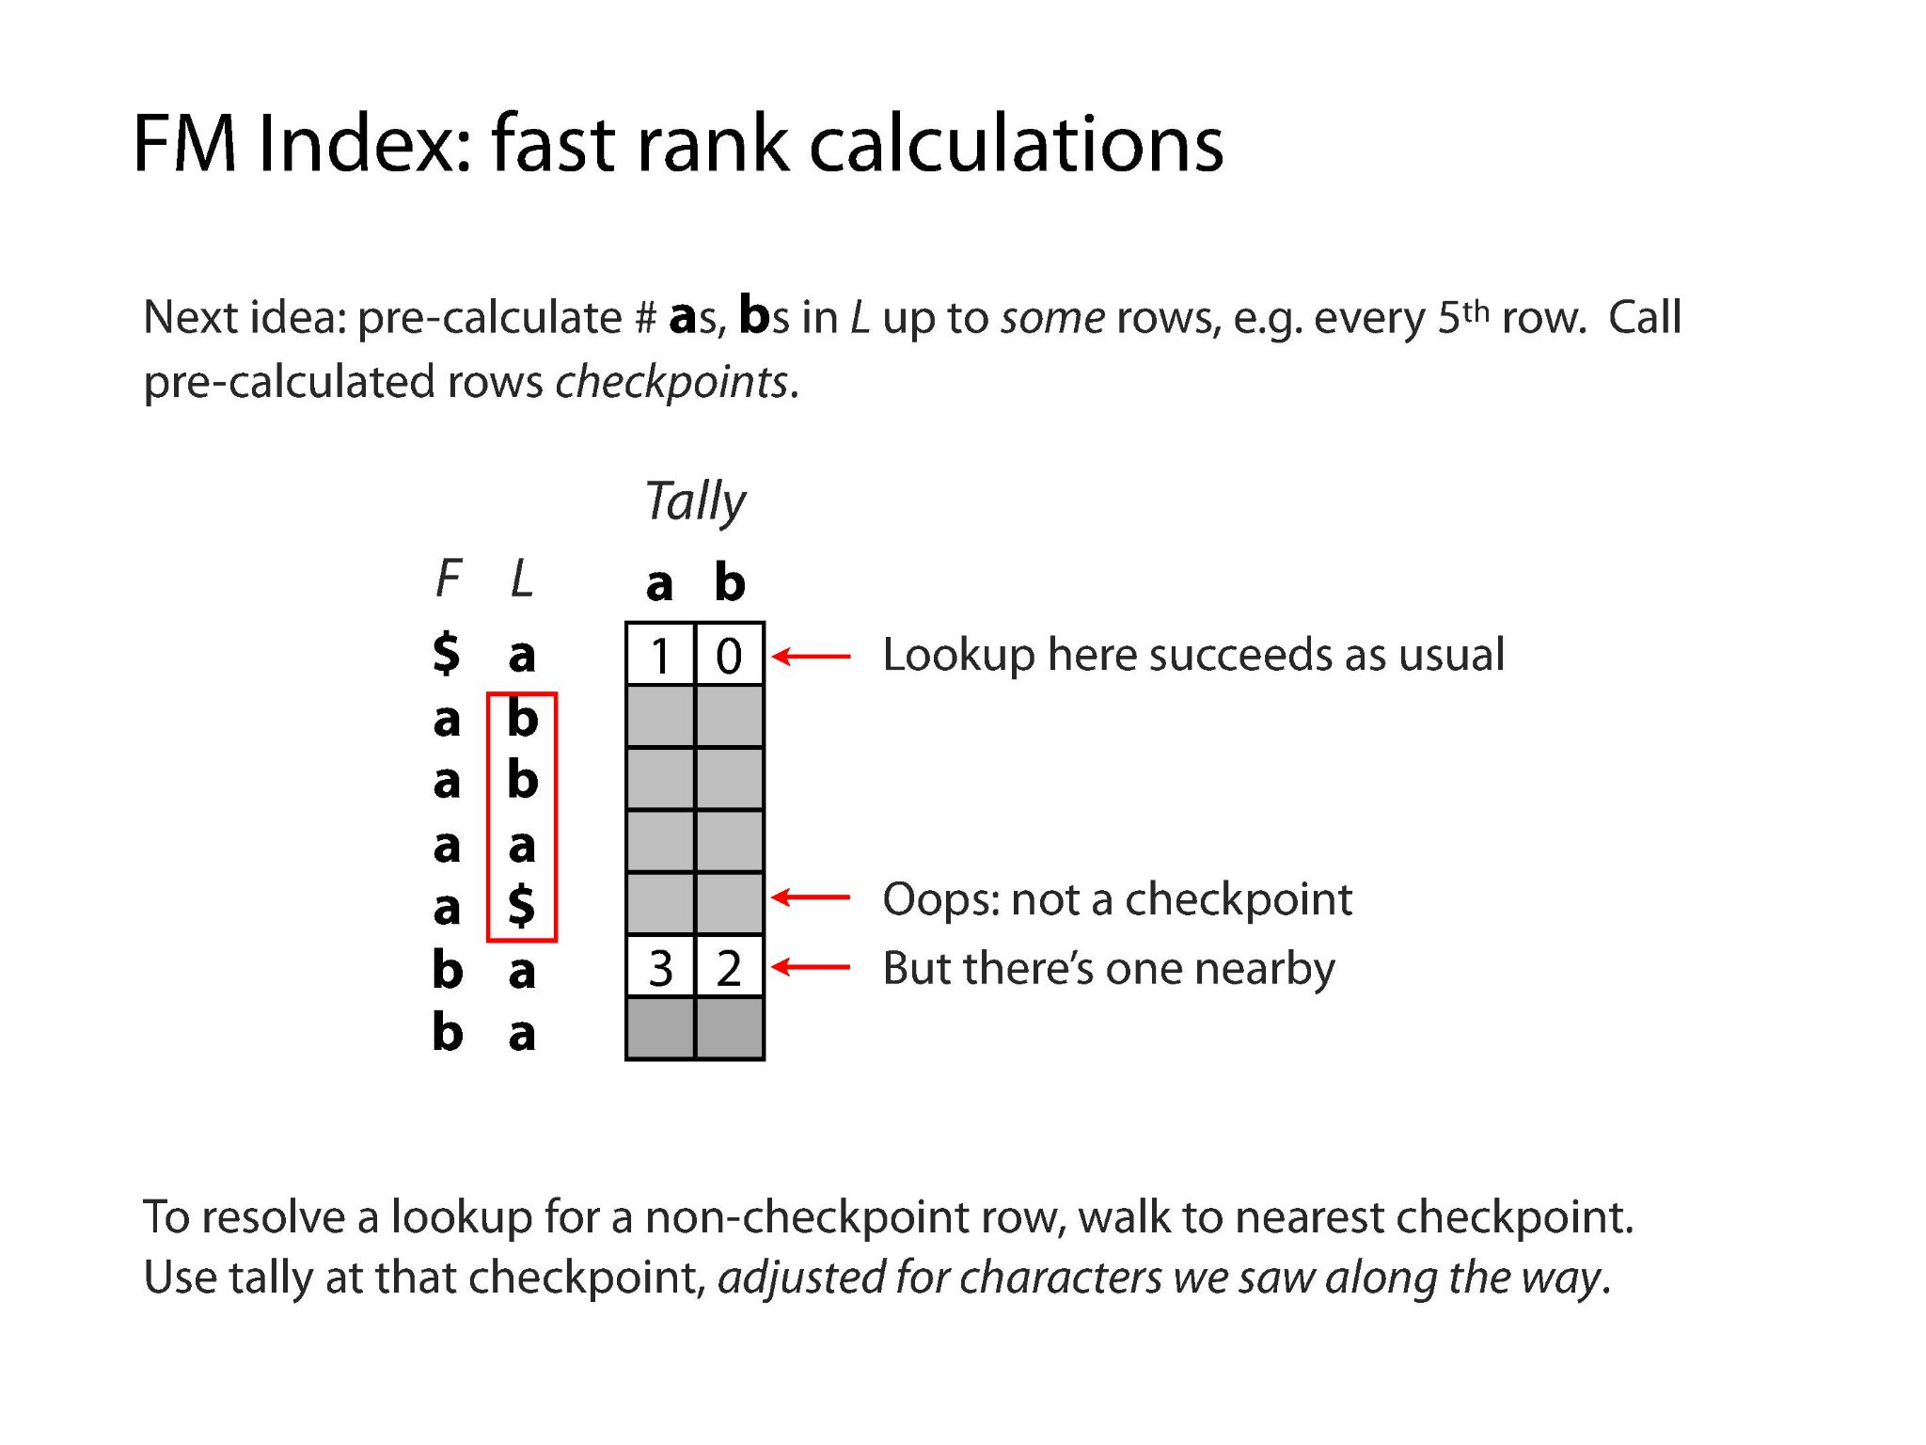

Slide 42
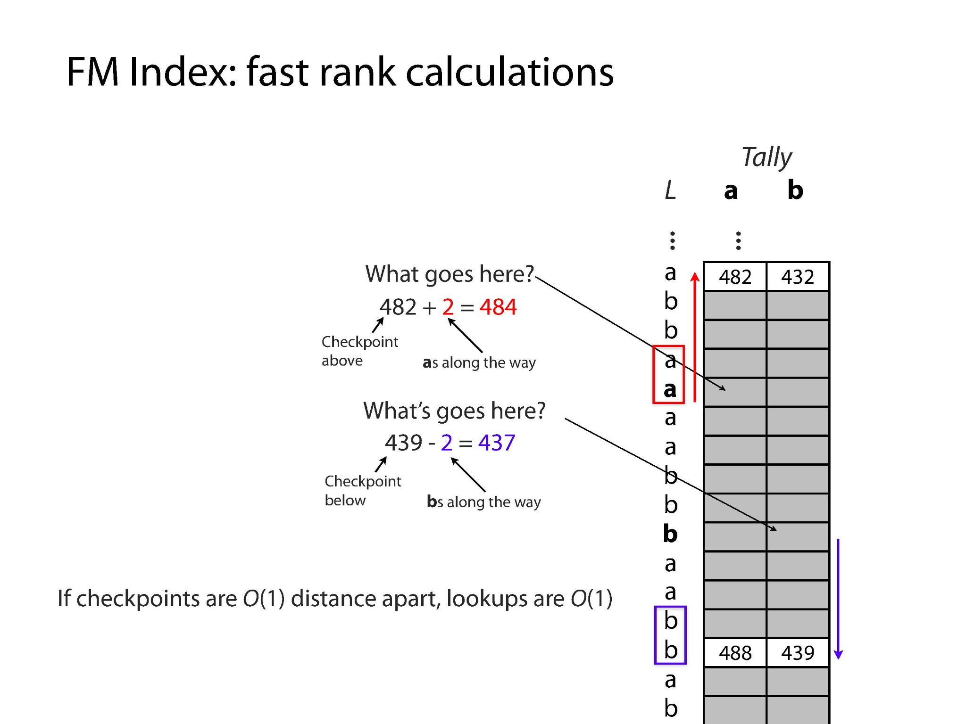

Slide 43
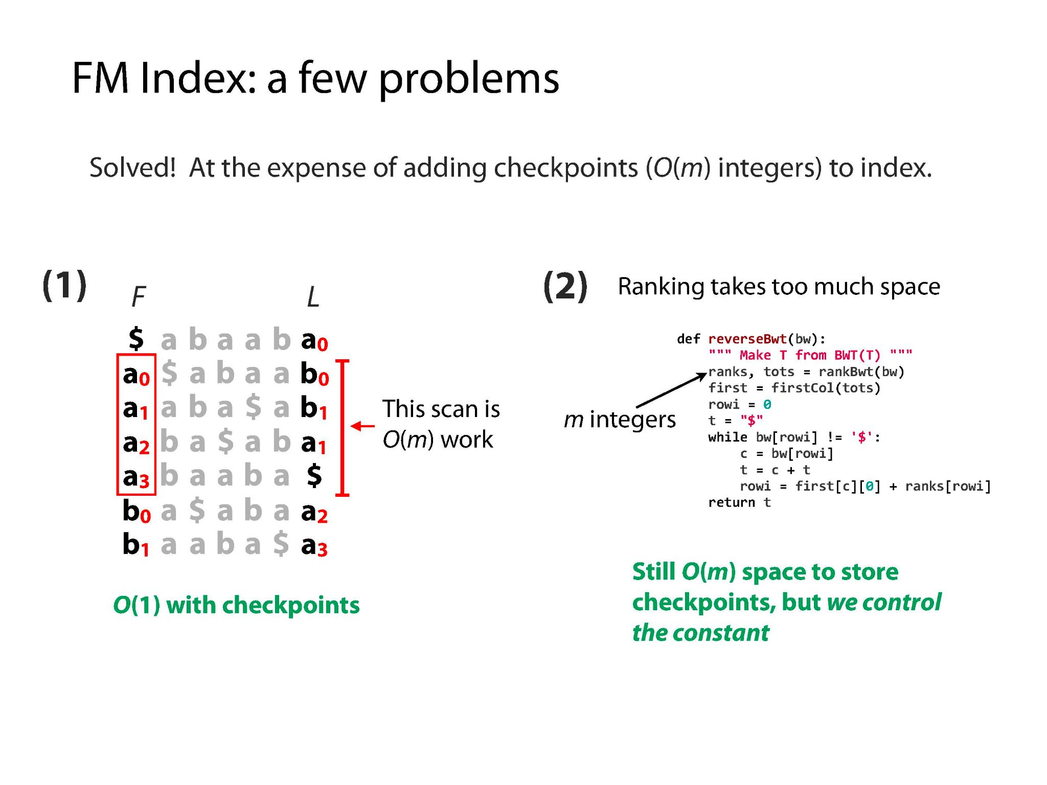

Slide 44

Bowtie (Langmead et al., 2009)
performs global, ungapped short-read alignment to a reference
Mostly for mammalian short reads (<50 bp, upper limit of 1000 bp)
Uses the FM-index
Quality-aware backtracking to allow few mismatches
Excessive backtracking can occur with low-quality reads
Greedy depth-first search

Slide 45
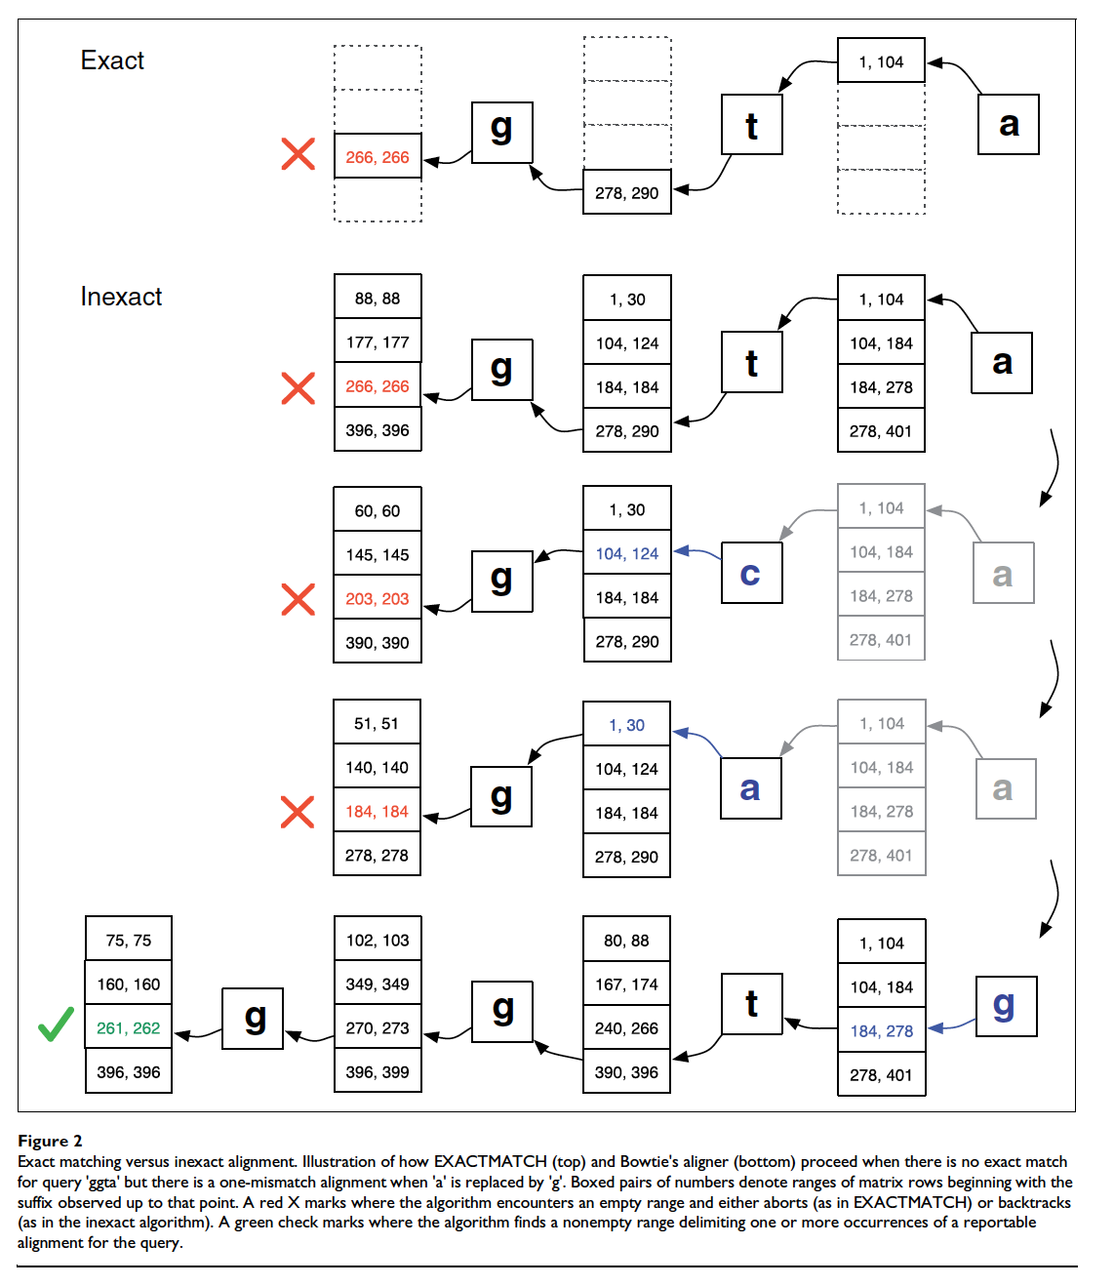
Bowtie
(Langmead et al., 2009)

Slide 46
Bowtie 2 (Langmead & L. Salzberg, 2012)
Aim to increase speed of Bowtie and generalize it
Adapted to medium and longer reads (>50 bp) as well
Gapped alignment
Local and Global (end-to-end)
Support for single and paired-end reads
Switches to single when paired-end fails
Optimized for typical Illumina sequencers
2

Slide 47
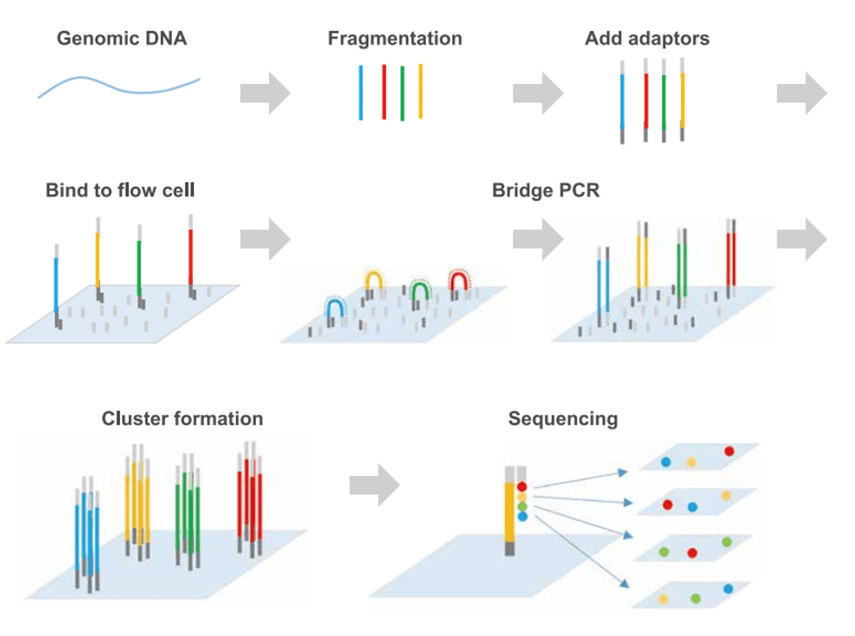
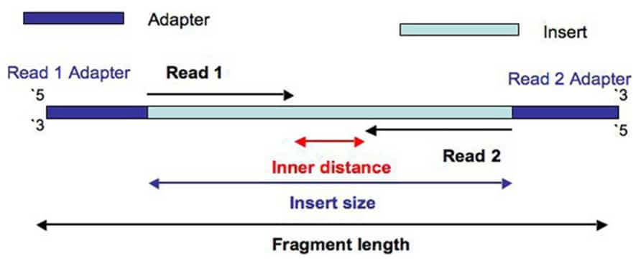
Bowtie 2
e.g.: Illumina and gapped paired-end sequencing

Slide 48
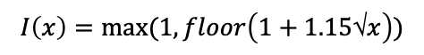
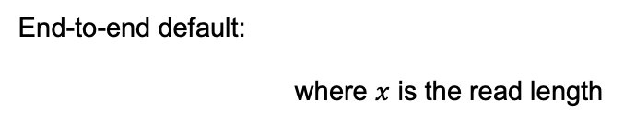
Bowtie 2: Step 1 – Seed Extraction
Attempt to find exact match (or 1 mismatch) for the whole read
If not, read is seeded by extracting multiple substrings of a read
Could be gapped, consecutive, or overlapping
Seed length configured through parameter –L (4-32 nt; 20-25 usually used)
For variable read lengths, seed interval defined through a sublinear function with parameter –i
$$I\left(x\right)=max⁡(1, floor\left(1+1.15\text{√}x\right))$$
End-to-end default:
where $x$ is the read length

Slide 49
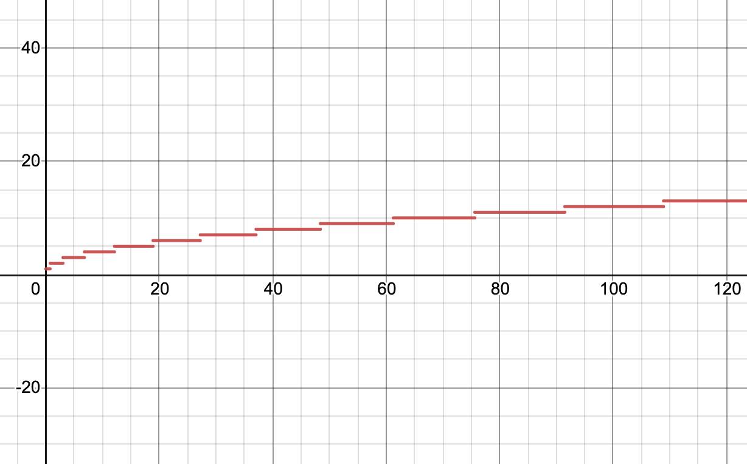
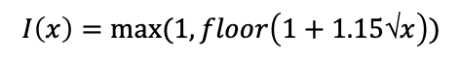
Bowtie 2: Step 1 – Seed Extraction
The longer the read, the more seeds are extracted → increases the chance of finding correct range
$$I\left(x\right)=max⁡(1, floor\left(1+1.15\text{√}x\right))$$

Slide 50
Bowtie 2: Step 2 – Seed Alignment with FM-index
Finds ungapped seed alignment in the same manner as Bowtie 1
Bidirectional BWT for paired-end alignment
Mismatches here can be configured with parameter –N (0 or 1)
Input
Output
→
Seed
0 or more BW (“seed-hit”) ranges
>1 when mismatches allowed or repetitive sequence

Slide 51
Bowtie 2: Step 2 – Seed Alignment with FM-index
Handles repetitive sequences with reseeding
Input
Output
0 or more BW (“seed-hit”) ranges
>1 when mismatches allowed or repetitive sequence
→
Average number of seed hits per seed string
→
Step 3
→
<1000
>1000
→
Reseeding successively
Number of rounds configured with parameter –R
→
Step 2

Slide 52
Bowtie 2: Step 2 – Seed Alignment with FM-index
Reseeding increases the chances that best alignment found with repetitive sequences
ATCATCATCAGATCGCCATC…
{
{
{
{
{
Seed extraction with –L 4
→
ATCATCATCAGATCGCCATC…
{
{
{
{
{
Reseeding with –R 2
{
{
{
{
ATCATCATCAGATCGCCATC…
-----
5 nt shift every round

Slide 53
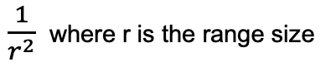
Bowtie 2: Step 3 – Prioritize, Resolve
Rows of seed-hit ranges weighted according to their size to resolve respective offsets
Input
→
0 or more BW (“seed-hit”) ranges
Weight rows according to size of the range
$\frac{1}{r^{2}}$ where r is the range size
→
Walk-left procedure to LF-map ranges through random weighted selection
Output
→
Resolved offsets and information on seed origin

Slide 54
Bowtie 2: Step 4 – Extend
Extends aligned seed offsets to perform Single Instruction Multiple Data (SIMD) parallelized gapped alignment of read on extended offset
Input
→
Extension with flanking sequences of offset from reference
Resolved offsets and seed origin information
→
SIMD vertical striped parallel computing
Output
→
Needleman-Wunsch or Smith-Waterman (optimal but slow; Farrar, 2007) dynamic programming
→
Gapped alignments in SAM/BAM file format
→

Slide 55
Bowtie 2: Step 4 – Extend
Dynamic programming can be troublesome with repetitive sequences
Failure: the attempt’s alignment score is smaller than the current best alignment score
Number of attempts that can fail in a row configured with –D parameter (if last attempt fails, report result and move on to next read)
Can also adjust gap initiation and continuation penalties for reference and reads separately

Slide 56
Parameters:
–L: Seed length (cst) for step 1 (increase → slower but more optimal)
–i: Variable seed interval formula for step 1
–N: Mismatches allowed in step 2 seed alignment
–R: Maximum number of reseeding rounds for step 2 (increase → slower but more optimal)
–D: Maximum number of failed step 4 attempts allowed (increase → slower but more optimal)
Bowtie 2: Overview
(Langmead & L. Salzberg, 2012)
Bowtie 2 algorithm scheme

Slide 57
Bowtie 2: Overview
Additional Parameters:
–k: maximum number of distinct alignments reported
–a: search for and report all alignments
––seed: seed for random picking between equally good alignments
––non-deterministic: use current time to re-initialize seed
––end-to-end: global
––local: allow trimming
––no-lmm-upfront: do not attempt to match whole read first
–p: parallelize alignment with suitable hardware
… Manual → http://bowtie-bio.sourceforge.net/bowtie2/manual.shtml

Slide 58

Reference: GCTAGCTGCAGTACAGT
Bowtie 2: Tracing Example
0
GCTAGCTGCAGTACAGT$
CTAGCTGCAGTACAGT$G
TAGCTGCAGTACAGT$GC
AGCTGCAGTACAGT$GCT
GCTGCAGTACAGT$GCTA
CTGCAGTACAGT$GCTAG
TGCAGTACAGT$GCTAGC
GCAGTACAGT$GCTAGCT
CAGTACAGT$GCTAGCTG
AGTACAGT$GCTAGCTGC
GTACAGT$GCTAGCTGCA
TACAGT$GCTAGCTGCAG
ACAGT$GCTAGCTGCAGT
CAGT$GCTAGCTGCAGTA
AGT$GCTAGCTGCAGTAC
GT$GCTAGCTGCAGTACA
T$GCTAGCTGCAGTACAG
$GCTAGCTGCAGTACAGT
$ GCTAGCTGCAGTACAGT₀
A₀CAGT$GCTAGCTGCAGT₁
A₁GCTGCAGTACAGT$GCT₂
A₂GT$GCTAGCTGCAGTAC₀
A₃GTACAGT$GCTAGCTGC₁
C₀AGT$GCTAGCTGCAGTA₀
C₁AGTACAGT$GCTAGCTG₀
C₂TAGCTGCAGTACAGT$G₁
C₃TGCAGTACAGT$GCTAG₂
G₀CAGTACAGT$GCTAGCT₃
G₁CTAGCTGCAGTACAGT$
G₂CTGCAGTACAGT$GCTA₁
G₃T$GCTAGCTGCAGTACA₂
G₄TACAGT$GCTAGCTGCA₃
T₀$GCTAGCTGCAGTACAG₃
T₁ACAGT$GCTAGCTGCAG₄
T₂AGCTGCAGTACAGT$GC₂
T₃GCAGTACAGT$GCTAGC₃
Tally Table
12
 | A | C | G | T
0 | 0 | 0 | 0 | 1
1
2
3
4 | 0 | 2 | 0 | 3
5
6
7
8 | 1 | 2 | 3 | 3
9
10
11
12 | 3 | 2 | 3 | 4
13
14
15
16 | 4 | 3 | 5 | 4
17
4
8
Suffix Array
→
8
0
4
12
16
16

Slide 59
F L
$ T₀
A₀ T₁
A₁ T₂
A₂ C₀
A₃ C₁
C₀ A₀
C₁ G₀
C₂ G₁
C₃ G₂
G₀ T₃
G₁ $
G₂ A₁
G₃ A₂
G₄ A₃
T₀ G₃
T₁ G₄
T₂ C₂
T₃ C₃
A | C | G | T
1 | 5 | 9 | 14
Bowtie 2: Tracing Example
→
0
1
12
Tally Table
Reference: GCTAGCTGCAGTACAGT
AGCTG_ _ _TAC
Read: AGCTGTAC
2
3
 | A | C | G | T
0 | 0 | 0 | 0 | 1
1
2
3
4 | 0 | 2 | 0 | 3
5
6
7
8 | 1 | 2 | 3 | 3
9
10
11
12 | 3 | 2 | 3 | 4
13
14
15
16 | 4 | 3 | 5 | 4
17
4
5
{
{
6
8
7
Seed extraction with –L 4
8
9
10
0
→
AGCT
11
4
12
LF_{top} | 0 | 14
LF_{bottom} | 18 | 18
13
→
14
16
15
16
17
→
SA
→

Slide 60
F L
$ T₀
A₀ T₁
A₁ T₂
A₂ C₀
A₃ C₁
C₀ A₀
C₁ G₀
C₂ G₁
C₃ G₂
G₀ T₃
G₁ $
G₂ A₁
G₃ A₂
G₄ A₃
T₀ G₃
T₁ G₄
T₂ C₂
T₃ C₃
A | C | G | T
1 | 5 | 9 | 14
Bowtie 2: Tracing Example
0
1
12
Tally Table
2
3
 | A | C | G | T
0 | 0 | 0 | 0 | 1
1
2
3
4 | 0 | 2 | 0 | 3
5
6
7
8 | 1 | 2 | 3 | 3
9
10
11
12 | 3 | 2 | 3 | 4
13
14
15
16 | 4 | 3 | 5 | 4
17
→
AGCT
4
5
LF_{top} | 0 | 14 | 7
LF_{bottom} | 18 | 18 | 9
6
8
→
7
8
→
9
10
0
11
4
12
13
→
14
16
15
16
17
→
SA

Slide 61
F L
$ T₀
A₀ T₁
A₁ T₂
A₂ C₀
A₃ C₁
C₀ A₀
C₁ G₀
C₂ G₁
C₃ G₂
G₀ T₃
G₁ $
G₂ A₁
G₃ A₂
G₄ A₃
T₀ G₃
T₁ G₄
T₂ C₂
T₃ C₃
A | C | G | T
1 | 5 | 9 | 14
Bowtie 2: Tracing Example
0
1
12
Tally Table
2
3
 | A | C | G | T
0 | 0 | 0 | 0 | 1
1
2
3
4 | 0 | 2 | 0 | 3
5
6
7
8 | 1 | 2 | 3 | 3
9
10
11
12 | 3 | 2 | 3 | 4
13
14
15
16 | 4 | 3 | 5 | 4
17
→
AGCT
4
5
LF_{top} | 0 | 14 | 7 | 11
LF_{bottom} | 18 | 18 | 9 | 12
6
8
→
7
8
→
9
10
0
→
11
4
→
12
13
14
16
15
16
17
SA

Slide 62
F L
$ T₀
A₀ T₁
A₁ T₂
A₂ C₀
A₃ C₁
C₀ A₀
C₁ G₀
C₂ G₁
C₃ G₂
G₀ T₃
G₁ $
G₂ A₁
G₃ A₂
G₄ A₃
T₀ G₃
T₁ G₄
T₂ C₂
T₃ C₃
A | C | G | T
1 | 5 | 9 | 14
Bowtie 2: Tracing Example
0
1
12
Tally Table
→
2
→
3
 | A | C | G | T
0 | 0 | 0 | 0 | 1
1
2
3
4 | 0 | 2 | 0 | 3
5
6
7
8 | 1 | 2 | 3 | 3
9
10
11
12 | 3 | 2 | 3 | 4
13
14
15
16 | 4 | 3 | 5 | 4
17
→
AGCT
4
5
LF_{top} | 0 | 14 | 7 | 11 | 2
LF_{bottom} | 18 | 18 | 9 | 12 | 3
6
8
7
8
9
BW range: { [2,3) }
10
0
→
11
4
→
12
13
14
16
15
16
17
SA

Slide 63
F L
$ T₀
A₀ T₁
A₁ T₂
A₂ C₀
A₃ C₁
C₀ A₀
C₁ G₀
C₂ G₁
C₃ G₂
G₀ T₃
G₁ $
G₂ A₁
G₃ A₂
G₄ A₃
T₀ G₃
T₁ G₄
T₂ C₂
T₃ C₃
Bowtie 2: Tracing Example
0
1
12
Seed:
→
2
→
AGCT
→
3
4
5
BW range: { [2,3) }
Offset: 3
6
8
7
8
9
Reference: GCTAGCTGCAGTACAGT
10
0
→
→
→
11
4
12
GCTAGCTGCAGT
13
14
16
15
16
17
SA

Slide 64

Bowtie 2: Tracing Example
→
AGCT
Reference: GCTAGCTGCAGTACAGT
Gap → -2
Match → 3
Mismatch → -3
→
→
→
BW range: { [2,3) }
Offset: 3
GCTAGCTGCAGTACAGT
GCTAGCTGCAGTACAGT
AGCT_ _ _GTAC
AGCTG_ _ _TAC
→
→
→

Slide 65
Bowtie 2:
Practical

Slide 66
Other Methods: SOAP2 (Li et al., 2009)
Short Oligonucleotide Alignment Program 2
Burrows-Wheeler Transform with hashed reference indices
Supports reads up to 1024bp
Single and paired-end
Allows gaps and mismatches
Manual → http://soap.genomics.org.cn/soapaligner.html

Slide 67

Other Methods: BWA (Li et al., 2010)
Burrows-Wheeler Aligner
Uses FM-index for both reference and query
Turns reference into prefix trie, query into prefix Directed Acyclic Word Graph (DAWG)
Dynamic Programming with heuristics: traverse prefix DAWG, prune low scoring matches at each node (high match preferred)
Keep track of seed matches through SA, extend small ranges with SW (speed)
Manual → http://bio-bwa.sourceforge.net/bwa.shtml

Slide 68

Other Methods: STAR (Dobin et al., 2012)
Spliced Transcripts Alignment to a Reference
Designed for RNAseq data
Can handle lengths as long as full transcripts
Suffix Array
Maximal Mappable Prefix (MMP) to find maximal length seeds, repeats for unmapped portions (accounts for splice sites, mismatches, deletions, sequencing errors)
Manual → https://github.com/alexdobin/STAR/blob/master/doc/STARmanual.pdf
Seeds then clustered around user-defined ‘seed anchor’ and stitched (‘anchor seed’ defines maximal intron length; aligns paired-end reads separately)

Slide 69

Other Methods: TopHat2 (Kim et al., 2013)
Designed for RNAseq and transcriptome data
Built on Bowtie
Can make use of splice junction annotation as aid
Superseded by HISAT2
Can handle variable read lengths (suitable for combining datasets)
Manual → https://ccb.jhu.edu/software/tophat/manual.shtml

Slide 70
Other Methods: MUMmer4 (Marçais et al., 2018)
Can be used with Maximal Unique Match (MUM) or Maximal Exact Match (MEM; not suitable for repeats) for seeding similar to MMP
Suffix Array
Clusters seed matches
Extends with parallelized SW alignment
Manual → https://mummer4.github.io/manual/manual.html

Slide 71


Other Methods: HISAT2 (Kim et al., 2018)
Hierarchical Indexing for Spliced Alignment of Transcripts 2
Builds linear graph of reference genome, then adds alternative paths (mutations)
This is turned into a prefix sorted graph
Represented in tabular form for space
Long repeats projected to a single location, later retrieved through FM index
Support for HLA typing and DNA-fingerprinting

Slide 72

Other Methods: HISAT2
Hierarchical Indexing is applied at Global and Local levels to spot repetitive sequences and account for splicing (speed)
Manual → http://daehwankimlab.github.io/hisat2/manual/
(Kim et al., 2018)

Slide 73
Comparative Analysis
(Langmead & Salzberg, 2012; Musich et al., 2021)
Configuration controls performance-resource trade-off
Bowtie 2 local mode slower than end-to-end mode
Suffix Arrays have a faster lookup time because there is no need to derive offset but require more memory as compared to BWT
HISAT2, TopHat2, STAR designed for transcriptomes
MUMmer4 output needs to be preprocessed before downstream analysis
What about time, space, performance, read length, and parallelization?

Slide 74

Comparative Analysis: Time
(Langmead & Salzberg, 2012)

Slide 75

Comparative Analysis: Time
(Musich et al., 2021)

Slide 76

Comparative Analysis: Performance
BWA switched to local in paired-end when one of the ends fails map
Bowtie 2 trimmed less reads than BWA in long read lengths (c).
(Langmead & Salzberg, 2012)

Slide 77

Comparative Analysis: Performance
(Musich et al., 2021)

Slide 78

Comparative Analysis: Performance & Time
(Musich et al., 2021)

Slide 79
Comparative Analysis: Space
BWA: generally lowest (2.39-3.66 GB)
Bowtie 2: generally moderate (3.24-3.39 GB)
SOAP2: generally highest (5.34 GB)
(Langmead & Salzberg, 2012)

Slide 80

Comparative Analysis: Read length
(Musich et al., 2021)

Slide 81
Comparative Analysis: Parallelization
Bowtie 2 local, BWA, HISAT2, and MUMmer4: linear or almost linear speedup
Bowtie 2 E2E: slightly super-linear speedup
STAR and TopHat2: logarithmic speedup
(Musich et al., 2021)

Slide 82




Latest Methods: HISAT2
HISAT2 parallelization (Guo et al., 2022)

Slide 83

Latest Methods: Accel-Align
Accel-Align (Yan et al., 2021)
Uses hashing instead of FM-indexing
9x faster than Bowtie 2 in single-end
11x faster than Bowtie 2 in paired-end
Prospects: parallelize seeding stage rather than DP which has heavy data dependencies and generalize to local and error-prone alignment

Slide 84
References _{1/3}
Burrows, M., & Wheeler, D. (1994). A block-sorting lossless data compression algorithm. In Digital SRC Research Report.
Dobin, A., Davis, C. A., Schlesinger, F., Drenkow, J., Zaleski, C., Jha, S., ... & Gingeras, T. R. (2013). STAR: ultrafast universal RNA-seq aligner. Bioinformatics, 29(1), 15-21.
Farrar, M. (2007). Striped Smith–Waterman speeds database searches six times over other SIMD implementations. Bioinformatics, 23(2), 156-161.
Guo, J., Gao, J., & Liu, Z. (2022). HISAT2 Parallelization Method Based on Spark Cluster. In Journal of Physics: Conference Series (Vol. 2179, No. 1, p. 012038). IOP Publishing.
Kim, D., Paggi, J. M., Park, C., Bennett, C., & Salzberg, S. L. (2019). Graph-based genome alignment and genotyping with HISAT2 and HISAT-genotype. Nature biotechnology, 37(8), 907-915.

Slide 85
References _{2/3}
Kim, D., Pertea, G., Trapnell, C., Pimentel, H., Kelley, R., & Salzberg, S. L. (2013). TopHat2: accurate alignment of transcriptomes in the presence of insertions, deletions and gene fusions. Genome biology, 14(4), 1-13.
Langmead, B., & Salzberg, S. L. (2012). Fast gapped-read alignment with Bowtie 2. Nature methods, 9(4), 357-359. ( [https://github.com/BenLangmead/bowtie2](https://github.com/BenLangmead/bowtie2) )
Langmead, B., Trapnell, C., Pop, M., & Salzberg, S. L. (2009). Ultrafast and memory-efficient alignment of short DNA sequences to the human genome. Genome biology, 10(3), 1-10.
Li, H., & Durbin, R. (2010). Fast and accurate long-read alignment with Burrows–Wheeler transform. Bioinformatics, 26(5), 589-595.
Li, R., Yu, C., Li, Y., Lam, T. W., Yiu, S. M., Kristiansen, K., & Wang, J. (2009). SOAP2: an improved ultrafast tool for short read alignment. Bioinformatics, 25(15), 1966-1967.

Slide 86
References _{3/3}
Marçais, G., Delcher, A. L., Phillippy, A. M., Coston, R., Salzberg, S. L., & Zimin, A. (2018). MUMmer4: A fast and versatile genome alignment system. PLoS computational biology, 14(1), e1005944.
Musich, Ryan, Lance Cadle-Davidson, and Michael V. Osier. "Comparison of short-read sequence aligners indicates strengths and weaknesses for biologists to consider." Frontiers in Plant Science 12 (2021).
Yan, Y., Chaturvedi, N., & Appuswamy, R. (2021). Accel-align: a fast sequence mapper and aligner based on the seed–embed–extend method. BMC bioinformatics, 22(1), 1-20.

